Slide 1
On the Utility of WordNet for Ontology Alignment: Is it Really Worth It?
Uthayasanker Thayasivam and Prashant Doshi
THINC Lab
Thinc.cs.uga.edu
Department of Computer Science
University of Georgia

Slide 2
Outline
Introduction
Background
Integrating WordNet
Experiments
Methodology
Results and Analysis
Conclusions

Slide 3
Introduction: Ontology alignment
Reference
Entry
Book
Has
Chapter
sections
Novel
Chapter
Chapter
Collection
HarryPotterVersion1
Harry_Potter_1
Notes:
What Why and How
What:
The process of determining correspondences between concepts
Classes
Properties
Instances
Why:
To promote interoperability on the semantic Web
How:
By measuring similarity between two concepts using their structural and lexical data
Use of large lexical databases such as WordNet

Slide 4
Introduction: Ontology alignment
Reference
Entry
Book
Has
Chapter
sections
Novel
Chapter
Chapter
Collection
HarryPotterVersion1
Harry_Potter_1
Determining correspondences between
Classes
Notes:
What Why and How
What:
The process of determining correspondences between concepts
Classes
Properties
Instances
Why:
To promote interoperability on the semantic Web
How:
By measuring similarity between two concepts using their structural and lexical data
Use of large lexical databases such as WordNet

Slide 5
Introduction: Ontology alignment
Reference
Entry
Book
Has
Chapter
sections
Novel
Chapter
Chapter
Collection
HarryPotterVersion1
Harry_Potter_1
Determining correspondences between
Classes, Properties
Notes:
What Why and How
What:
The process of determining correspondences between concepts
Classes
Properties
Instances
Why:
To promote interoperability on the semantic Web
How:
By measuring similarity between two concepts using their structural and lexical data
Use of large lexical databases such as WordNet

Slide 6
Introduction: Ontology alignment
Reference
Entry
Book
Has
Chapter
sections
Novel
Chapter
Chapter
Collection
HarryPotterVersion1
Harry_Potter_1
Determining correspondences between
Classes, Properties, and Instances
Notes:
What Why and How
What:
The process of determining correspondences between concepts
Classes
Properties
Instances
Why:
To promote interoperability on the semantic Web
How:
By measuring similarity between two concepts using their structural and lexical data
Use of large lexical databases such as WordNet

Slide 7
WordNet and Ontology Alignment
Exploiting lexical data
lexical databases like WordNet
Common belief
Use of WordNet in ontology alignment always improves the recall of the alignment
Improvement in the recall supersedes
Loss in precision
Additional execution time
We conducted a study to analyze the tradeoffs involved in using WordNet for ontology alignment.
Notes:
While alignment is often viewed as an offline and onetime task, continuously evolving ontologies and applications involving real-time ontology alignment such as semantic search and Web service composition stress the importance of computational complexity considerations - T. Hughes and B. Ashpole, “The semantics of ontology alignment,

Slide 8
Outcomes of the Study
The utility of WN in aligning ontologies
Not always clear
Not always advisable.
A set of “rules of thumb”
To decide whether WN would be worthwhile for a given ontology pair
It is advisable for ontology alignment tools to allow the user to switch the use of lexical database

Slide 9
The Study Setup
Compare: Precision, Recall and Execution-Time
Dataset (real-world ontologies): OAEI 2009
Benchmark 300
Conference
Alignment tool: Optima (Doshi & Thomas: 07) - an iterative expectation-maximization algorithm.
Competitive performance
Open-source
Ability to switch off WordNet
23 ontologies

Slide 10
Optima
Models ontologies as a directed graph
Models alignment as a maximum likelihood problem
Solves it using Generalized Expected Maximization
Iterative alignment algorithm
Inexact Matching
Process of finding a best possible match

Slide 11
Integrating WordNet: Similarity Measures
Syntactic string based similarity
Entirely based on the string similarity between the concepts’ names, labels and other associated text
E.g.: Smith-Waterman
Semantic similarity
Attempts to utilize the meaning behind the concept names to ascertain the similarity of the concepts
E.g.: Lin, Gloss base Cosine*
*Yatskevich and Giunchiglia(07)
Notes:
Yatskevich and Giunchiglia [7] demonstrate that gloss-based similarity measuring algorithms (matchers) showed the best matching performance

Slide 12
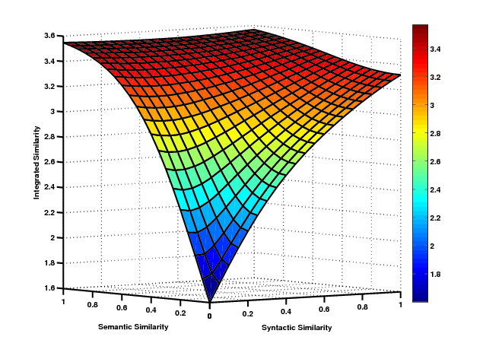
Integrating WordNet: Integrated Similarity
Integrated Similarity: 3D sigmoid restricted to the quadrant where the semantic (Lin + Gloss based cosine) and syntactic similarities (Smith-Waterman) ranges from 0-1.

Slide 13
Experiments: Methodology
Measured the maximum recall and F-measure that Optima attains on a pair of ontologies given varying execution time
With integrated similarity measure (WordNet)
With just syntactic similarity measure
Ran each execution until there was no improvement in the performance
Recorded the recall and F-measure every time it changed along with the time consumed till then

Slide 14
Experiment: Results
 | Max. recall improved with WordNet | Max. recall remained same with WordNet | Max. recall reduced with WordNet
Max. F-measure improved with WordNet | 7 | 0 | 0 | 7
Max. F-measure remained same with WordNet | 0 | 6 | 0 | 6
Max. F-measure reduced with WordNet | 0 | 9 | 1 | 10
 | 7 | 15 | 1 | 23
Dataset: 23 real-world ontology pairs from OAEI 2009
Notes:
Explain titles
The cells: total number of pairs per trend

Slide 15
Experiment: Results
For many of the ontology pairs, the final recall with WN integrated is higher than the recall with just the syntactic similarity
E.g.: (101, 205) with WordNet matches
(Unpublished , Manuscript)
Paired Student’s t-test over the entire dataset
Difference in execution time is statistically significant
p-value of 0.057
Improvement in F-measure due to WN reduces to the extent where it loses significance
p-value=0.184.

Slide 16
Experiment: Results

Slide 17
Experiment: Results

Slide 18
Experiment: Results

Slide 19
Experiment: Results

Slide 20
Experiment: Results

Slide 21
Experiment: Results

Slide 22
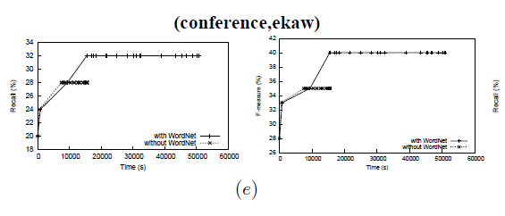
Experiment: Results
Max. recall & precision improved with WordNet
Notes:
Each data point is the maximum recall or F-measure, as appropriate, that could be obtained given the execution time.

Slide 23
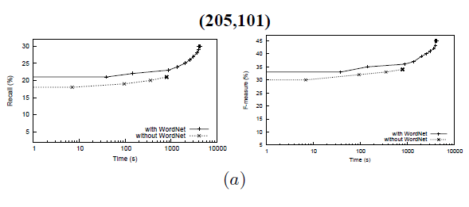
Experiment: Observations Max. recall & precision improved with WordNet
Sometimes the improvement is obtained after spending significantly more time
In some cases approximately an order of magnitude more time (a)
Notes:
Challenge: Tokenizing
1The concept Meta-Review should be tokenized into two words (Meta,
Review) while Registration Non–Member needs to be tokenized into two
words (Registration, NonMember) but should not be tokenized into three
words (Registration, Non, Member). The hyphen (–) is a delimiter in
the former concept but should be just ignored in the later concept. This
tokenization is demanded by WN matchers since MetaReview does not
exist in WN but the word NonMember exists in WN

Slide 24
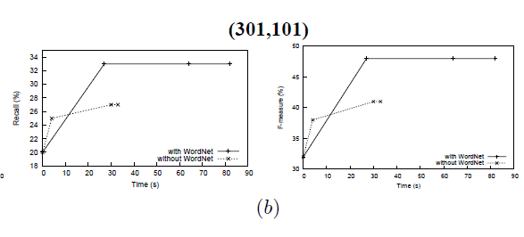
Experiment: Observations Max. recall & precision improved with WordNet
In two of these (b, e)
Aligning without WN results in better recall for an initial short time span
WordNet initialization
Notes:
Challenge: Tokenizing
1The concept Meta-Review should be tokenized into two words (Meta,
Review) while Registration Non–Member needs to be tokenized into two
words (Registration, NonMember) but should not be tokenized into three
words (Registration, Non, Member). The hyphen (–) is a delimiter in
the former concept but should be just ignored in the later concept. This
tokenization is demanded by WN matchers since MetaReview does not
exist in WN but the word NonMember exists in WN

Slide 25
Experiment: Observations Max. recall & precision improved with WordNet
Aligning without WordNet
➔ Better recall for an initial short time span
WordNet initialization

Slide 26
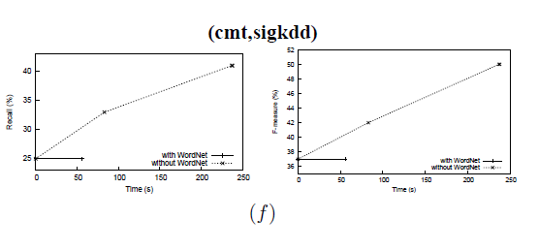
Experiment: Results
Max. recall & precision did not improve with WordNet
Notes:
Each data point is the maximum recall or F-measure, as appropriate, that could be obtained given the execution time.

Slide 27
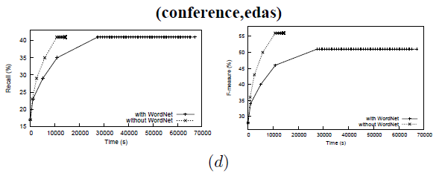
Experiment: Observations Max. recall & precision did not improve with WordNet
Predominantly, improvement in F-measure due to WN was smaller in comparison to the improvement in recall
Notes:
The final recall in (d) does not change when WN is utilized, the final F-measure drops to below what we could get when just the syntactic similarity is used

Slide 28
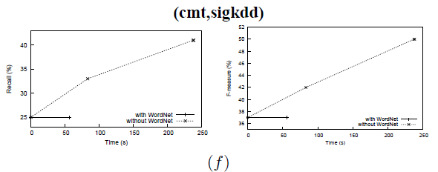
Experiment: Observations Max. recall & precision did not improve with WordNet
Conference ontology pair (f) results in worse recall with WN integrated.
several concepts with compound words or phrases as labels
E.g: Meta-Review, Registration Non-Member
Notes:
Challenge: Tokenizing
1The concept Meta-Review should be tokenized into two words (Meta,
Review) while Registration Non–Member needs to be tokenized into two
words (Registration, NonMember) but should not be tokenized into three
words (Registration, Non, Member). The hyphen (–) is a delimiter in
the former concept but should be just ignored in the later concept. This
tokenization is demanded by WN matchers since MetaReview does not
exist in WN but the word NonMember exists in WN

Slide 29
Summary of Observations
Three Trends
Final recall and F-measure due to WordNet improve considerably
Slightly lower values of recall and F-measure were achieved without the use of WordNet in much less time
Alignment with WordNet exhibit similar or better recall
Poorer F-measure due to reduced precision
Integrating WordNet degraded the alignment both recall and precision
this was rare
15 of the 23 pairs did not exhibit an increase in recall due to the additional use of WordNet
9 of these showed a decrease in overall F-measure
Integrating a lexical database such as WordNet may not always be worthwhile
Especially if the execution time is a concern as well

Slide 30
Discussion: Rules of Thumb
Ontologies that have a deep hierarchy (“tall” ontology) may consume an excessive amount of time when aligned using WordNet
Such ontologies tend to have several specialized classes
Identifying the least common subsumer in WordNet required by algorithms such as Lin requires traversing a large portion of the WN hierarchy
Aligning a “tall” ontology against a “short” ontology (shallow hierarchy),
WordNet will likely suggest several matches between the specific concepts of the tall ontology and more general concepts of the short ontology
Reduced precision

Slide 31
Discussions - The rules of thumb
Compound words or phrases appearing as entity labels in an ontology need to be appropriately tokenized and a single representative word or WordNet-based similarity measure must be obtained

Slide 32
Conclusion
WordNet in addition to syntactic string-based similarity measures does improve the quality of the alignment in many cases
BUT….
After consuming significantly more time
After trading off precision
➔ Much less improvement in F-measure

Slide 33
Conclusion
WordNet in addition to syntactic string-based similarity measures does improve the quality of the alignment in many cases
BUT….
After consuming significantly more time
After trading off precision
Much less improvement in F-measure

Slide 34
Conclusion
WordNet in addition to syntactic string-based similarity measures does improve the quality of the alignment in many cases
BUT….
After consuming significantly more time
After trading off precision
Much less improvement in F-measure
Online, Real-time Ontology Alignment is demanded by applications such as
Semantic web service composition
Semantic web search

Slide 35
Thank you

Slide 36
?s
Thank you

Slide 37
Appendix: Supportive Slides

Slide 38
Experiment: Results
3 Trends
Dataset: 23 real-world ontology pairs from OAEI 2009

