Slide 1
Predicting Missing Provenance Using Semantic Associations in Reservoir Engineering
Jing Zhao
University of Southern California
zhaoj@usc.edu
Sep 19th, 2011

Slide 2
Outline
Background and Introduction
Our Approach
  Annotation
  Association Detection
  Confidence Assignment
  Prediction
Evaluation
Conclusion and Future Work

Slide 3
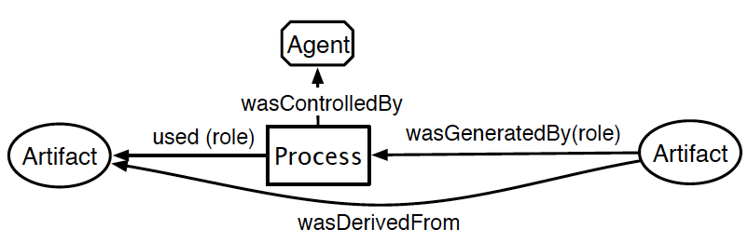
Provenance Information
The provenance of a piece of data is the process that led to that piece of data [1]
Usage of provenance
  Data quality assessment
  Data auditing
  Repetition of data derivation
[1] Moreau, L. (2010) The Foundations for Provenance on the Web. Foundations and Trends in Web Science, 2 (2--3). pp. 99-241. ISSN 1555-077X

Slide 4
Incomplete Provenance in Reservoir Engineering
Complicated domain dataset
  E.g., reservoir models
  Large amount of data items integrated from multiple data sources
  Provenance information for data auditing and data quality control
Incomplete provenance
  Legacy tools not supporting provenance functionalities
  Manual provenance annotation
  Integrating operations
    Copy/Paste across reservoir models
Predict missing provenance
  Immediate parent process

Slide 5
Our Observations
Data items may share the same provenance
Special semantic “connections” exist between data items with identical provenance

Slide 6
Semantic Associations
Sequences of relationships connecting two entities in the ontology graph [2][3]
Express special semantic connections explicitly
Reveal hidden data generation patterns
[2] B. Aleman-Meza, C. Halaschek, I. B. Arpinar, and A. Sheth, “Contextaware semantic association ranking,” in SWDB, 2003.
[3] K. Anyanwu and A. Sheth, “p-queries: Enabling querying for semantic
associations on the semantic web,” in WWW, 2003.

Slide 7
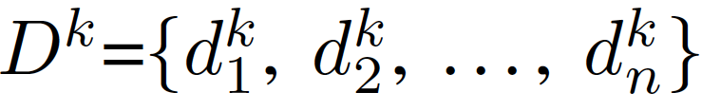

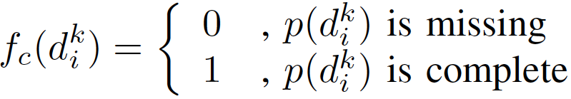
Problem Definition
Date set
  Reservoir model
Provenance of a data item:
Provenance indicator function

Slide 8
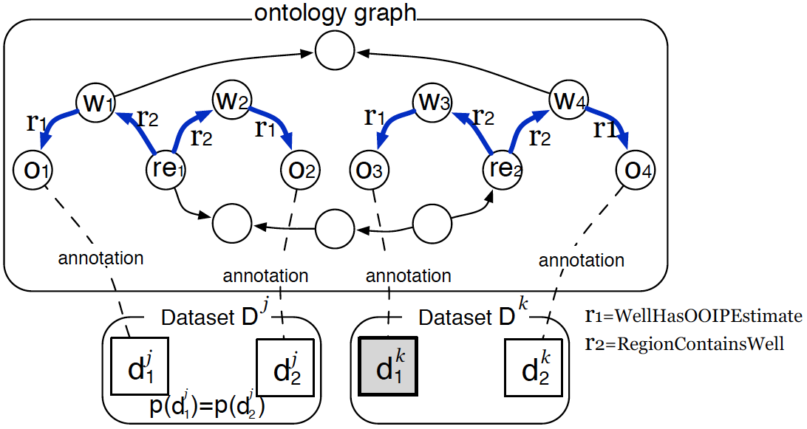
Use Semantic Associations for Prediction

Slide 9
Outline
Background and Motivation
Our Approach
  Annotation
  Association Detection
  Confidence Assignment
  Prediction
Evaluation
Conclusion and Future Work

Slide 10
Bootstrapping

Slide 11
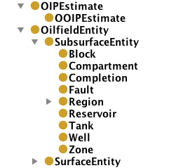

Annotation
Domain ontology
  Domain classes
    Reservoir, Well, Region
  Relationships
    ReservoirContainsWell
  Domain entities
    Instances of domain classes
Annotation function

Slide 12
Association Detection
Historical datasets
  with complete provenance
1. Identify data items with identical provenance
2. Identify their annotation domain entities
3. Compute semantic associations in the ontology graph

Slide 13

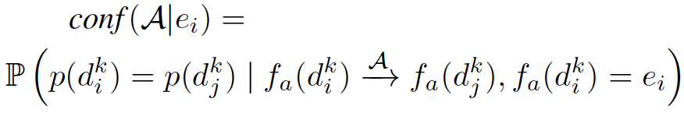
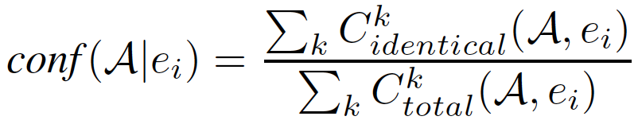
Confidence of Association
Probability that two data items have identical provenance, if their annotation domain entities are associated by association A.
Conditional confidence
Calculation

Slide 14
Prediction

Slide 15
Outline
Background and Motivation
Our Approach
  Annotation
  Association Detection
  Confidence Assignment
  Prediction
Evaluation
Conclusion and Future Work

Slide 16
Experiment Setup
Use cases
  Two types of reservoir models
  Type 1: ~1000 data items in one dataset
  Type 2: ~500 data items
Historical datasets
  ~2000 datasets
  Duplicate real dataset samples
  Use the pattern learnt from real dataset samples
Test set
  10% of historical datasets
  Randomly drop provenance

Slide 17
Baseline Approaches
Baseline 1
  For a data item annotated by an entity e, select the generation process which were most frequently used to create data items annotated by e in the historical datasets
Baseline 2
  Instead of using semantic associations, only consider provenance similarity between domain entity pairs

Slide 18
Results of Use Case 1: 500 historical datasets
(a) 500 historical datasets

Slide 19
Results of Use Case 1: 1000 historical datasets
(b) 1000 historical datasets

Slide 20
Results of Use Case 1: 2000 historical datasets
(c) 2000 historical datasets

Slide 21
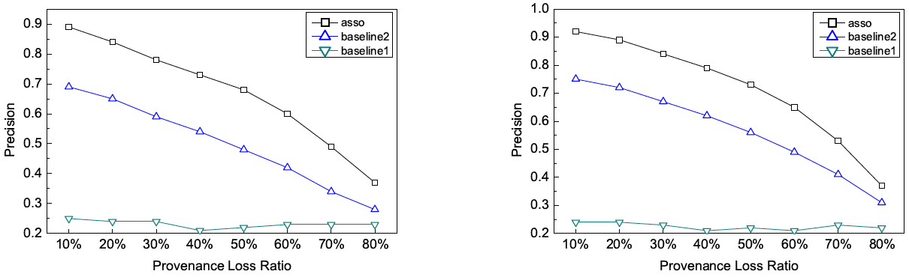
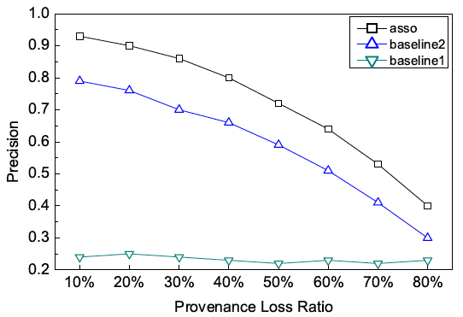
Results of Use Case 2
(a) 500
(b) 1000
(c) 2000

Slide 22
Conclusion and Future Work
Predict missing provenance
Semantic associations
  Hidden semantic “connections” between fine-grained data items sharing identical provenance
Historical datasets analysis
Dataset → ontology graph → dataset
Future work
  Inconsistent provenance
  More complicated provenance
  Provenance integration framework

