Slide 1
Computational Asset Description for Cyber Experiment Support using OWL
Telcordia Contact:
Marian Nodine
Telcordia Technologies Applied Research
nodine@research.telcordia.com
September 7,2011

Slide 2
Goals of the Asset Description Ontology
Support definition of assets that will be used in a given cyber network experiment to facilitate analysis of the experimental validity and rigor.
Support detailed description of assets, configurations, and required controls being used during testbed build-out and experiment execution to facilitate automation of network setup, configuration, validation and control.
Support documentation of assets, configurations, and supporting control and analysis systems that were used for a given experiment to facilitate accurate verification and repeatability.

Slide 3
Experimental Design
System under test:
Scale? How many nodes? Hosts?
Topology framework
Types of asset on the network: hardware, operating systems, applications, …
Specifics of the assets and asset configurations being controlled:
Updated to what point? With what patches? What security updates?
Specific settings for specific configuration parameters.
General description of other assets required.
Implied network functions that are required to support the assets explicitly defined for the experiment.
Constraints on other assets or asset functions.
Experimental framework:
Changes that need to be made to SUT during experiment.
Types of control assets required to make those changes.
Metrics that need to be collected on assets being observed, required accuracy levels.
Functions that collect those metrics.

Slide 4
Automated Testbed Setup
System under test:
Nodes, hosts, software actually being used in the actual network to create the experimental network (including virtual machine software, communication emulators, …
Nodes, hosts and topology of the experimental network
May actually be physical or virtual
Hardware, operating systems, applications, in the experimental network for each device
Dependencies among the assets that are required for correct operation
Need to validate that the experimental network makes sense from an operational perspective
Specifics of the asset configurations for each asset
Security updates and patches
Specific settings for configuration parameters.
Experimental framework:
Assets needed during build-out, e.g. image files.
Controller assets used to initialize SUT assets
Includes information on configuration parameters, API to install, configure, start, stop, clean up from the controllers
Sensor assets that need to be in place to collect metrics
Includes information on API to install, configure, start, stop, upload information, clean up from the sensors

Slide 5
Test Execution (Description)
System under test:
Nodes, hosts, software added to or removed from the actual network during the experiment
Nodes, hosts and topology changes in the experimental network
Changes to the hardware, operating systems, applications, for each device in the experimental network
Specifics of any changes to the assets and asset configurations for each asset in the experimental network during the experiment
Add or remove security updates and patches
Change or update configuration parameter settings.
Experimental framework:
Assets used during the experiment for controlling SUT assets to effect needed changes during the experiment
Assets used to control sensor assets being used to collect metrics

Slide 6
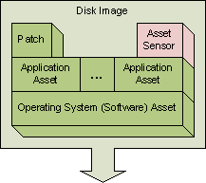
Wide Variety of Assets to Model

Slide 7
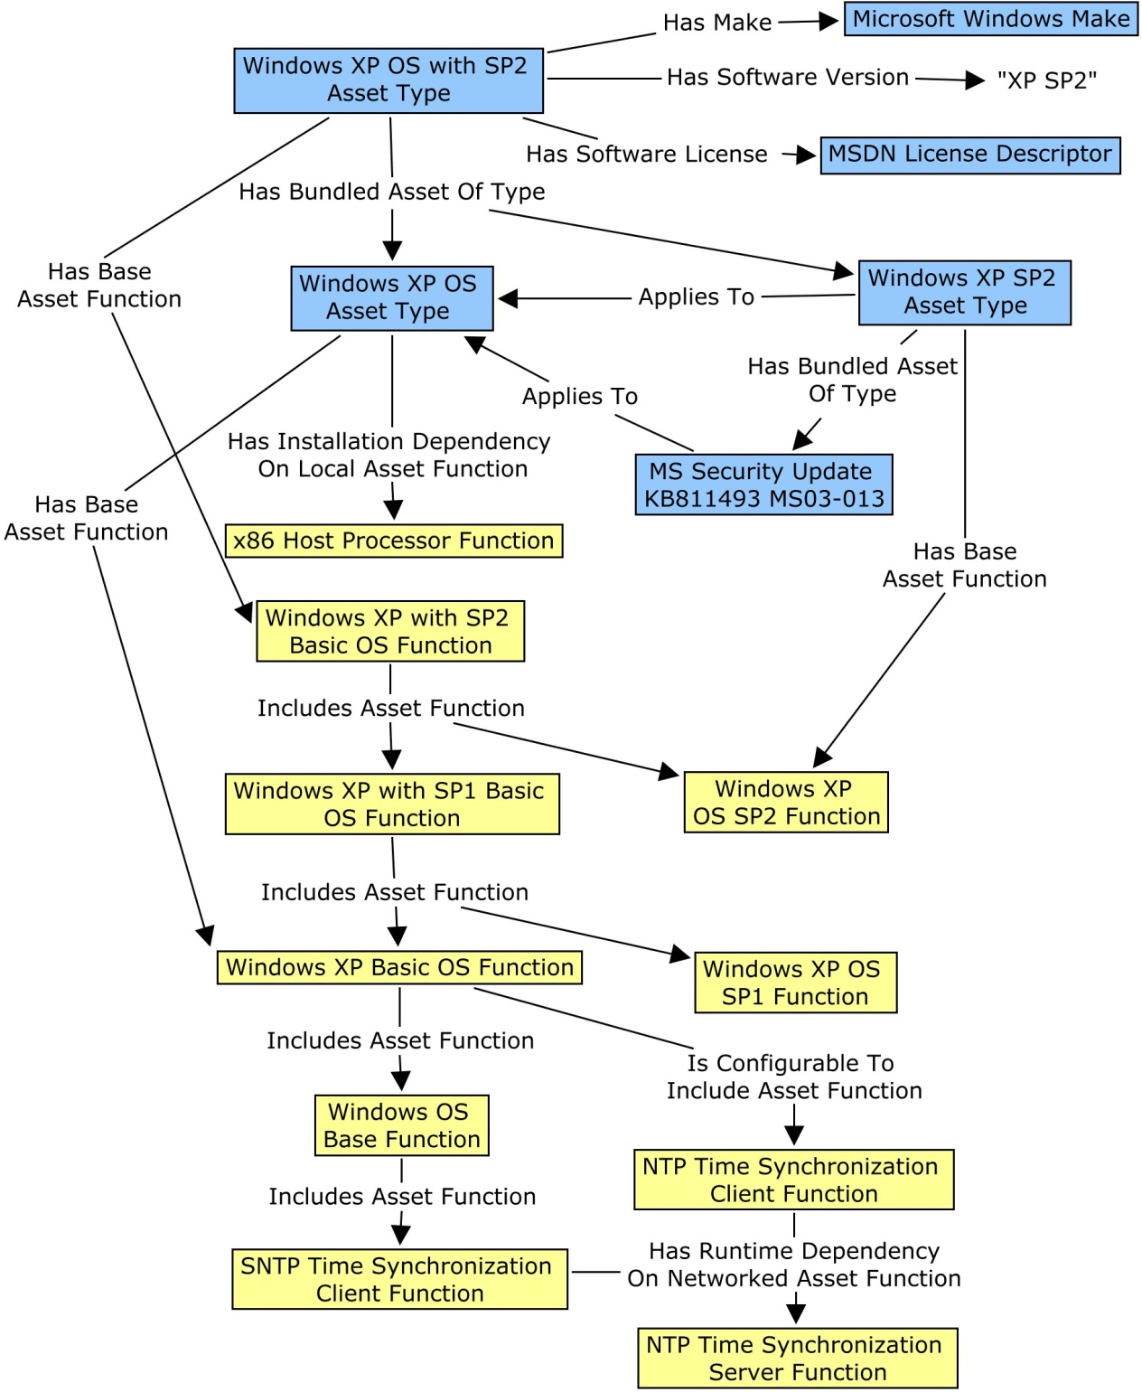
Describing Asset Types
An asset is a “purchasable unit”
Part, Licensable software
Challenge: Need to have orthogonal views about an asset during the different experiment phases.
Asset Function: What it does
Every type instance has its own function instance
Functions can include more generic functions
Functions can depend on other functions, e.g. a client function depends on the related server function
Asset Type: What it is
Types can be bundled together into other types if the bundle is also purchasable
Types have dependencies on the functions of other assets, e.g., a Windows operating system is dependent on the x86 Host Processor Function
Types have associated configuration information

Slide 8
Assets and Asset Types
Challenge: 3 levels of abstraction:
Asset instances, e.g. Thinkpad T61 with a specific serial number.
Specific types, e.g. all Thinkpad T61s with a particular hardware configuration / part number.
General classes, e.g., Thinkpad T61s, Computers with x86 processors.
Asset description ontology deals with general classes (as classes) and specific types (as instances)
Windows OS vs. Windows XP OS with SP2.
Asset core ontology deals with asset instances, and each instance has a reference to the specific type “instance” in the asset description ontology for its specific type.
Instances are actually more like a view into the relational inventory database.
Each specific type then has an associated function.

Slide 9
Dependencies of Asset Types on Asset Functions
Asset types depend on other asset types via their functions.
Dependencies are germane at different times: Installation, Initialization, Runtime
Challenge: M:N relationship between asset types due to the functions they provide and depend on:
A given asset type may be dependent on a specific group of functions that is provided by multiple other asset types.
A set of functions provided by a given asset type may be required by multiple other types of asset.

Slide 10
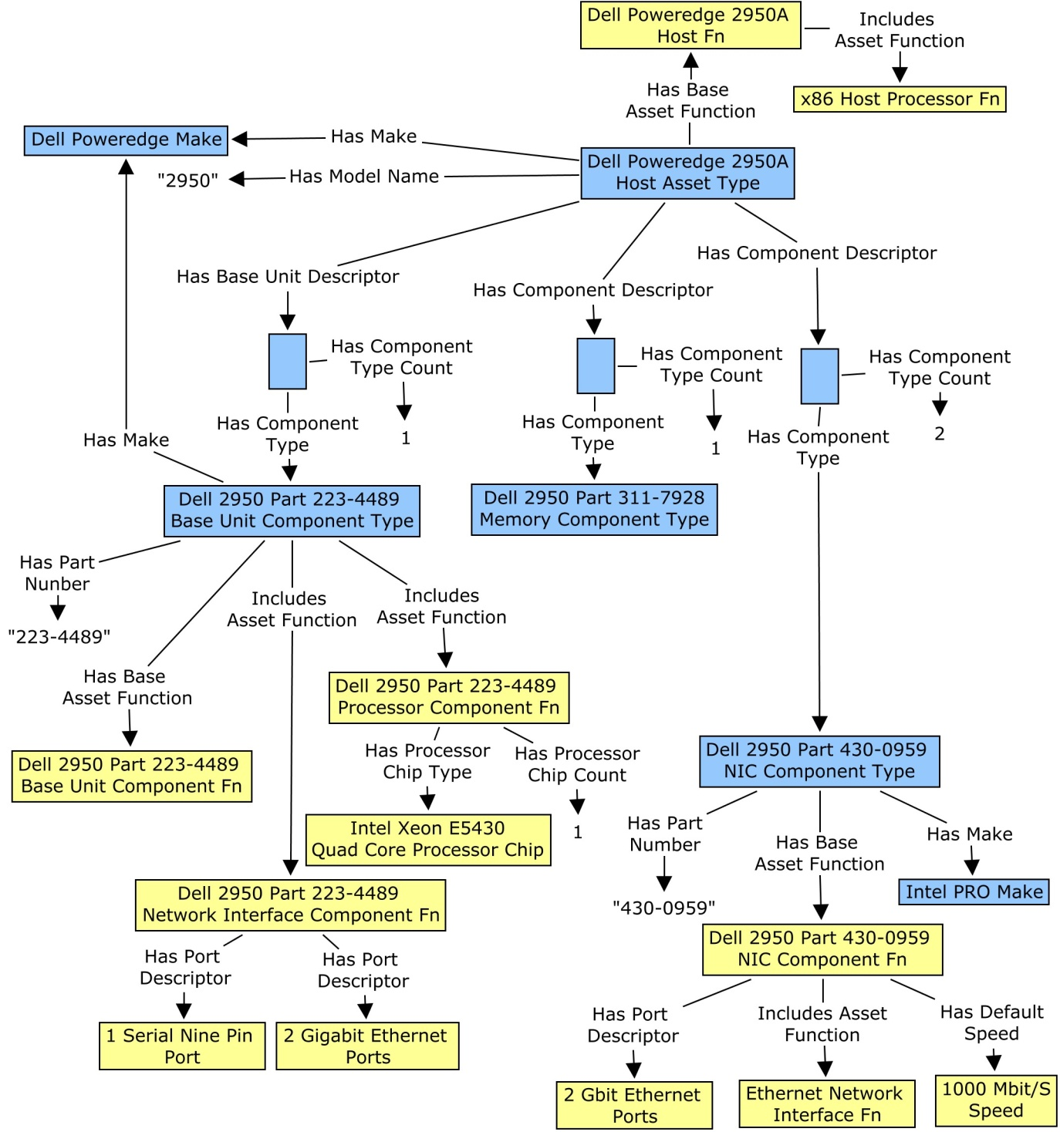
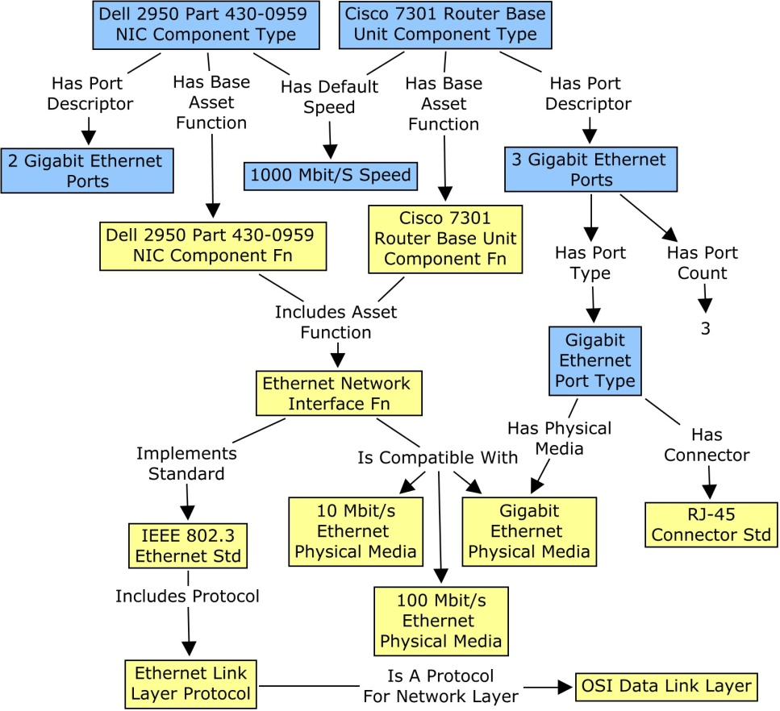
Hardware and Network Connectivity
Given a set of network nodes and a topology, with a few nodes fixed, automatically fill out the topology described using a compatible set of real and/or emulated nodes and connections.
Notes:
Describe hardware component wise, by part number
Reason about connectivity based on protocol compatibility

Slide 11
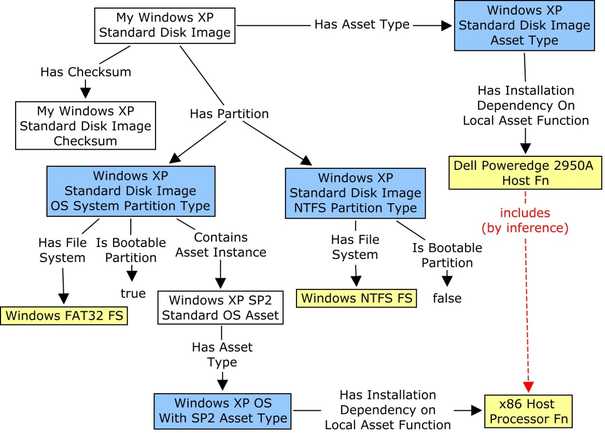
Operating Systems and Installation
Given the need to set up a large set of devices with a standard OS configuration automatically, find the appropriate disk image.
Then, for each device, ensure that the image is appropriate for the device, and if so, copy it onto the device.

Slide 12
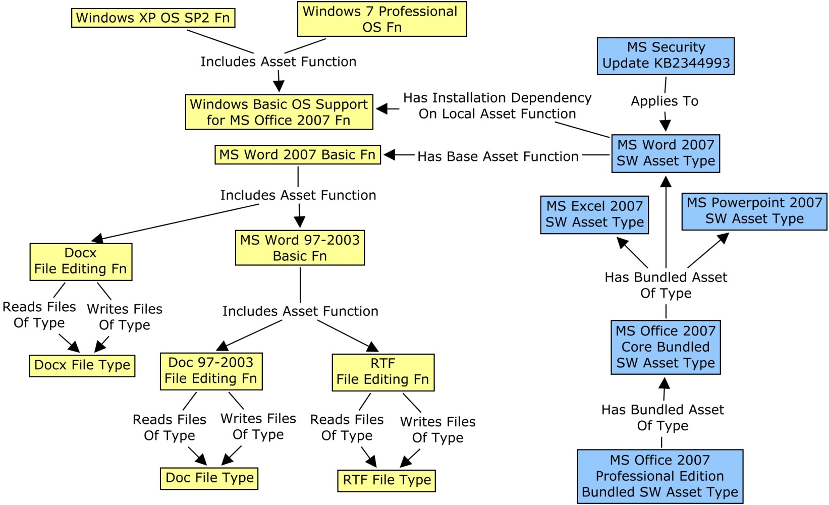
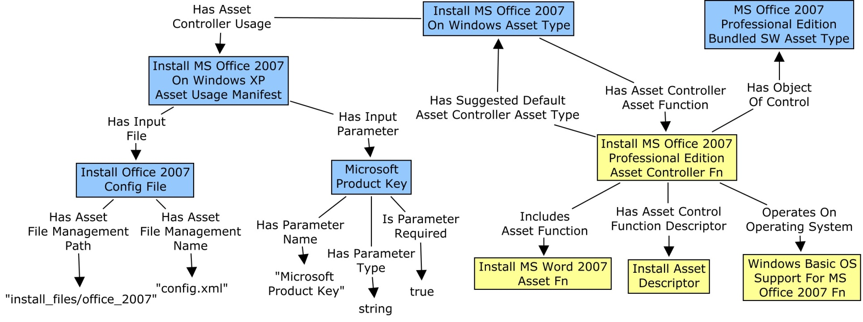
Software Applications and Installation
Given a recipe for a set of devices that includes a particular software bundle with a specific configuration, for each device in the set, specify what an installer asset would need to follow the recipe.

Slide 13
Supporting Ontology Maintenance
Ontology maintenance currently requires knowledge expertise
Ontology needs to evolve as new asset types are brought in to the testbeds, but …
Need to maintain a regularity of structure in order to be able to reason effectively.
Unreasonable to have this done manually by inventory managers
Solutions:
Generic ingesters that extract knowledge about individual new assets from the database and connect them to the ontology.
Canned SPARQL queries that support the requirements of the applications using the ontologies.
Rigorous automated regression testing to test the consistency of the information in the database with respect to a set of rules about its structure and with respect to the canned SPARQL queries.
Scrapers that can extract the information about the asset types and their dependencies from online sources (we did not get to this).

Slide 14
Marian Nodine
nodine@research.telcordia.com

