Slide 1
Automated profiling of optimism and pessimism in online news
Case Study with Odewire.com
Tim Musgrove, Chief Scientist Peter Ridge, Senior Director of Product Management Robin Walsh, VP of Engineering Federated Media Publishing
(tmusgrove, pridge,rwalsh}@federatedmedia.net
Presented at IEEE’s International Conference on Semantic Computing
10:30am Monday, September 19th Stanford University, Palo Alto California
http://www.ieee-icsc.org/ICSC2011/

Slide 2
Who is FM?
Founder: John Battelle
http://FederatedMedia.net
Conversation-modeling is mission critical for Federated Media, because we want marketing messages to blend into the conversation on a webpage (and not detract from it).
Part of this modeling is about or getting a better understanding of how news reporting is slanted.

Slide 3
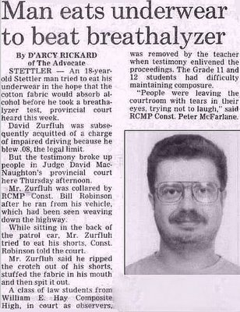
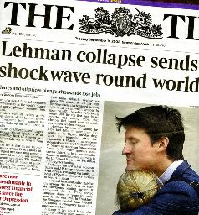
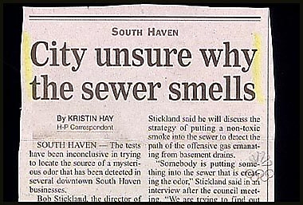
The news today is mostly negative...

Slide 4
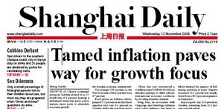
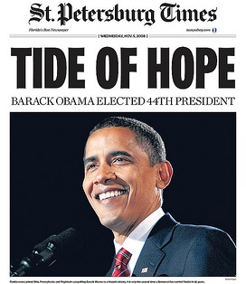
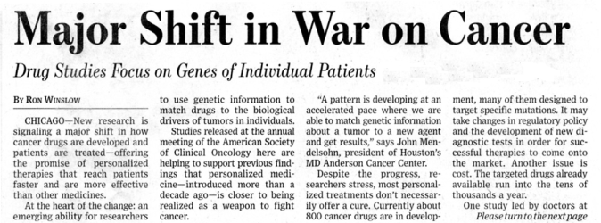
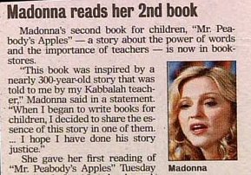
But there’s positive news out there… all around the world.

Slide 5
Enter Ode Magazine: News for the intelligent optimist
But, how to turn it into a wire?

Slide 6
Even on days when the news is mostly gloomy, OdeWire lets the light shine through…
…by gathering just the solutions-oriented news, from all around the world.

Slide 7
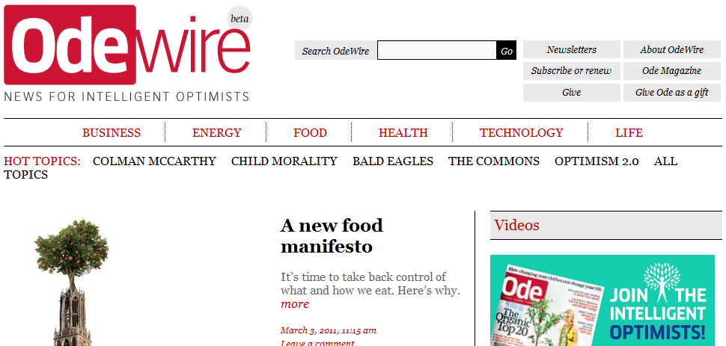
Enter the “Slant Engine”
Originally conceived by TextDigger Inc., the tool was acquired by Federated Media in 2010
Powers Odewire.com, launched this Summer

Slide 8
What does it do?
The Slant Engine detects attitudes, ideologies, and biases in news content: the “slant”
This might be liberal vs. conservative, sub-culture vs. mainstream culture, or in the case of OdeWire, optimistic vs. pessimistic

Slide 9
How does it work?
Starts with definitions of
certain classes of entities, and
certain thematic functions that can attach to entities
Looks in the text for snippets that satisfy the above definitions
Notes which snippets support the slant we’re looking for, and which ones cut against it
Computes a final score and submits to editorial

Slide 10
Examples
Entity classes:
World_Problems = (pollution, war, disease…)
Social_Goods = (education, health services…)
Thematic functions:
Efforts_against X
Progress_in X
Setback_in X
Support_for X
Elements of Slant:
(Entity_class | Thematic_function) ➔ Slant:Weight
(Efforts_against | World_Problems) ➔ Optimism 0.70
(Setback_in | Social_Goods) ➔ Anti-Optimism 0.80

Slide 11
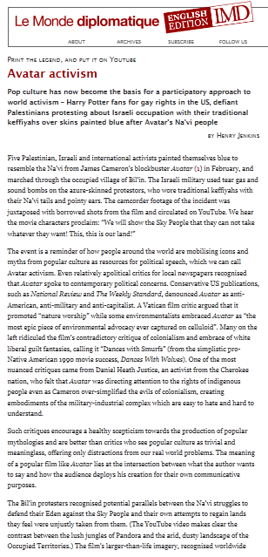
Example of extracted snippets
http://mondediplo.com/2010/09/15avatar
a participatory approach to world activism
environmentalists embraced Avatar
epic piece of environmental advocacy
directing attention to the rights of indigenous people
healthy scepticism towards the production of popular mythologies
creation for their own communicative purposes
attempts to regain lands
an empowered image of their own struggles
call attention to the plight
participatory culture

Slide 12
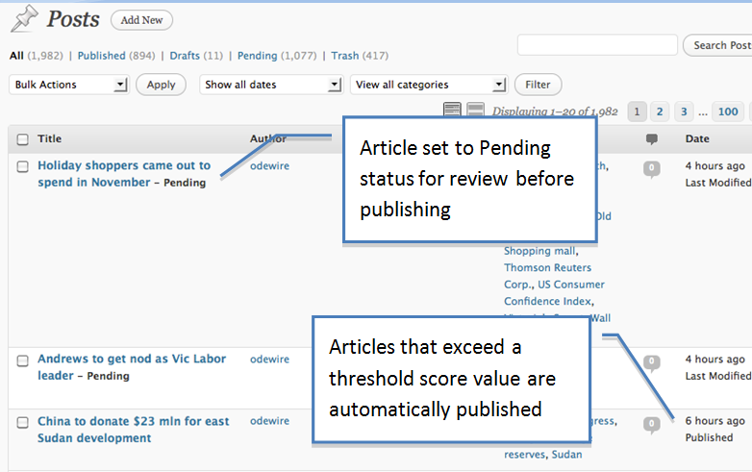
WordPress integration allows semi-automation w/editorial review

Slide 13
Results after 6 months of private beta: Even our ten “most optimistic” sources have a low percentage of stories that are optimistic
News Source | Percent Optimistic
Le Monde Diplomatique | 4.88%
Treehugger | 4.60%
Huffington Post | 3.48%
IPSNews | 2.92%
Wall Street Journal | 2.82%
Mother Jones | 2.82%
The Guardian | 2.40%
CNN | 2.36%
Christian Science Monitor | 2.24%
AllAfrica | 2.11%
Average across all 60 sources: 1.45%

Slide 14
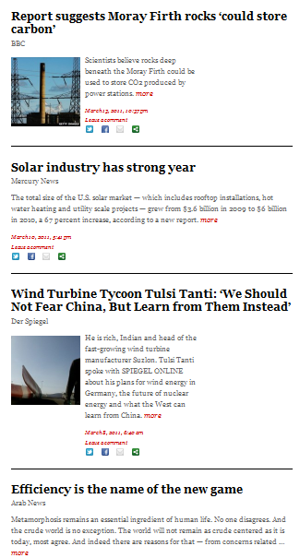
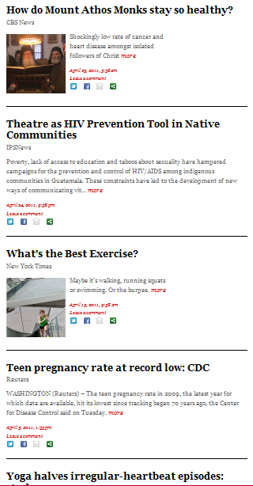
The result: an ongoing feed of solutions-oriented news from around the globe With a 95% reduction in labor compared to doing it all manually
Energy Health

Slide 15
Similar Ranking
Seven of the top ten most optimistic sources according to human editors, were placed in the top ten by the engine also
Pearson correlation overall was 0.605
News Source | Rank by editors | Rank by engine
Le Monde Diplomatique | 1 | 1
Treehugger | 2 | 8
Huffington Post | 3 | 24
IPSNews | 4 | 3
Wall Street Journal | 5 | 22
Mother Jones | 6 | 5
The Guardian | 7 | 6
CNN | 8 | 10
Christian Science Monitor | 9 | 4
AllAfrica | 10 | 21

Slide 16
Confidence, Precision and Recall
For editors wanting to see most reasonable candidates, the “sweet spot” seems to be a confidence of 50 to 60
A safe threshold for auto-publishing seems to be 90
Confidence Threshold | Recall | Precision | F-Measure
90% | 24% | 93% | 38%
60% | 84% | 71% | 77%
50% | 89% | 64% | 74%
40% | 94% | 48% | 64%

Slide 17
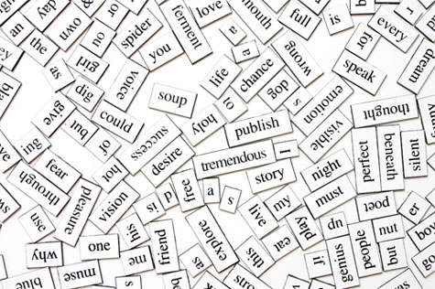
What’s next?
Relevance: We want content and ads both to be relevant and engaging, all the time
“Better, smarter, deeper”: Improved modeling of blog and news content will enable a multitude of “semantic mashups” to be created

