Slide 1
Semantic Computing in Real-World: Vertical and Horizontal application, within Enterprise and on the Web
Panel at Intl Conf on Semantic Computing, Palo Alto, CA, Sept 20m 2011
Amit P. Sheth LexisNexis Ohio Eminent Scholar
Ohio Center of Excellence in Knowledge-enabled Computing (Kno.e.sis)
Wright State University, Dayton, OH
amit@knoesis.org

Slide 2
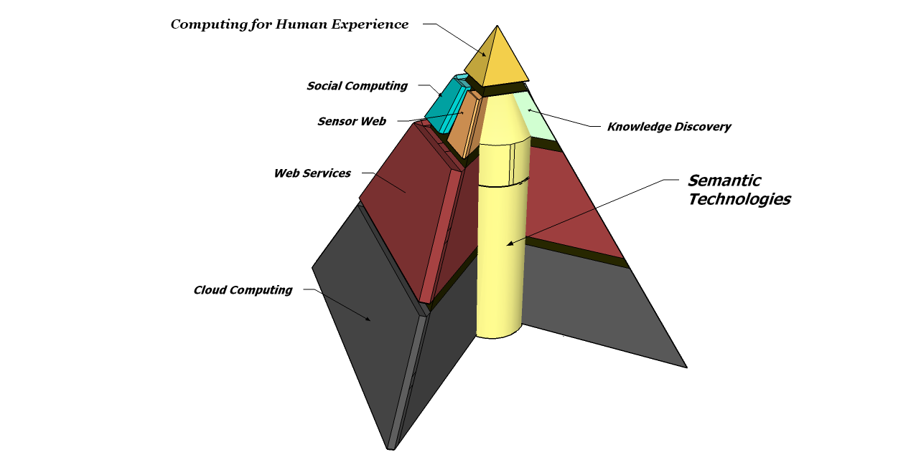
Semantics as core enabler, enhancer @ Kno.e.sis
Ohio Center of Excellence in Knowledge-enabled Computing
one of the two largest academic groups in Semantic Web; multidisciplinary;
15 Faculty
~50 PhD Students
knoesis.org

Slide 3
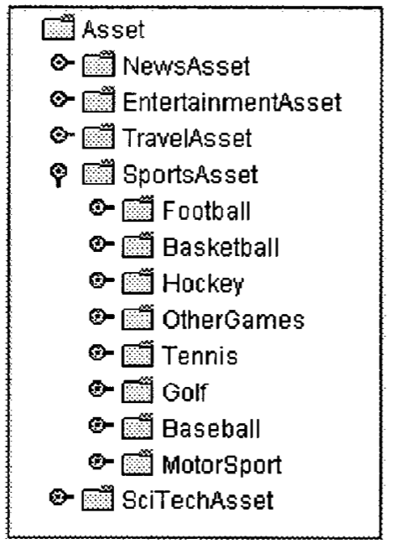
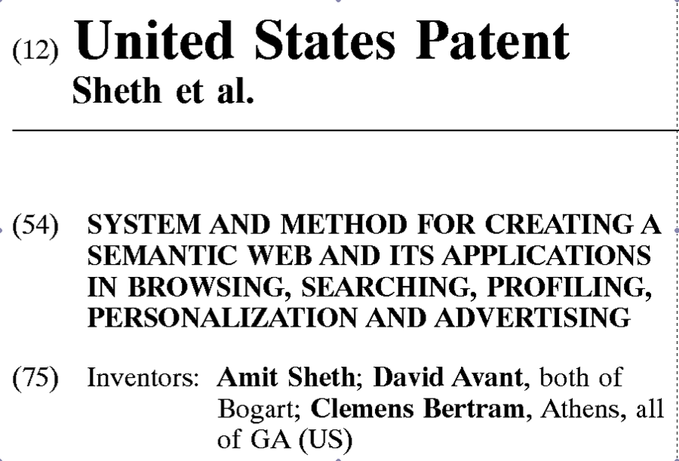
Semantics & Semantic Web in 1999-2002
2001
Patent : http://bit.ly/sw-p

Slide 4
Significant Presence In …
BBC Sound Index
MediaAnywhere
/Taalee
Twitris
Twarql
……….
Pharmaceutical
Defense
Health Care
ASEMR
Finance
GIS
Life Science
Scooner
App Specific
Search
Social
Sensor
……….

Slide 5
Semantic Web In Action
Create Domain Model and Knowledge bases
Semantic Annotations
Taalee - MediaAnywhere
Bio2RDF
BestBuy
Linked Open Data
Schema.org
BBC Sound Index
Global Investment Bank
Twarql
Scooner
Semagix
ASEMR
Reasoning and Analysis

Slide 6
Semantic Search 1999 - 2001

Slide 7
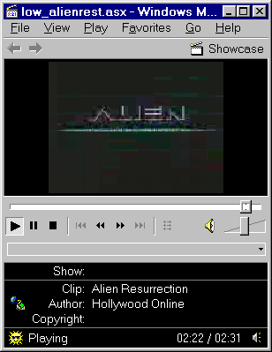
Taalee Semantic/Faceted Search & Browsing (1999-2001)
Targeted e-shopping/e-commerce
assets access
uniform view of worldwide distributed assets of similar type
Taalee - Search
Notes:
Animation needs work

Slide 8
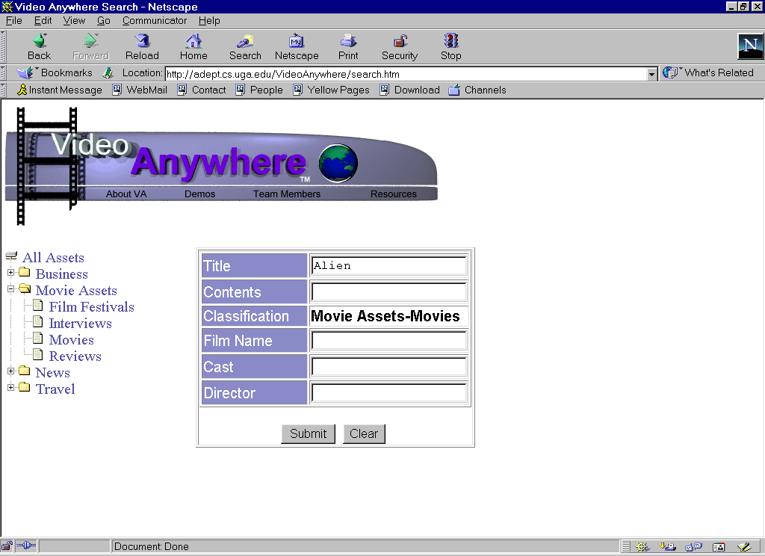
Taalee Semantic/Faceted Search & Browsing (1999-2001)
BLENDED BROWSING & QUERYING
Targeted e-shopping/e-commerce
ATTRIBUTE & KEYWORD QUERYING
assets access
SEMANTIC BROWSING
uniform view of worldwide distributed assets of similar type
Taalee - Search
Notes:
Animation needs work

Slide 9
Fast Forward to 2010 - 2011

Slide 10
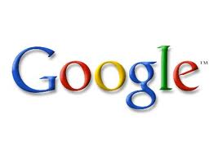
Schema.org
Shared Vocabulary
Amazing things can happen

Slide 11
Enterprise Applications

Slide 12
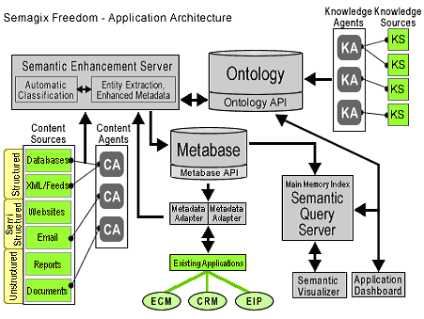
Extracting Semantic Metadata from Semi structured and Structured Sources (1999 – 2002)
Semagix Freedom for building
ontology-driven information system
Managing Semantic Content on the Web

Slide 13
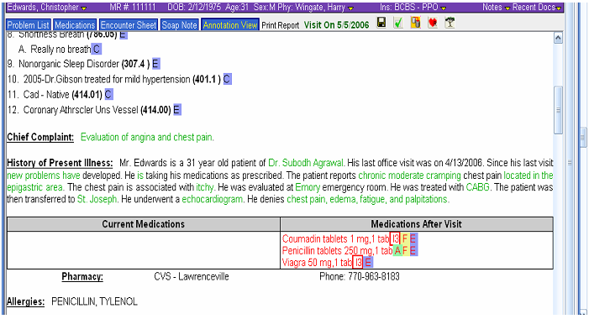
Active Semantic Electronic Medical Record Application
In Use Today at Athens Heart Center For Clinical Decision Support since January 2006
Amit P. Sheth, S. Agrawal,Jonathan Lathem, Nicole Oldham, H. Wingate, P. Yadav, and K. Gallagher, Active Semantic Electronic Medical Record, Proc. of the 5th International Semantic Web Conference

Slide 14
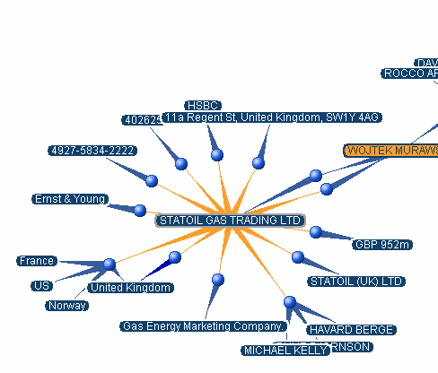
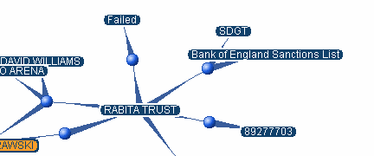
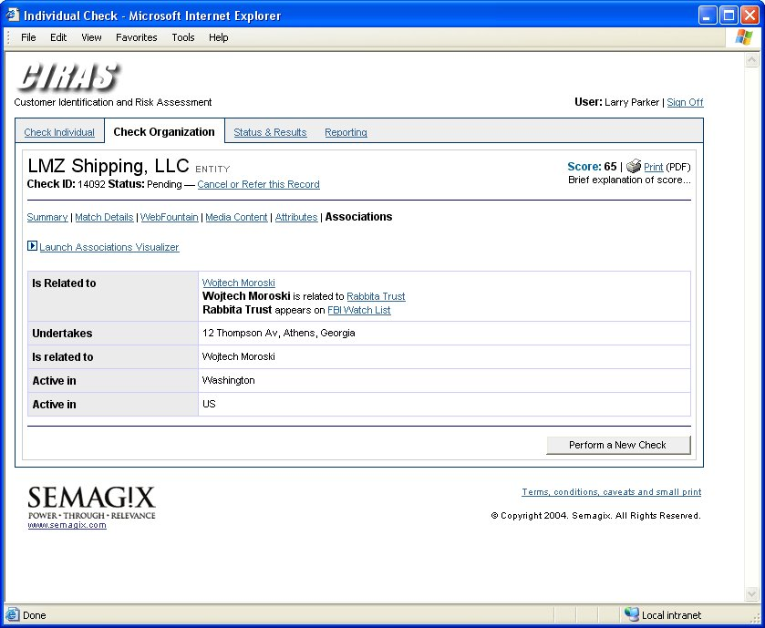
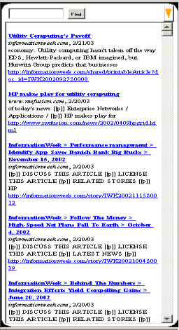
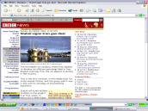
Global Investment Bank
Watch Lists
Law
Enforcement
Regulators
Public Records
World Wide
Web content
BLOGS, RSS
Semi-structured Government Data
Un-structure text, Semi-structured Data
Establishing
New Account
User will be able to navigate
the ontology using a number
of different interfaces
Scores the entity
based on the
content and entity
relationships
Fraud Prevention application used in financial services – Related KYC application is deployed at Majority of Global Banks
Notes:
(a) Serve global population of 500 users (B) Complete all source checks in 20 seconds or less © Integrate with enterprise single sign-on systems (d) Meet complex name matching and disambiguation criteria (e) Adhere to complex security requirements
Results: Rapid, accurate KYC checks; Automatic audit trails; Reduction in in false positives; Streamlines and enhances due diligence of potential high risk accounts

Slide 15
Using large data sets for Structured Data on the web

Slide 16
Linked Open Data
Publish Open Data Sets in RDF
By 2010, 203 data data sets
25 billion Triples
Image: http://richard.cyganiak.de/2007/10/lod/

Slide 17
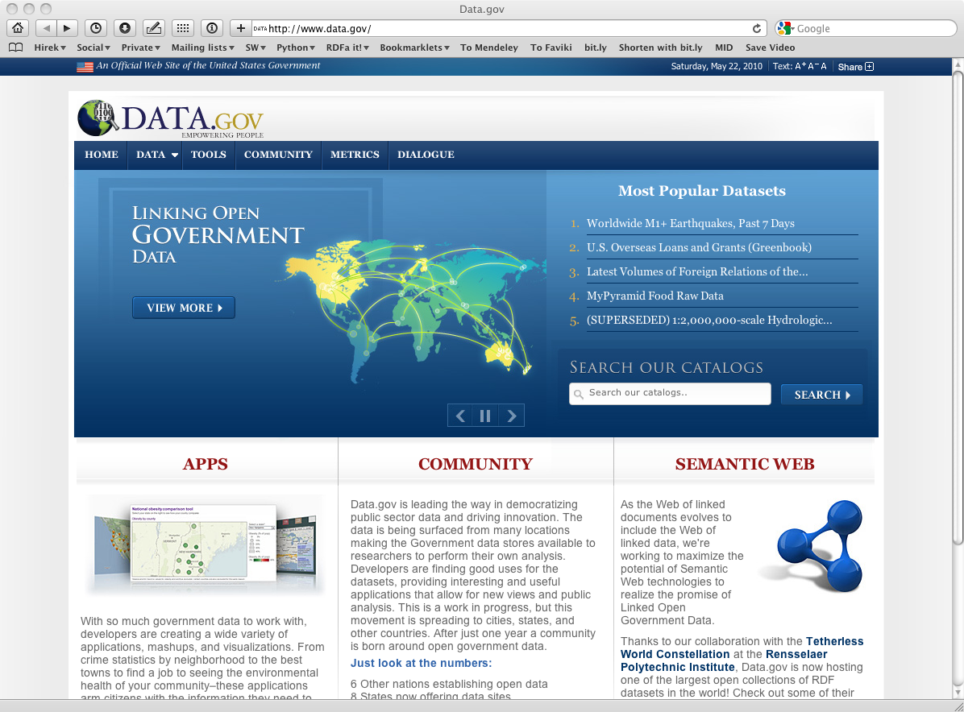
You publish the raw data…
Ivan Herman, "Semantic Web Adoption and Application”,
http://www.w3.org/People/Ivan/CorePresentations/Applications/
Notes:
Obtained from Ivan’s slide

Slide 18
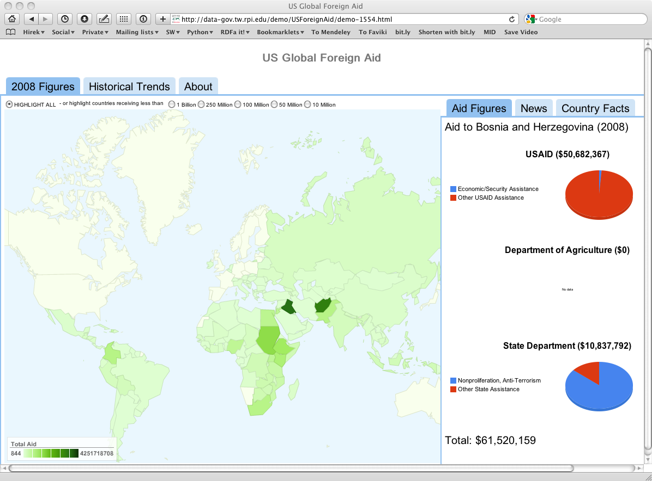
… and others can use it
Ivan Herman, "Semantic Web Adoption and Application”,
http://www.w3.org/People/Ivan/CorePresentations/Applications/
Notes:
Obtained from Ivan’s slide

Slide 19
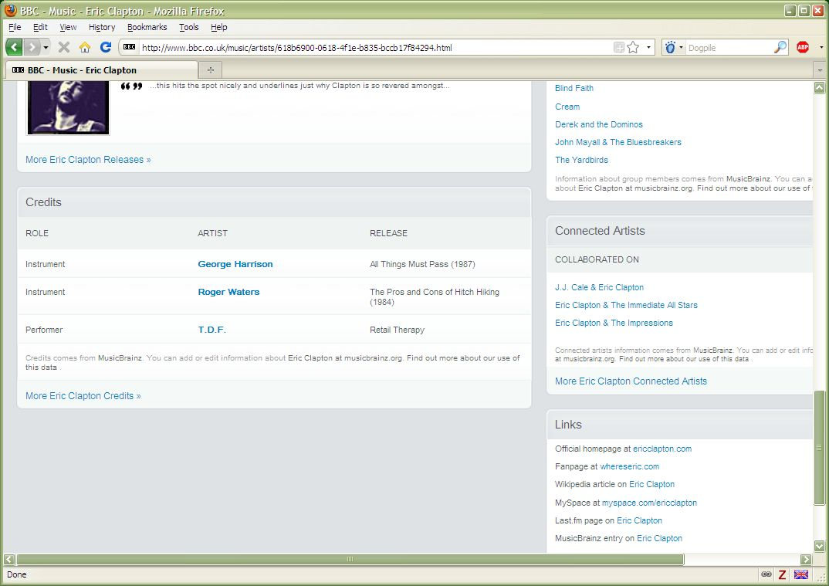
Using the LOD to build Web site: BBC
Ivan Herman, "Semantic Web Adoption and Application”,
http://www.w3.org/People/Ivan/CorePresentations/Applications/
Notes:
Obtained from Ivan’s slide

Slide 20
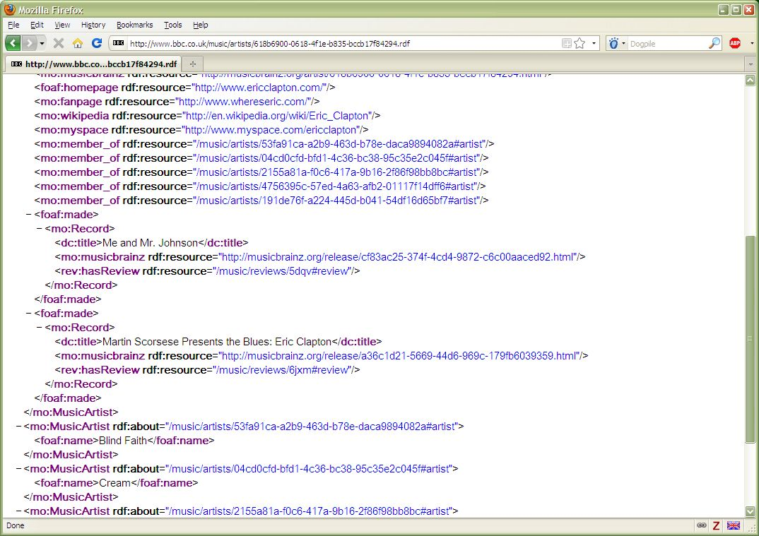
Using the LOD to build Web site: BBC
Ivan Herman, "Semantic Web Adoption and Application”,
http://www.w3.org/People/Ivan/CorePresentations/Applications/
Notes:
Obtained from Ivan’s slide

Slide 21
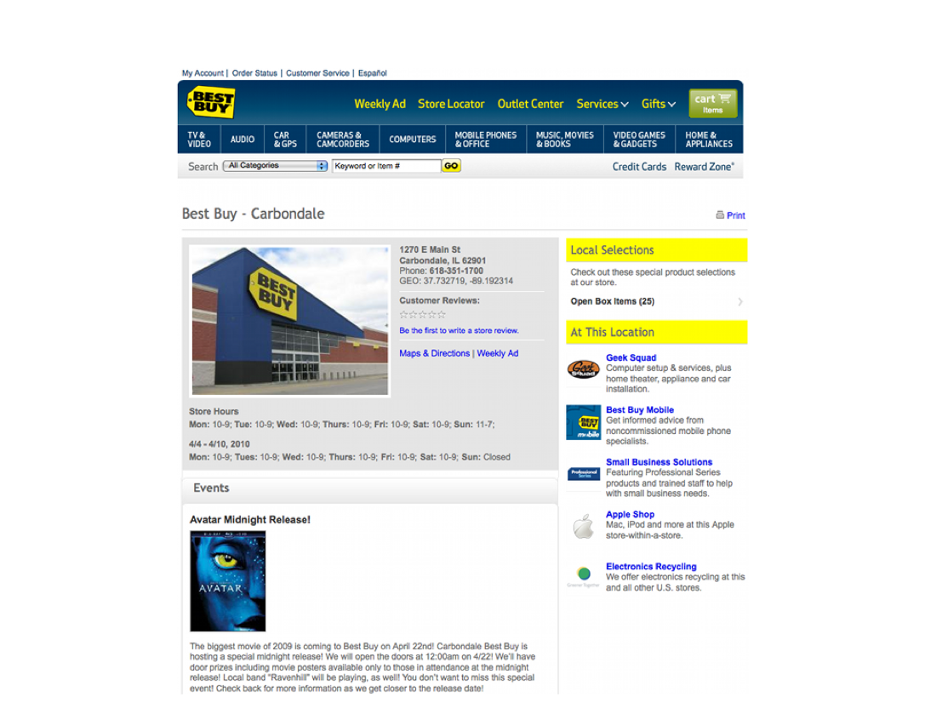
GoodRelations Ontology - RDFa
Ivan Herman, "Semantic Web Adoption and Application”,
http://www.w3.org/People/Ivan/CorePresentations/Applications/
Notes:
Obtained from Ivan’s slide

Slide 22
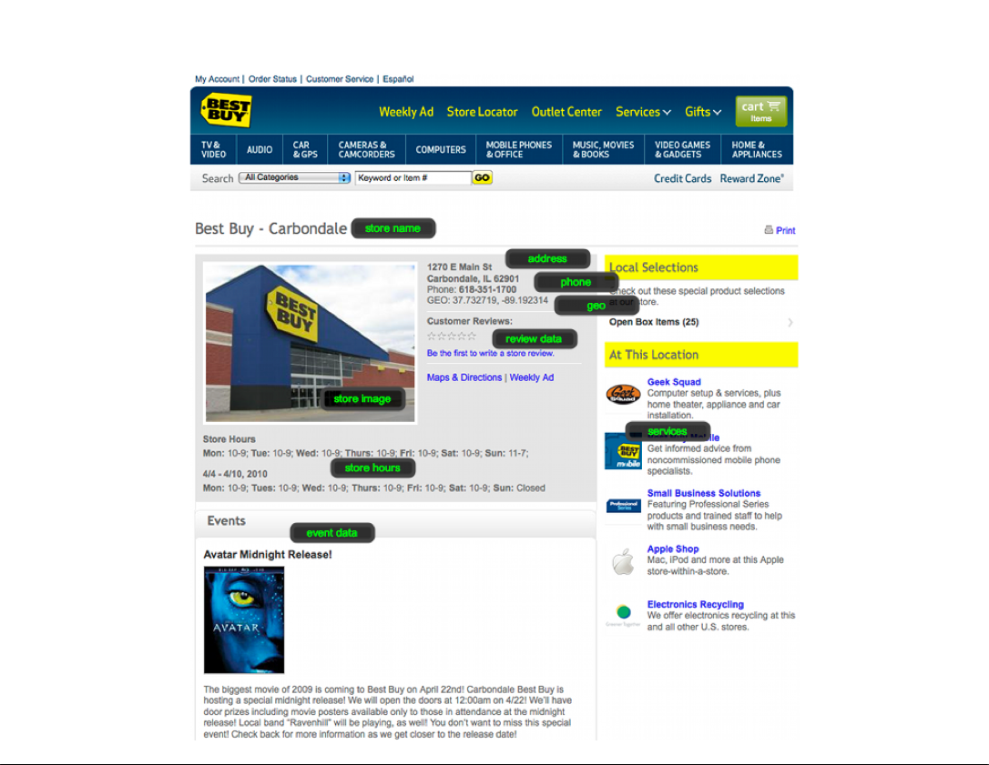
GoodRelations Ontology - RDFa
Ivan Herman, "Semantic Web Adoption and Application”,
http://www.w3.org/People/Ivan/CorePresentations/Applications/
Notes:
Obtained from Ivan’s slide

Slide 23
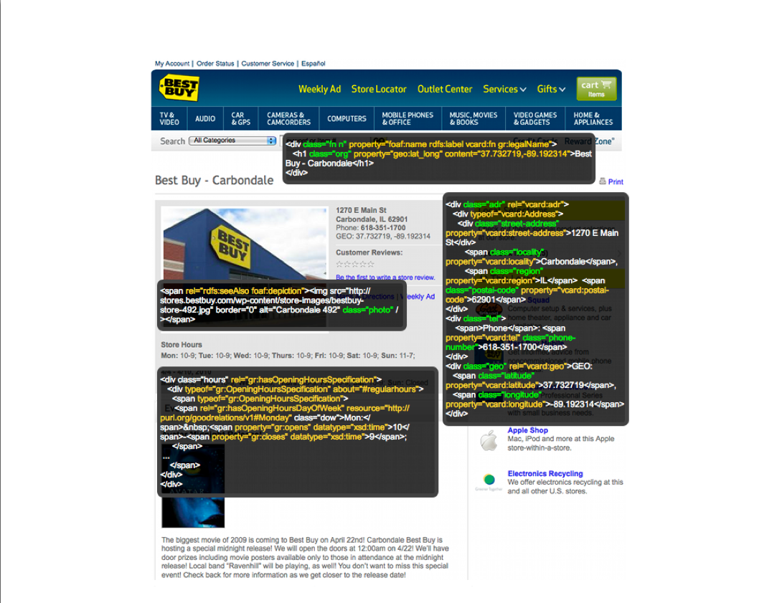
GoodRelations Ontology - RDFa
Ivan Herman, "Semantic Web Adoption and Application”,
http://www.w3.org/People/Ivan/CorePresentations/Applications/
Notes:
Obtained from Ivan’s slide

Slide 24
Using Community Engagement

Slide 25
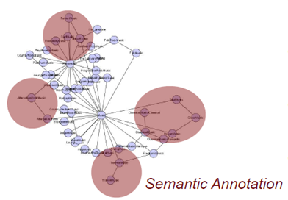
BBC Sound Index
Using MusicBrainz to spot entities in the BBC Sound Index
60 songs with Merry Christmas
3600 songs with Yesterday
195 releases of American Pie
32 Artists Amrican Pie

Slide 26
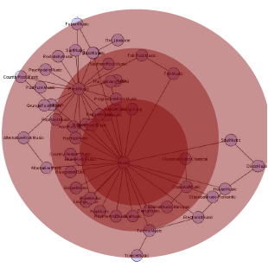
BBC Sound Index
Which ‘Merry Christmas’?; ‘So Good’is also a song
Scoped Relationship graphs
– Using context cues from the content, webpage title, url…
e.g. new Merry Christmas tune
– Reduce potential entity spot size
e.g. new albums/songs
• Generate candidate entities
• Spot and Disambiguate

Slide 27
The Vision
http://www.almaden.ibm.com/cs/projects/iis/sound/

Slide 28
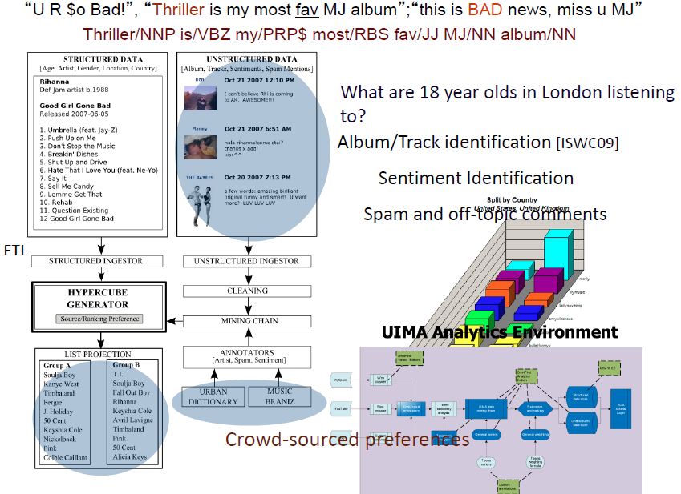

Slide 29
Social Data

Slide 30
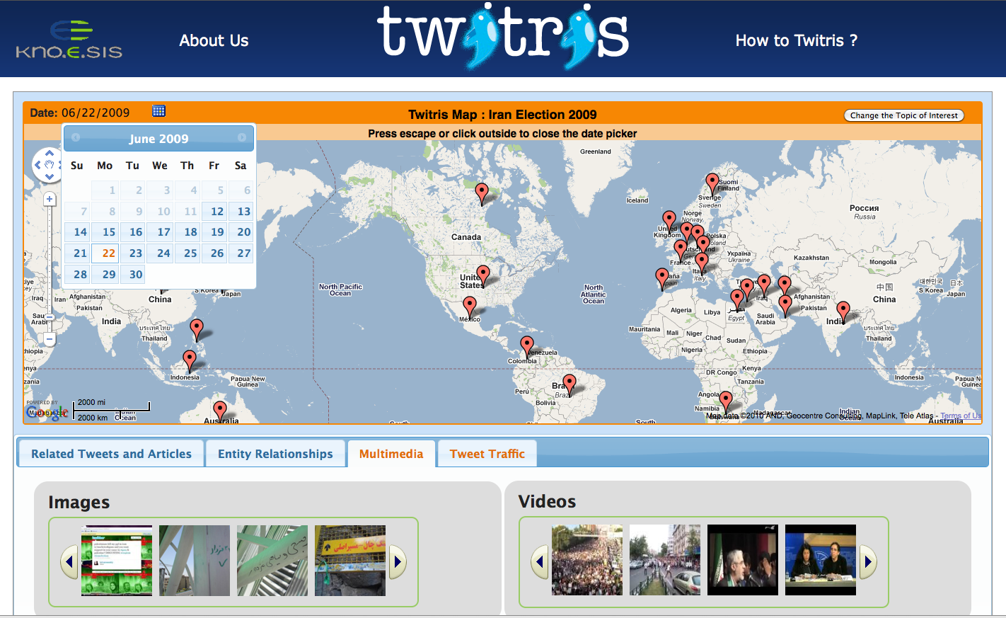
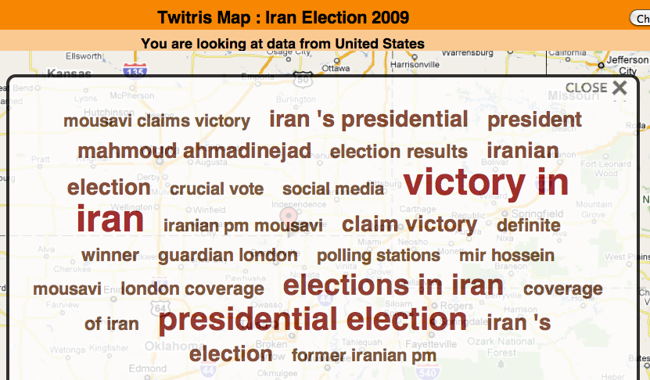
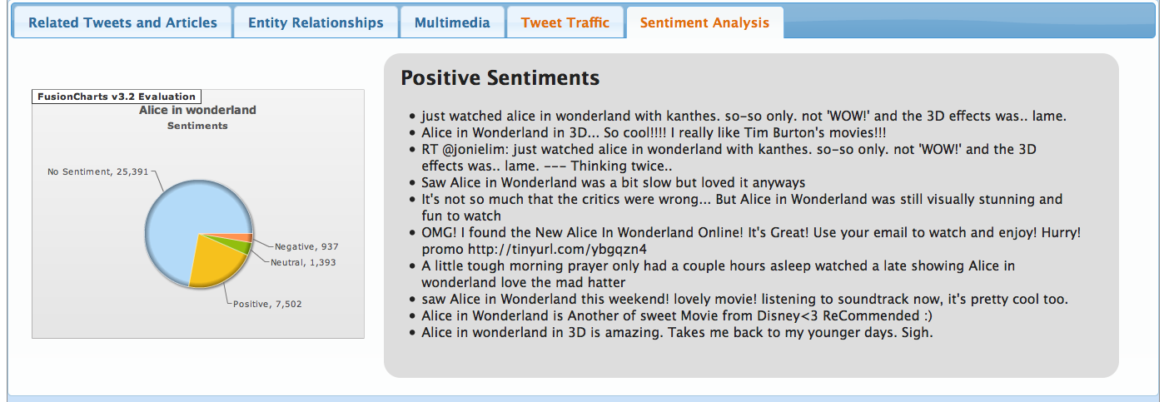
Twitris: Semantic Social Web Mash-up
Select date
Select topic
N-gram summaries
Topic tree
Tweet traffic
Sentiment Analysis
Spatial Marker
Images & Videos
Related tweets
Reference news
Wikipedia articles
More: TWITRIS

Slide 31
Twarql (Twitter Feeds through SPARQL)
Semantically annotate tweets with entities, hashtags, URLs, sentiments, etc.
Encode content in a structured format (RDF) using shared vocabularies (FOAT, SIOC, MOAT, etc.)
Structured querying of tweets
Subscribe to a stream of tweets that match a given query
Real-time delivery of streaming data.
More: TWARQL

Slide 32
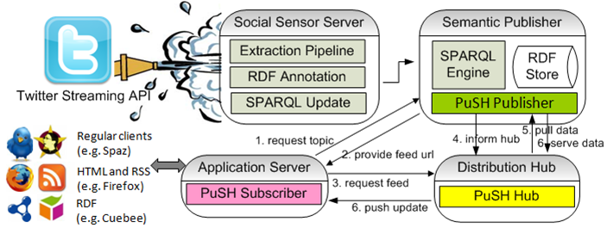
Twarql Architecture
More: TWARQL
Notes:
Architecture of twarql
Stream tweets
Covert it into RDF
Use SPARQL Query to filter it

Slide 33
User Controlled Content Dissemination
Create Semantic Social Graphs (FOAF) of publishers (followee) and subscribers (followers).
Dynamically create subset of subscribers (SPARQL Query on Semantic Social Graph), based on publishers privacy preference for the content generated.
Distribute the content to only the subset of subscribers from the Social graph in (near) Real-Time
Example –
SMOB ( Semantic Microblogging Framework) http://smob.me
Semantic Hub ( Publisher/Subscriber protocol) http://semantichub.appspot.com

Slide 34
Semantic Hub

Slide 35
Scenario ….
Give me a stream of locations where Kinect is being mentioned now
Give me all people that have said negative things about Kinect
More: TWARQL

Slide 36
Creating Focus Specific Knowledge Bases for Knowledge Exploration

Slide 37
Scooner
HPC keywords
Doozer: Base Hierarchy from Wikipedia
Focused Pattern based extraction
SenseLab Neuroscience Ontologies
Initial KB Creation
Meta Knowledgebase
PubMed Abstracts
Knoesis: Parsing based NLP Triples
Enrich Knowledge Base
NLM: Rule based BKR Triples
Final Knowledge Base
More: Scooner

Slide 38
Search for “VIP Peptide”
More: Scooner

Slide 39
Exploring Relationships
More: Scooner

Slide 40
Interested in more?
“Citizen Sensor Data Mining, Social Media Analytics and Development Centric Web Applications” (WWW2011)
Jorge Cardoso, Martin Hepp and Miltiadis Lytras “The Semantic Web : Real World Applications from Industry”
Ivan Herman, “Semantic Web Adoption and Application”
Michael Hausenblas, “Open Data Ireland : From Research to Practice”
Amit Sheth: “Semantics Scales Up: Beyond Search in Web 3.0”
See showcase of several applications at: http://knoesis.org/showcase

