Slide 1
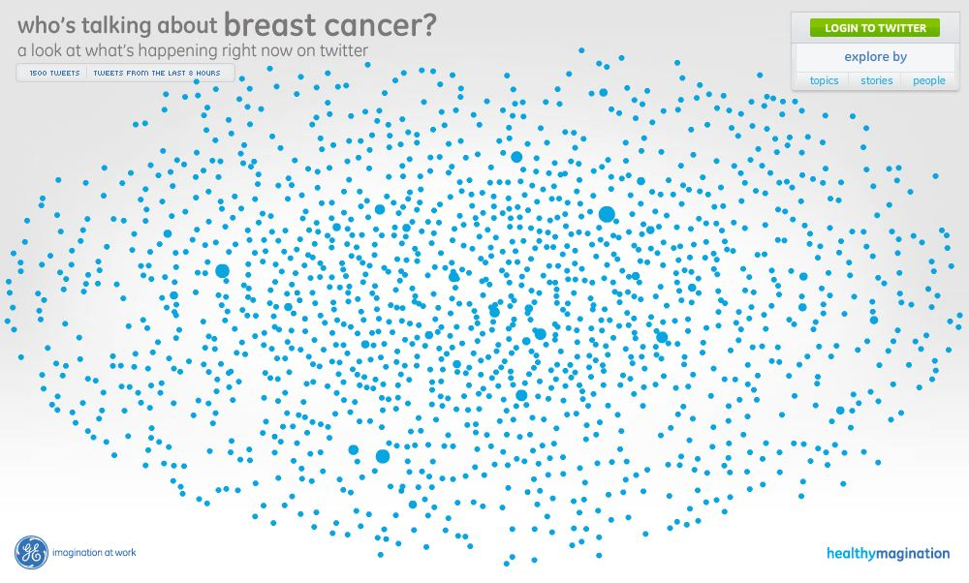

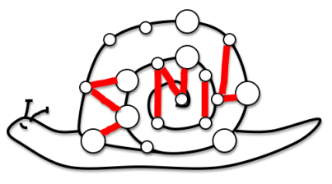
Understanding Cancer-based Networks in Twitter using Social Network Analysis
Dhiraj Murthy
Daniela Oliveira
Alexander Gross
Social Network Innovation Lab (SNIL)
Bowdoin College
@socialnetlab
IEEE Computer Society Intra-disciplinary Workshop on Semantic Computing, 2011
Notes:
1
1
Picture from XKCD - http://xkcd.com/802/

Slide 2
Outline
Introduction to Twitter and e-health
Preliminary Study
Our Proposed Approach
Modeling and Inferring Trust
Concluding Remarks
Notes:
2
2

Slide 3

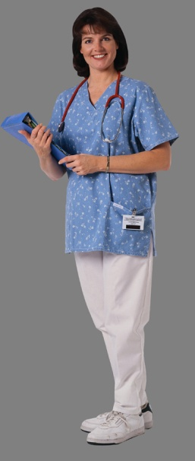
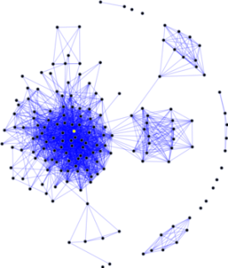
OSN and Healthcare
Notes:
3
3
3

Slide 4
E-Health
Health Information National Trend Survey (HINTS, 2007):
  23% reported using a social networking site.
  61% of adult Americans look online for health information:
    41% have read someone else's medical information;
    15% have posted medical information.
Notes:
4
4

Slide 5
Twitter
Great impact in dissemination of health information
Microblogging: short messages or tweets
Unidirectional: followers and followees
  Follower considers followee “interesting”
Notes:
5
5

Slide 6
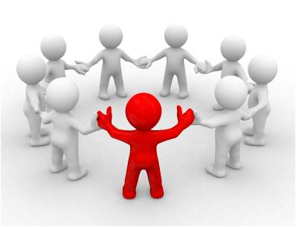
Why Social Media/Twitter?
Information gathering: experiences,treatment options, questions, clinical trials
Responses are synchronous, fast and regular
Telepresence
Content patient controlled
Better health outcomes
Patient support networks
Notes:
6
6

Slide 7
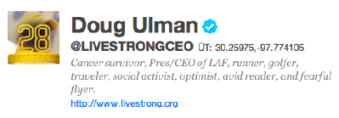
Twitter Cancer Networks
Highly active
Far reach:
  Prof. Naoto Ueno, doctor and cancer survivor (4100 followers)
  Tweets caused cancer screening program in Japan to undergo a rethink.
Notes:
7
7

Slide 8
Trust Challenges
How much to share:
  personal experiences, family diseases
Content is uncensored and collaborative:
  How much to trust a source of information?
  Content may be contradictory and incorrect.
Previous validation of statements in unfeasible.
Notes:
8
8

Slide 9
Our Work: Dynamics of Cancer-based Networks
How cancer-based networks on Twitter influence:
  flow of health-related information?
  Health-related attitudes and outcomes?
How to visualize these networks?
How can we model and infer trust in users and their statements (tweets)?
How do trust in users and beliefs in tweets propagate?
Notes:
9
9

Slide 10
Prelminary Study Case with Twitter
Understand nature and information contained in health networks;
Develop methods for capturing data;
Evaluate whether this data revealed positive health outcomes
Notes:
10
10

Slide 11
Preliminary Study Case with Twitter
Investigations have been two-fold:
  nature of directional communication in Twitter:
    topical contexts by keywords ( ‘chemo’, ‘cancer survivor’, and ‘lymphoma’)
  size, connectivity, and structure of cancer-related communities
Notes:
11
11

Slide 12
Data Set
195,915 tweets:
  88,293: ‘chemo’
  18,443: ‘mammogram’
  39,215: ‘lymphoma’
  49,961: ‘melanoma’
Seed: Dr. Anas Younes, oncologist and cancer researcher at the MD Anderson Cancer Research Center
Notes:
12
12

Slide 13
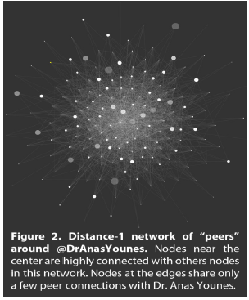
Visualization: Distance 1 from the seed
Notes:
13
13
13

Slide 14
Network with Distance 2 from the seed
Twitter users: 175-200 million
Network at a distance of 2 from seed: 30 million users and over 72 million unique connections between these users (1/6 of Twitter).
The Seed’s network entities The number of nodes and connections in the discovered network
Notes:
14
14

Slide 15
Visualization – Distance 2 from the seed
Visualizing Large Networks (a) This network graph contains more than 70,000 users and 90,000 connections, only 0.16% of the size of the complete distance-2 network around the Seed. (b) Up-close, node distinction improves, the it remains nearly impossible to distinguish which nodes are connected by which edges
Notes:
15
15
15

Slide 16
Challenge: Visualization
Health networks of this size resist visualization:
  processor intensive problem of laying out millions of objects;
  the information visualized not very meaningful.
  Current visualization tools (Pajek, Cytoscape) not developed for large-scale networks.
Notes:
16
16
16

Slide 17
Proposed Approach
Construction of topical groups (‘lists’) where users have an interest in a specific topic:
  Cancer survivors, Livestrong, oncologists;
Generate network visualization files of selected ‘list’ networks identified by keyword, number of followers, and affiliations
  cancer survival networks, cancer support groups and lists based on treatment advice/options
Lists visualized as complete networks (Cytoscape)
Notes:
17
17
17

Slide 18
Modeling and Inferring Trust
Adaptation of Web of Trust (Richardson et al.’ 03)
t_{ij} = amount of trust user i has for user j she follows
t_{jk} = amount of trust user j has for user k she follows
t_{ik} = amount of trust user i should have for user k (not a followee), function of t_{ij} and t_{jk}

Slide 19
T- Personal Trust Matrix
NxN matrix, where N is the number of user
t_{i} = row vector of user i trust in other users, she follows
t_{ik} = how much user i trusts user k she follows
t_{kj} = how much user k trusts user j she follows
(t_{ik} . t_{kj}) = amount user i trusts user j via k
∑_{k} (t_{ik} . t_{kj}) = how much user i trusts user j via any other node.

Slide 20
M – Merged Trust Matrix
Represents trust between any two users
M⁽⁰⁾ = T
M^{(n)} = T . M ^{(n-1)}
Repeat (2) until M^{(n)} = M^{(n-1)}
M^{(i)} is the value of M in iteration i.
Matrix multiplication definition:
C_{ij} = ∑_{k} (A_{ik} . B_{kj})

Slide 21
How to Infer Trust for Tweets
Estimated Personal beliefs (through Machine Learning)
b_{i} = user i’s personal belief (trust) on a tweet
b = collection of users personal beliefs on a tweet
How much a user believes in any tweet in the network?

Slide 22
The Merged Beliefs Structure (b)
Computes for any user, her belief in any tweet
b⁽⁰⁾ = b
b^{(n)} = T . b^{(n-1)} or (b_{i})^{n} = ∑_{k} (t_{ik} . (b_{k})^{n-1})
Repeat (2) until b^{(n)} = b^{(n-1)}
where:
b^{(i)} is the value of b in interaction i.

Slide 23
Concluding Remarks
Health-related networks can be meaningful visualized and analyzed:
  lists and seeds;
  Social Network Analysis + Natural Language Processing + Machine Learning
Challenge: modeling and inferring trust:
  Subjective
  Transitory nature of th networks
  Lack of bidirectional relationships in Twitter
Notes:
23
23
23

Slide 24
Thank you!

