Slide 1
Content-Based Geospatial Schema Matching Using Semi-Supervised Geosemantic Clustering and Hierarchy
Jeffrey Partyka Dr. Latifur Khan
Notes:
Acknowledgements: funded by national geospatial agency and air force (put logos for both)

Slide 2
Topic Outline
Background and Motivation
A Closer Look at GeoSim - Overview - Entropy-Based Distribution (EBD) - Details of GeoSim_{G} - Details of GeoSim_{H}
Experimental Results
Future Work & Conclusions

Slide 3
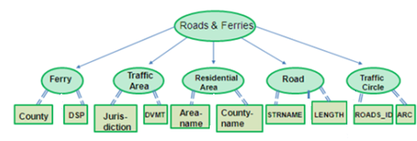
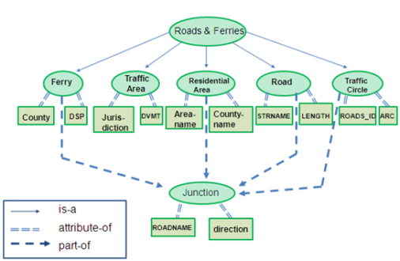
Information Integration
Defined as the merging of information from disparate sources
County
DSP
Kitsap
Kingston
Wahkiak
Puget Island
Oracle
RDF/OWL
RDF/OWL
SQL
COUNTYNAME
CID
TRAIL RANGE DR
96
KITSAP
97
Notes:
3

Slide 4
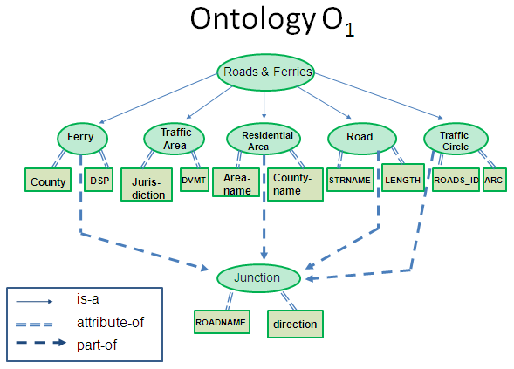
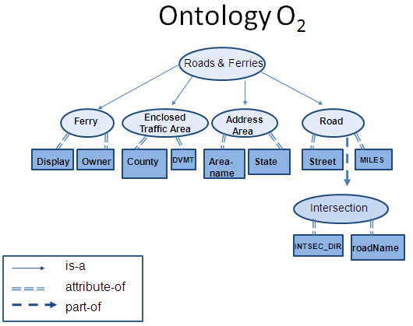
Scenarios
1
Identifying Points of Interest In Satellite Imagery
Image DB #1
Image DB #2
“Is the object in the imagery a cooling tower?”
Your Application
Yes/No/Maybe?
Gazetteer
Nuclear Plant Ontology
2
2
Determining semantic similarity between geographic data sources

Slide 5
Semantic Similarity Via Clustering
Data Source S₁
Data Source S₂
roadName | City
Johnson Rd. | Plano
School Dr. | Richardson
Zeppelin St. | Lakehurst
Alma Dr. | Richardson
Preston Rd. | Addison
Dallas Pkwy | Dallas
Road | County
Custer Pwy | Cooke
15th St. | Collin
Parker Rd. | Collin
Alma Dr. | Collin
Campbell Rd. | Denton
Harry Hines Blvd. | Dallas
Semantic Similarity Application
Plano
Collin Addison
School Dr.
Preston Rd. Zeppelin St. 15th St.
Custer Pwy
Parker Rd. Alma Dr.
Lakehurst
Denton

Slide 6
Instance-Based Semantic Similarity Approach
1
Select attribute pairs for comparison
roadName
roadType
city
rType
rName
town
county
2
Match instances between compared attributes
roadName
Run Sim algorithms…
rName
K Ave.
L Ave.
Jupiter Rd.
LBJ Freeway
Coit Rd.
US 75
3
Determine final attribute similarity
Sim = .98
roadName
rName

Slide 7
Instance-Based Geospatial Schema Matching Challenges
1
Not enough information is used to cluster the instances (only semantic, only geographic, but rarely both)
2
Inconsistent clusterings, leading to widely varying semantic similarity scores
3
Hierarchical relationships between instances often not accounted for

Slide 8
Not Enough Info Used For Clustering
Clustering Using Only Semantic Properties (i.e: Keyword Overlap)
County | City
Collin | PLANO
Collin | RICHARDSON
Cooke | LAKEHURST
Collin | RICHARDSON
Dallas Co. | ADDISON
Dallas Co. | DALLAS
PLANO
DALLAS
Collin
RICHARDSON
Dallas Co.
Clustering Using Only Geographic Properties (i.e: Geographic Type)
roadName
Johnson Rd.
School Dr.
Zeppelin St.
Alma Ln.
Preston Cir.
Dallas Pkwy
Johnson Rd.
Zeppelin St.
Preston Cir.
School Dr.
Alma Ln.
Dallas Pkwy

Slide 9
Inconsistent Clusterings

Slide 10
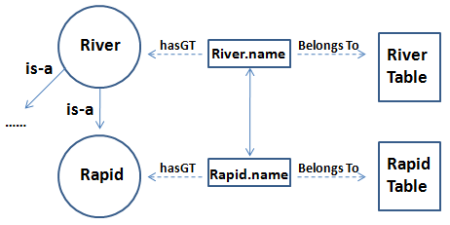
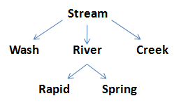
Hierarchical Relationships
Need to watch out for:
• Being overly specific in GT specification
• Being overly general in GT specification

Slide 11
Introducing GeoSim
Geospatial, clustering based schema matching solution for determining semantic similarity between two compared data sources
Handles both 1:1 attribute comparisons and 1:1 table comparisons
Uses both semantic and geographic properties of instances between compared attributes to produce a more effective clustering

Slide 12
Flow of Control for GeoSim

Slide 13
Determining Semantic Similarity
We use Entropy-Based Distribution (EBD)
EBD is a measurement of type similarity between 2 attributes (or columns):
EBD takes values in the range of [0,1] . Greater EBD corresponds to more similar type distributions between compared attributes (columns)
EBD = H(C|T) H(C)

Slide 14
Illustration of EBD
X
X
X
Z
Y
Y
att1
X
X
X
Y
Y
Z
att2
X
X
Y
Y
Y
Z
Z
Y
Y
X
Y
X
Entropy = H(C) =
Y
Y
Y
Z
Y
Z
Y
X
X
X
X
X
Conditional Entropy = H(C|T) = —
Notes:
Change x and X under conditional entropy equation to c and C; also, change y and Y to t and T

Slide 15
Details of Clustering in GeoSim
● GeoSim uses K-medoid clustering over the semantic and geographic types of instances between compared attributes
● K-means is not suitable because we cannot compute a centroid among string instances, so we use K-medoid clustering ● Use Normalized Google Distance (NGD) as a distance measure between any two keywords in a cluster
● WordNet would not be a suitable distance measure in the GIS domain

Slide 16
Definition of Google Distance
NGD(x, y) is a measure for the symmetric conditional probability of co-occurrence of x and y
Notes:
Add Google Distance citation here

Slide 17
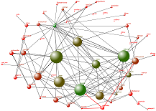
Semantic Clustering with NGD
roadName | City
Johnson Rd. | Plano
School Dr. | Richardson
Zeppelin St. | Lakehurst
Alma Dr. | Richardson
Preston Rd. | Addison
Dallas Pkwy | Dallas
Google Distance Calculation
Road | County
Custer Pwy | Cooke
15th St. | Collin
Parker Rd. | Collin
Mathias Cir. | Collin
Campbell Rd. | Denton
Harry Hines Blvd. | Dallas
S₁
S₂
Parker Rd.
15th St. Campbell Rd.
Johnson Rd.
Zeppelin St. Preston Rd. Mathias Cir.
School Dr.
Alma Dr. Harry Hines Blvd.
Dallas Pwy
Custer Pwy

Slide 18
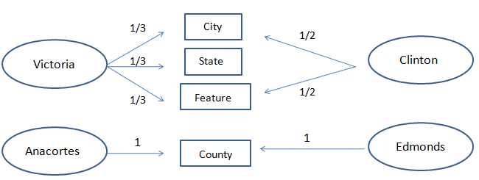
Geographic Clustering
We use a gazetteer to determine the geographic type (GT) of an instance
Instances of S₁
GTs
Instances of S₂
Anacortes
Victoria ?
Victoria ?
Edmonds
Clinton ?
Clinton ?
Victoria ?

Slide 19
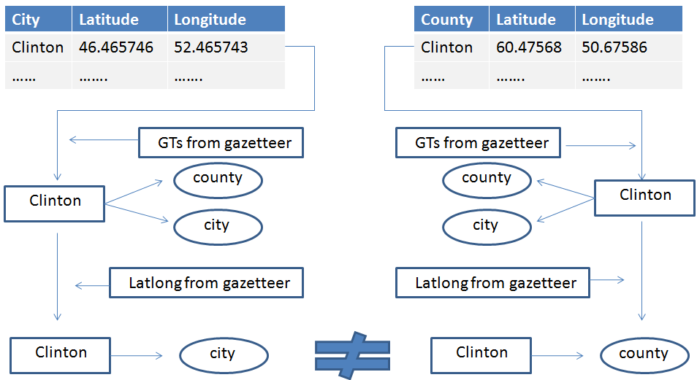
Using Latlong Value to Derive 1:1 Instance to GT Mappings
Notes:
Need a slide combining NGT + GT -- also, need to talk about how when comparing atts with GTs and NGTs, I create clusters for GTs and NGTs, I weigh them equally.

Slide 20
Geographic Clustering using GTs
roadName | City
Johnson Rd. | Plano
School Dr. | Richardson
Zeppelin St. | Lakehurst
Alma Dr. | Richardson
Preston Rd. | Addison
Dallas Pkwy | Dallas
Road | County
Custer Pwy | Cooke
15th St. | Collin
Parker Rd. | Collin
Mathias Cir. | Collin
Campbell Rd. | Denton
Harry Hines Blvd. | Dallas
Geonames Gazetteer
S₁
S₂
Johnson Rd.
Parker Rd. Preston Rd. Campbell Rd.
Zeppelin St.
15th St.
School Dr.
Alma Dr.
Dallas Pwy
Custer Pwy

Slide 21
Using Semantic and Geographic Properties (SSGS)
Coppell
Semantic Distance: Imp_{S}(C_{i}) = =
Dallas County
Collin County
Dallas
Cooke County
Richardson
Geographic Distance:
Coppell
Dallas County
Dallas
Collin County
Richardson
Cooke County
Objective Function to be Minimized (over all clusters): O_{SSGS} = where W_{i} =
Mohammad M. Masud, Jing Gao, Latifur Khan, Jiawei Han, Bhavani M. Thuraisingham: A Practical Approach to Classify Evolving Data Streams: Training with Limited Amount of Labeled Data. In: Gianotti, F. et al. (eds.) ICDM 2008, pp. 929--934. Computer Society Press (2008)
Notes:
We can replace W_{i}

Slide 22
Hierarchical Matching Over Instance GTs
● GeoSim includes a hierarchical matching component, GeoSim_{H}, that accounts for relationships between GTs of instances:
Stream
Wash
River
Creek
Rapid
Spring
Where EBD is the semantic similarity from GeoSim_{G}, W_{ebd} is its weighting factor, Sim_{struct} is the path length from one GT to another over all distinct GT pairings between the instances of the compared attributes, and W_{struct} is its weighting factor.

Slide 23
Measuring Path Length
● We use a variant of the Leacock-Chodorow (LDC) method, modified for the geospatial domain (LDC_{G})
● LDC relies on WordNet path length between concepts (len(c_{1,} c₂) above), as well as depth of WordNet hierarchy (D above)
● LDC_{G} relies on path length between concepts residing within the relevant geospatial ontology (c_{1,} c₂ ). D is the depth of this ontology.
=
* Z

Slide 24
Experimental Results
● We conducted 3 separate experiments comparing GeoSim against popular methods for computing semantic similarity ● Experiment #1 tested GeoSim_{G}‘s matching abilities over distinct heterogeneous data sources against 4 other methods used to calculate semantic similarity
● Experiment #2 tested GeoSim_{G}‘s ability to produce consistent similarity scores over a set of attribute comparisons versus the same 4 methods from Experiment #1 ● Experiment #3 tested GeoSim_{H}‘s hierarchical matching ability

Slide 25
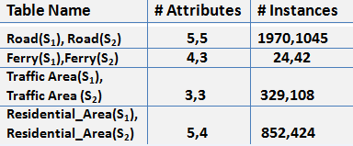
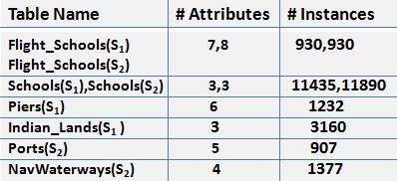
Dataset Details
GTD Dataset
GLD Dataset

Slide 26
Experiment #1 and Results
● This experiment compared GeoSim_{G} against popular methods for computing semantic similarity:
● Two heterogeneous data sources, GIS Transportation Dataset (GTD) and GIS Location Dataset(GLD) were compared at the attribute level for semantic matches
GeoSim_{G} outperformed the other methods as follows:
-N-grams: GTD(.83-.44), GLD(.79-.09) -SVD: GTD(.83-.13), GLD(.79-.17) -NMF: GTD(.83-.25), GLD(.79-.22) -GSim: GTD(.83-.71), GLD(.79-.68)
Notes:
GTD ground truth contains 29 correct attribute mappings; GLD contains 52

Slide 27
Experiment #2 and Results
● This experiment measured GeoSim_{G}‘s ability to generate consistent semantic similarity scores for each attribute comparison it discovered
● We averaged the variance in the precision and recall over all attribute comparisons after 50 trials runs
-N-grams: GTD(.10-.25 (P)|.06-.37 (R)), GLD(.08-.44(P) |.04-.06(R) ) -SVD: GTD(.10-.15 (P)|.06-.27 (R)), GLD(.08-.17(P) |.04-.20(R) ) -NMF: GTD(.10-.19 (P)|.06-.33 (R)), GLD(.08-.28(P) |.04-.22(R) ) -GSim: GTD(.10-.19 (P)|.06-.09 (R)), GLD(.08-.25(P) |.04-.11(R) )

Slide 28
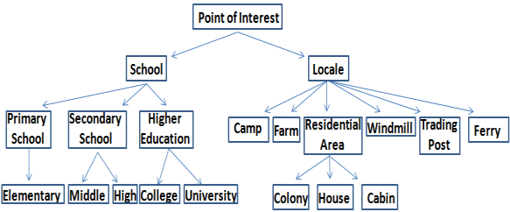
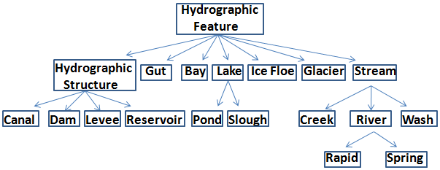
Experiment #3 POI and HYDRO Ontologies
POI Ontology
HYDRO Ontology
Notes:
Both ontologies’ instances were gleaned from GNIS (Geographic Names Information System) maintained by the USGS, and the ontologies were constructed by using the relationships between GTs found in the ADL gazetteer Ground truth for POI contained 32 correct attribute mappings, and the ground truth for HYDRO contained 27 correct attribute mappings

Slide 29
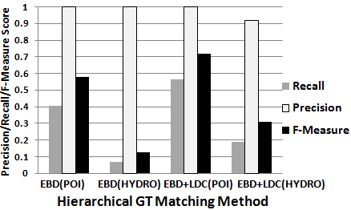
Experiment #3 Results
Comparison of F-measure scores over POI and HYDRO generated by GeoSim_{G} alone and GeoSim_{G} + GeoSim_{H}

Slide 30
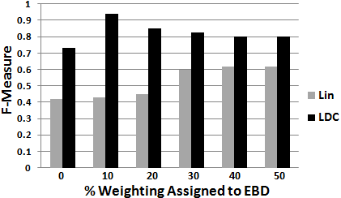
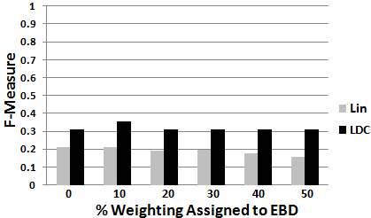
Experiment #3 Results(cont)
Comparison of F-measure scores generated by EBD+LDC and EBD + Lin over POI over 5 different weightings for W_{ebd}
Comparison of F-measure scores generated by EBD+LDC and EBD + Lin over HYDRO over 5 different weightings for W_{ebd}

Slide 31
Future Work
● Apply GeoSim to instance matching situations where many instances do not have a GT (GT discernment via EM?) ● Attempt to leverage the Geospatial Semantic Web to derive more accurate attribute matches (ie: discerning the GTs of geographically ambiguous instances, discovering a match template for this attribute pair, etc.) ● Multi-Attribute Matching (1:N matching)

Slide 32
THANK YOU! ANY QUESTIONS?

