Slide 1
PhishZoo: Detecting Phishing Websites By Looking at Them
Sadia Afroz
Rachel Greenstadt

Slide 2
The Phishing Problem
URL
Browser Indicator
SSL
Alice uses online bank
Real bank
Alice thinks everything that looks like her bank
Is her bank!
Fake bank
Notes:
Phishing is a web-based attack that uses social engineering techniques to exploit Internet users and acquire sensitive data. Most phishing attacks work by creating a fake version of the real site's web interface to gain the user's trust.

Slide 3
What is PhishZoo
Phishing
Site
?
Fake site
Real site

Slide 4
Overview
Motivation
Related works
Contribution
PhishZoo: Approach
Evaluation and results
Conclusion and future works

Slide 5
Motivation
Current state of phishing
According to the Anti-Phishing Working Group (APWG), there were at least 67, 677 phishing attacks in the last six months of 2010.

Slide 6
Importance of Appearance
90.9% people trusts a site based on it’s appearance
[Dhamija et al, 2006]
Spear Phishing
Increase use of spear phishing or targeted attacks
The majority of users provide sensitive credentials to a small set of sites (fewer than 20) [Cao et al, 2008]

Slide 7
Related works
Non-content based approaches:
URL based phishing detection [Ma et al, 2009]
Blacklisting
Whitelisting
Content based approaches:
CANTINA
Google’s anti-phishing filter
Visual similarity based phishing detection:
Screenshots of websites [Chen et al, 2009]
Screen capture with Earth Mover’s Distance [Fu et al, 2006]
Layout and style similarity [ Liu et al, 2006]
Optical character recognition of Screenshots of webpage [Dunlop et al, 2010]

Slide 8
Contribution
We investigated vision techniques to detect phishing sites more robustly.
It can detect new phishing sites which are not yet blacklisted and targeted attacks against small brokerages and corporate intranets..

Slide 9
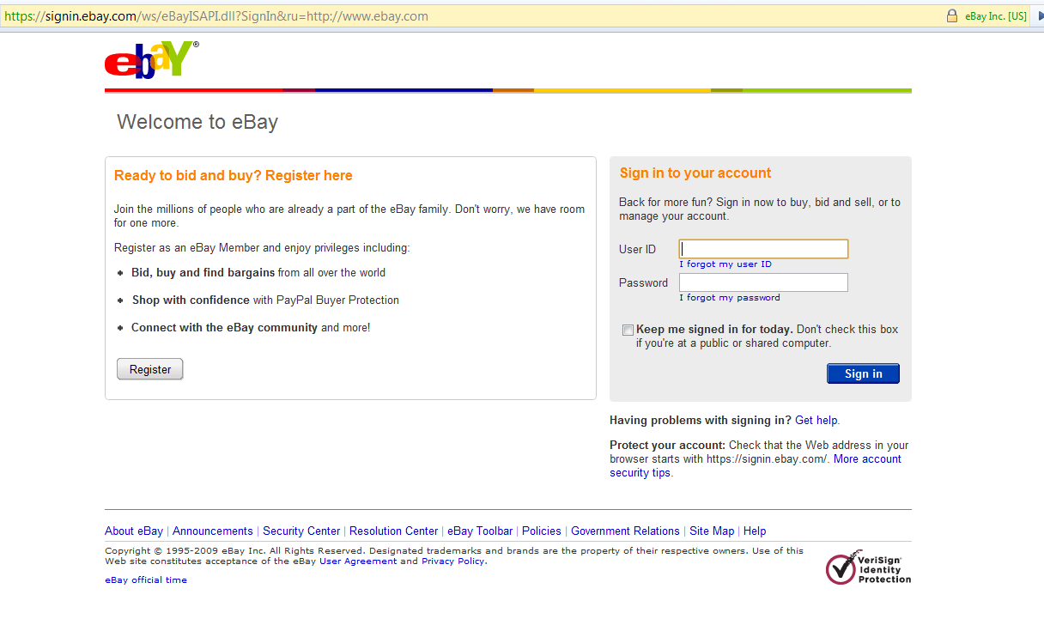
PhishZoo: Approach
Images
Visible text
Profile Stored
Extracts
visual elements
of the site
Real site
Visual components match but the url, ssl don’t match
Phishing
Alert
Images
Visible text
Extracts
visual elements
of the site
Fake site
Notes:
Profile Making
A profile of a site is a combination of different metrics that uniquely identifies that site
A user chooses real sites that he wants to protect from phishing to be saved as profiles.
Heuristic methods can be used to help verify a site’s authenticity at this stage.
In a profile, PhishZoo stores SSL certificates, URL and contents related to a site’s appearance such as HTML files, extracted features of the logo.
SIFT is used to extract image features.

Slide 10
PhishZoo: Site Profile
Profile Making
A profile of a site is a combination of different metrics that uniquely identifies that site
A user chooses real sites that he wants to protect from phishing to be saved as profiles.
In a profile, PhishZoo stores SSL certificates, URL and contents related to a site’s appearance such as HTML files, extracted features of the logo.
SIFT is used to extract image features.

Slide 11
PhishZoo: Image matching
Currently, only logo of a site is saved in the site profile.
For image matching, we used SIFT
SIFT extracts keypoints from an image
These keypoints are invariant to affine transformation, scaling, rotation upto 30 degrees, and illumination.
During matching, the keypoints of two images are matched.
Two images are considered similar if the percentage of matched keypoints is greater than a threshold

Slide 12
Data Collection
We used 20 stored sites.
For true positive testing: 1000 verified phishing sites from Phishtank.
For false positive testing: 200 most popular sites accessed by Internet users (taken from http://www.alexa.com/topsites).
Notes:
These sites are reported by users and verified as phishing by voting.

Slide 13
Evaluation and Results
Profile Content Analysis:
HTML
Visible text in HTML
Keywords : top TF-IDF ranked words of a site and url
Images
Images and visible text
Screenshots
Images and keywords

Slide 14
Results: Texts

Slide 15
Results: Images

Slide 16
Performance Analysis:
Keyword and image matching has better accuracy than other profile contents.
This recommended approach takes about 7 to 17 seconds on average to compare a site against all the profiles.

Slide 17
If matching found, then the site is phishing site
Perform
image matching
with the most
likely profile
Online profile
matching
Select most relevant profile
Site with most keyword match is the most relevant profile
Search for the
keywords in
current site
Select n keywords
From profiles
Fetch site
If any matching found, then site is phishing site
Perform
Image matching
with all profiles
in the background
Offline profile
matching

Slide 18
Limitations
Site redirection
No or obfuscated use of the keywords,
Use of cropped, extended or rotated (more than 30 degrees) images
Real logo
Fake logo

Slide 19
Conclusion and Future work
We described a new approach of web-phishing detection using vision techniques.
Use a faster image machine algorithm
Scene analysis

Slide 20
References
R. Dhamija, J. D. Tygar, and M. Hearst, “Why phishing works,” in CHI ’06: Proceedings of the SIGCHI conference on Human factors in computing systems, 2006.
Y. Cao, W. Han, and Y. Le, “Anti-phishing based on automated individual white-list,” in DIM ’08: Proceedings of the 4th ACM workshop on Digital identity management. New York, NY, USA: ACM, 2008, pp.51–60.
S. Egelman, L. Cranor, and J. Hong, “You’ve been warned: An empirical study of the effectiveness of web browser phishing warnings.” in CHI ’08: Proceedings of the twenty-sixth annual SIGCHI conference on Human factors in computing systems, 2008

