Slide 1
Multiresolution Semantic Visualization of Network Traffic
Update kbase
Create Models
Discover Patterns
Alefiya Hussain, Arun Viswanathan
USC/Information Sciences Institute
Notes:
1
1

Slide 2
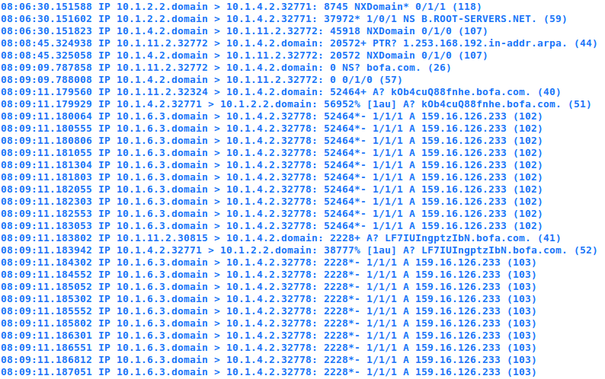
Goal: Understand behavior in large volume and variety network traffic
Need:
1. Associate meaning to the data;
2. Save discoveries and build upon them
Approach: create models in a kbase, systematically explore complex and subtle spatial and temporal patterns

Slide 3
Semantically Rich
Semantically Devoid

Slide 4
Visualization System
Labels all instances of the pattern in the data; creates abstract events to drive next iteration of visual analysis
III: Update kbase
Generate Viz
II: Create Models
I: Discover Patterns
Expressive logic-based abstract
model captures the relationship between the events
Use visualization to find a pattern: an ordered sequence of events

Slide 5
I: Discover a Pattern
Sense-making loop
Example
Attack: A large stream of packets sent from a node in the network
Behavior Model
Attack
Match
Represents
Symbol
10.1.11.2
Meaning
Attacker
Associate

Slide 6
II: Create Models
Model
Attack
State: Sequence of events
10.1.11.2
Attacker
State 1
State 1
State n
A model is an abstract representation of pattern
in the data
State 1
State 2
Behavior: sequence of states related by causal relationships
Model:
Collection of behaviors
State 3
State 4
State 6
State 5
Behavior
1
Behavior
2
Arun Viswanathan, Alefiya Hussain, Jelena Mirkovic, Stephen Schwab, John Wroclawski, “A Semantic Analysis Framework for Data Analysis of Networked Systems”, USENIX NSDI, April 2011

Slide 7
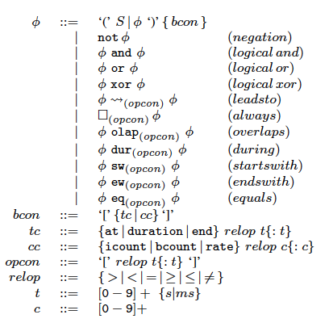
Causal Relationships
Model
Attack
10.1.11.2
Attacker
Logical
Operators
Temporal
Operators
Constraints
Express rich patterns within data:
- ordering
- dependence
- concurrency

Slide 8
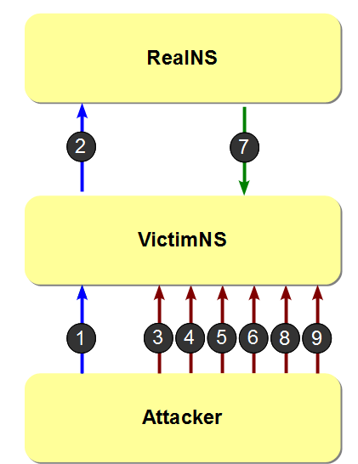
III: Generate Visualization
Model
Attack
10.1.11.2
Attacker
Webserver
Victim
With Behavior Models
Roles and Relationships are identified
Packets are visually encoded to highlight relationships
Attacker

Slide 9
Goal: Understand behavior in large volume and variety network traffic
Need:
1. Associate meaning to the data;
2. Save discoveries and build upon them
Approach: visualize with create models in a kbase, systematically explore complex and subtle spatial and temporal patterns

Slide 10
Large Network: Scale, Volume, Variety

Slide 11
Interactive Exploration
Spatial Reduction
highly connected networks
significant amount of redundancy in semantically relevant relationships
Connectivity profiles to summarize nodes
Temporal Reduction
useful to observe trends or change patterns in network data
aggregating groups of events based on time.
Behavior-based clustering to summarize events

Slide 12
Spatial Reduction
Connectivity profiles based on locality
Connectivity profiles based on behavior
Resolution
High
Low
+
Subnet
+
Reflectors

Slide 13
Temporal Reductions
Behavior based clustering
Example: Visualization of HTTP Connections
Resolution
Low:
webpage
Medium:
objects
High:
packets
Maaria’s Homepage
Advertisement
1. [header]
2. NAMESPACE = NET.ATTACKS
3. NAME = DNSKAMINSKY
4. QUALIFIER = {eventtype='PACKET_DNS'}
5. IMPORT = NET.APP_PROTO.DNSREQRES
6. [states]
8. AtoV_query = DNSREQRES.dns_req()
10. VtoR_query= DNSREQRES.dns_req(sipaddr=$AtoV_query.dipaddr,
dnsquesname=$AtoV_query.dnsquesname)
12.RtoV_resp = DNSREQRES.dns_res($ dnsauth=fakens.fake.com)
14.AtoV_resp = DNSREQRES.dns_res($VtoR_query,
dnsauth=realns.eby.com) [limit=*]
16.AtoV_noresp = DNSREQRES.dns_res($VtoR_query, dnsid != $VtoR_query.dnsid) [limit=*] 8.[behavior] 19.initial_query = (AtoV_query ~> VtoR_query)
20.b_1 = initial_query~>RtoV_resp ~> (AtoV_resp | AtoV_noresp) 21.b_2 = initial_query ~> AtoV_noresp ~> RtoV_resp
22.b_3 = initial_query ~> AtoV_resp ~> RtoV_resp
20.b_1 = initial_query~>RtoV_resp ~> (AtoV_resp |
Images
1. [header]
2. NAMESPACE = NET.ATTACKS
3. NAME = DNSKAMINSKY
4. QUALIFIER = {eventtype='PACKET_DNS'}
5. IMPORT = NET.APP_PROTO.DNSREQRES
6. [states]
8. AtoV_query = DNSREQRES.dns_req()
10. VtoR_query= DNSREQRES.dns_req(sipaddr=$AtoV_query.dipaddr,
dnsquesname=$AtoV_query.dnsquesname)
12.RtoV_resp = DNSREQRES.dns_res($ dnsauth=fakens.fake.com)
14.AtoV_resp = DNSREQRES.dns_res($VtoR_query,
dnsauth=realns.eby.com) [limit=*]
16.AtoV_noresp = DNSREQRES.dns_res($VtoR_query, dnsid != $VtoR_query.dnsid) [limit=*] 8.[behavior] 19.initial_query = (AtoV_query ~> VtoR_query)
20.b_1 = initial_query~>RtoV_resp ~> (AtoV_resp | AtoV_noresp) 21.b_2 = initial_query ~> AtoV_noresp ~> RtoV_resp
22.b_3 = initial_query ~> AtoV_resp ~> RtoV_resp
1. [header]
2. NAMESPACE = NET.ATTACKS
3. NAME = DNSKAMINSKY
4. QUALIFIER = {eventtype='PACKET_DNS'}
5. IMPORT = NET.APP_PROTO.DNSREQRES
6. [states]
8. AtoV_query = DNSREQRES.dns_req()
10. VtoR_query= DNSREQRES.dns_req(sipaddr=$AtoV_query.dipaddr,
dnsquesname=$AtoV_query.dnsquesname)
12.RtoV_resp = DNSREQRES.dns_res($ dnsauth=fakens.fake.com)
14.AtoV_resp = DNSREQRES.dns_res($VtoR_query,
dnsauth=realns.eby.com) [limit=*]
16.AtoV_noresp = DNSREQRES.dns_res($VtoR_query, dnsid != $VtoR_query.dnsid) [limit=*] 8.[behavior] 19.initial_query = (AtoV_query ~> VtoR_query)
20.b_1 = initial_query~>RtoV_resp ~> (AtoV_resp | AtoV_noresp) 21.b_2 = initial_query ~> AtoV_noresp ~> RtoV_resp
22.b_3 = initial_query ~> AtoV_resp ~> RtoV_resp
Text

Slide 14
Challenges
Spatio-temporal reductions
Simultaneous exploration of spatial and temporal behaviors
Algorithms for clustering
Knowledge representation and data mining techniques
Performance and Scale
Multi-type, multivariate, time-ordered data

Slide 15
Future Work
Developing a prototype for network data set exploration and demonstration
Interactive and iterative
Enrich the kw-base to include a large range of frequently seen patterns
Thank you

