Slide 1
Utilizing Video Ontology for Fast and Accurate Query-by-Example Retrieval
Kimiaki Shirahama
Graduate School of Economics, Kobe University
Kuniaki Uehara
Graduate School of System Informatics, Kobe University
Notes:
Hi, I’m Kimiaki Shirahama at Kobe University in Japan. I will present our research, utilizing video ontology for fast and accurate query-by-example retrieval.

Slide 2
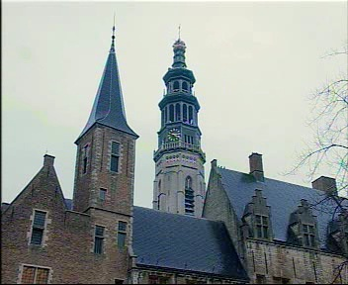
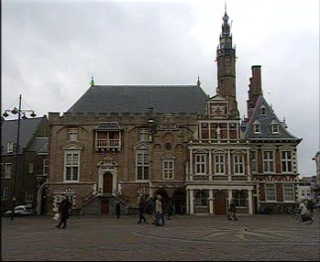
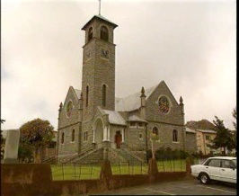
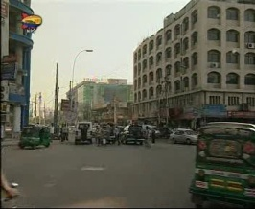
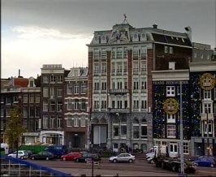
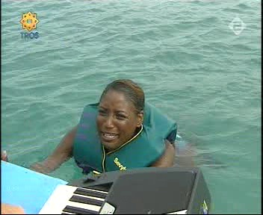
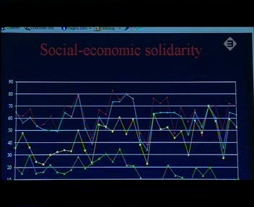
Need for Video Ontology
QBE (Query by Example):
Represent a query by providing example shots
Retrieve shots similar to example shots in terms of features
Query: Tall buildings are shown
(Example shots)
(Retrieved shots)
Relevant
Irrelevant
Characterized by few edges corresponding to sky regions (Overfitting)
The similarity on features does not agree with the similarity on semantic contents!
Notes:
First of all, there is a great demand to develop a video retrieval method for efficiently retrieving interesting shots from a large number of videos. Especially, in this research, we focus on query by example (QBE) approach. In QBE, a query is firstly represented by providing example shots. Then, QBE retrieves shots similar to example shots in terms of features. However, as can be seen from these retrieved shots, several irrelevant shots are inevitably retrieved. The reason for this is that the similarity on features …. In this case, these shots are similar to these example shots, because these are characterized by few edges corresponding to sky regions in these examples shots. In this research, in order to alleviate retrieving irrelevant shots to a query,

Slide 3
Our Use of Video Ontology
Construct a video ontology as knowledge base in QBE
(Formal and explicit specification of concepts, concept properties and their relations)
→ Filter shots that are clearly irrelevant to the query
Query: Tall buildings are shown
Retained
(Example shots)
Building: 0.9
Urban: 0.6
Person: 0
Building: 0.8
Urban: 0.9
Person: 0.2
Building: 0.9
Urban: 0.7
Person: 0.1
Building: 0.9
Urban: 0.7
Person: 0.1
Building: 0.8
Urban: 0.8
Person: 0
Filtered
Concept detection scores are
already assigned to all shots.
Building: 0.1
Urban: 0.0
Person: 0.8
Building: 0.0
Urban: 0.0
Person: 0.1
Building: 0.0
Urban: 0.1
Person: 0
Notes:
We construct a video ontology as knowledge base in QBE. To be precise, the video ontology is a formal and explicit specification of concepts, concept properties and their relations. As concepts, we consider semantic contents in a shot, such Person, Car, Building, and so on. Using the video ontology, we aim to filter shots. They are clearly irrelevant to the query. At this point, we assume that concept detection scores are already assigned to all shots using pre-defined classifiers. Each detection score represents the presence or absence of a concept. For example, since these shots have high detection scores for building, it is likely that buildings are shown in these shots. On the other hand, it is unlikely that buildings are shown in these shots, because of their low detection scores. Based on these concept detection scores, if we know that building and urban are important for this query, we can filter these shots because of their low detection scores.

Slide 4
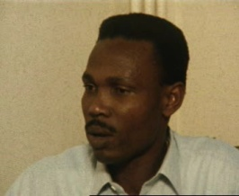
Overview of Our Approach
Query: Buildings are shown
Shot filtering
Concept vocabulary
Video ontology
Retained
Building
Building
Outdoor
Concept selection:
Buildings, Outdoor,
Tower, etc.
Outdoor
House
Window
Tower
Window
Filtered
Tower
House
Video ontology construction: Organize concepts into a meaningful structure
Concept selection: Select concepts related to a given query
Shot filtering: Filter irrelevant shots based on selected concepts
Filter as many irrelevant shots as possible
Retain as many relevant shots as possible
Notes:
To implement this idea, we need to solve these tasks. First, in order to determine which concepts are related to a query, we need to organize a set of concepts into a meaningful structure, that is, video ontology. Second, we need to develop a method. It selects concepts related to a query based on the video ontology. Finally, we need to develop a method. It filters irrelevant shots to the query based on detection results of selected concepts. For this method, we consider how to filter as many irrelevant shots as possible and how to retain as many relevant shots as possible. First, we explain the construction of our video ontology.

Slide 5
Large-Scale Concept Ontology for Multimedia (LSCOM)
The most popular ontology for video retrieval
1,000 concepts in broadcast news video domain
Broadcast_News
Program
Location
People
Objects
Activity and
events
Graphics
Weather
Office
Crowd
Bus
Maps
People related
Sports
Meeting
Face
Vehicle
Charts
Walk/Run
Many research effort to develop effective detection methods for LSCOM concepts
→ Use detection scores of 374 concepts provided by City University of Hong Kong
Concept properties and relations are clearly insufficient!
→ Organize LSCOM concepts into a meaningful structure!
Notes:
We organize concepts defined in Large-Scale Concept Ontology for Multimedia (LSCOM). Currently, LSCOM is the most popular ontology for video retrieval. It defines 1,000 concepts in broadcast news video domain. This shows a part of LSCOM. Many research effort has been devoted to develop effective detection methods for these LSCOM concepts. In this research, we use detection scores of 374 concepts provided by City University of Hong Kong. However, in LSCOM, concept properties and relations are clearly insufficient. For example, from this figure, we can not know that Bus is a kind of Vehicle, and Walk/Run is a kind of People’s action. Thus, we organize LSCOM concepts into a meaningful structure.

Slide 6
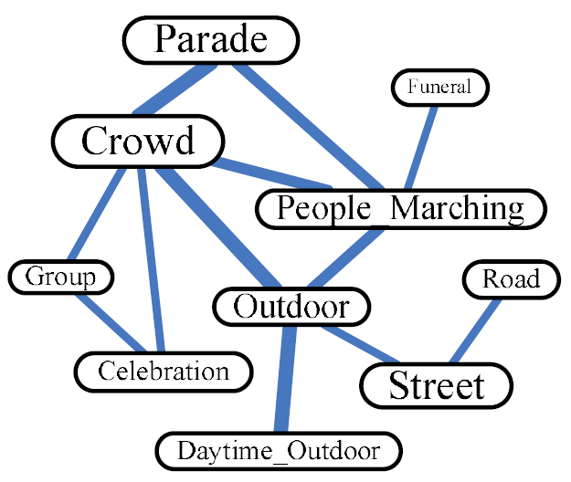
Concept Organization Approach
Inductive approach
Use annotated video collection (training data)
Only degrees of relatedness are represented
Deductive approach (our approach)
Manually organize LSCOM concepts
Various properties and relations are represented
(Wei, 2011)
OBJECT
Vehicle
CONSTRUCTION
locatedAt
Ground_Vehicle
Outdoor
WITH_PERSON
Car
Building
appearWith
partOf
Person
Window
Bicycle
Motorcycle
Tower
House
Limited kinds of reasoning
(e.g. majority voting, linear combination)
Various kinds of reasoning!
Notes:
Regarding how to organize LSCOM concepts, many methods have been proposed. They extract concept relations using annotated video collection. In this sense, these can be considered as an inductive approach. However, this approach can only extract degrees of relatedness among concepts. For example, from this graph, we can only know that crowd is highly related to parade, while its relation to road is not so high. Relying on such degrees of relatedness, we can only conduct limited kinds of reasoning, such as majority voting and linear combination. On the other hand, in this research, we adopt a deductive approach. There, we manually organize LSCOM concepts based on design patterns of general ontologies. As shown in this figure, we can define various concept properties and relations. Based on these, we can conduct various kinds of reasoning. They will be explained later.

Slide 7
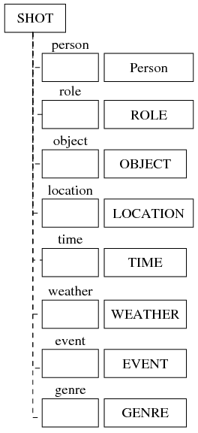
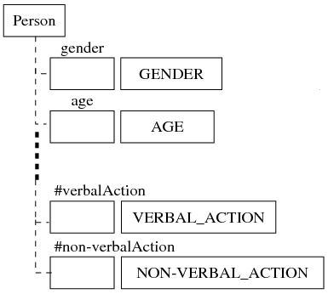
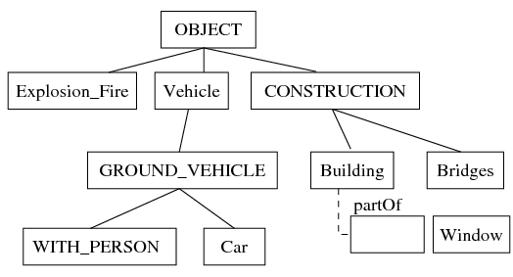
Our Video Ontology
Shot with 8 attributes (categories of semantic contents)
Define new concepts to construct a meaningful structure
Disjoint partition
Visual co-occurrence
Notes:
This shows an overview of our video ontology. First, we define a shot using 8 attributes. Each attribute represents a category of semantic contents. And, for each category, we construct this kind of concept hierarchy. It should be noted that only using LSCOM concepts is insufficient for constructing a meaningful structure. So, we define new concepts. They are represented only using captial letters. For the construction of each concept hierarchy, we mainly focus on these two points.

Slide 8
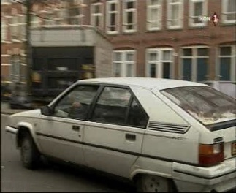
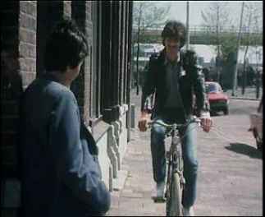
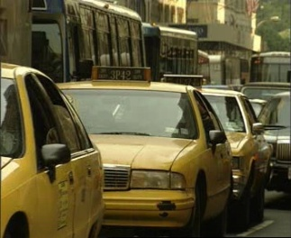
Video Ontology Construction
1. Disjoint partition
Vehicle
Vehicle
Ground_Vehicle
Car
Ground_Vehicle
Car
Bus
Cannot be an instance of more
than one subconcept!
All concepts should not be organized
into a single hierarchy
2. Visual co-occurrence
Some concepts are frequently shown
in the same shots
Ground_Vehicle
WITH_PERSON
Car
appearWith
Person
Bicycle
Motorcycle
Notes:
The first one is the disjoint partition. It is a well-known ontology design pattern to make the ontology easily understandable by both human and computer. The disjoint partition means that an instance of a concept cannot be an instance of more than one subconcept. So, we should not divide Vehicle into Ground_Vehicle and Car, because an instance of Car is also an instance of Ground_Vehicle. Instead, Car should be defined as a subconcept of Ground_Vehicle. In this way, to satisfy the disjoint partition, we carefully examine whether a concept is a generalization or specialization of another concept. In addition, to consistently examine generalization/specialization relations, we classify concepts into these 8 categories and construct a concept hierarchy for each category.
The second point is the visual co-occurrence. This means that some concepts are frequently shown in the same shots. For example, Person probably appears in shots where Bicycle is shown, like this. On the other hand, it is uncertain that Person appears in shots where Car is shown, like this. Considering this visual co-occurrence, we define WITH_PERSON as a subconcept of Ground_Vehicle. And, we define these concepts as subconcepts of WITH_PERSON.

Slide 9
Overview of Our Approach
Query: Buildings are shown
Shot filtering
Concept vocabulary
Video ontology
Retained
Building
Building
Outdoor
Concept selection:
Buildings, Outdoor,
Tower, etc.
Outdoor
House
Window
Tower
Window
Filtered
Tower
House
Video ontology construction: Organize concepts into a meaningful structure
Concept selection: Select concepts related to a given query
Shot filtering:
Filter as many irrelevant shots as possible
Retain as many relevant shots as possible
Notes:
Next, assuming that the video ontology is already constructed, we explain a method. It selects concepts related to a given query.

Slide 10
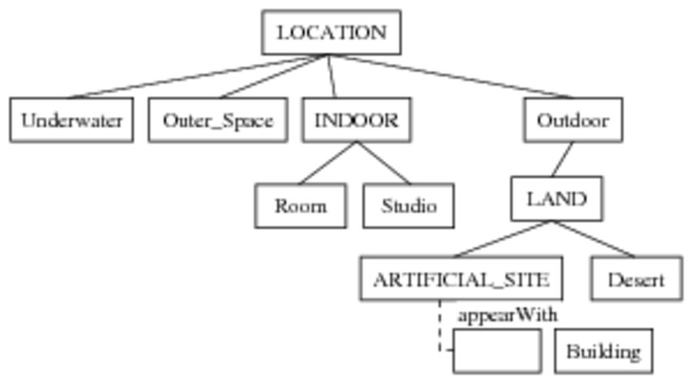
Concept Selection
Select concepts matching words in the text description of a query
Select their subconcepts, and concepts specified as properties
Select concepts with properties matching words in the text description of the query
Query: Buildings are shown
4. Validate selected concepts using example shots
→ Concepts detected with high detection scores are selected
Notes:
First, we select concepts matching words in the text description of a query. So, for this query, Building is first selected. Then, we select subconcepts of each concept selected at the first process. For this query, subconcepts of Building such as House, Factory, Tower and so on are selected. In addition, we select concepts. They are specified as properties of concepts selected in the first process. For this query, Window is selected since it is specified as the property of Building. Furthermore, we also select concepts. They have properties matching words in the text description of the query. For this query, Artificial_Site and its subconcepts such as Urban, Suburban, Cityspace, are selected because Building is specified as the property of Artificial_Site.
It should be noted that these three processes select concepts. They have possibility of being related to the query. So, many unrelated concepts are inevitably selected. For example, although these shots are provided as example shots for this query, Ruin, Military_Base, White_House and so on are selected. They are clearly unrelated to the query. Thus, we validate selected concepts using example shots. Specifically, we select concepts. They are detected in example shots with high detection scores.

Slide 11
Overview of Our Approach
Query: Buildings are shown
Shot filtering
Concept vocabulary
Video ontology
Retained
Building
Building
Outdoor
Concept selection:
Buildings, Outdoor,
Tower, etc.
Outdoor
House
Window
Tower
Window
Filtered
Tower
House
Video ontology construction: Organize concepts into a meaningful structure
Concept selection: Select concepts related to a given query
Shot filtering:
Filter as many irrelevant shots as possible
Retain as many relevant shots as possible
Notes:
Next, we explain a method. It filters irrelevant shots to a query based on selected concepts. First, we present how to filter many irrelevant shots using concept relations.

Slide 12
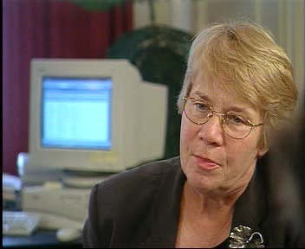
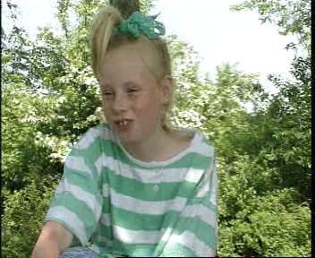
Shot Filtering Using Concept Relations
Simple filtering: Filter shots if none of
selected concepts are detected.
Query: Person appears with computers
Person, Female_Person
Computer,
Room, Laboratory
Indoor object
Indoor locations
(Wrongly retained shot)
Shots where Outdoor is
detected should be filtered!
Use concept relations to efficiently filter irrelevant shots
Notes:
Simply using selected concepts is not effective. Let us consider that these concepts are selected for this query. And, suppose that shots are filtered if none of selected concepts are detected. Although this filtering retains this kind of relevant shots, it wrongly retains many irrelevant shots like this. In order to efficiently filter irrelevant shots, we use concept relations. For example, in our video ontology, computer is defined as an indoor object, and room and laboratory are defined as indoor locations. Thus, we can infer that relevant shots to this query show indoor locations, and filter this kind of shots where Outdoor is detected. We theoretically present how to filter this kind of irrelevant shots using concept relations defined in our video ontology.

Slide 13
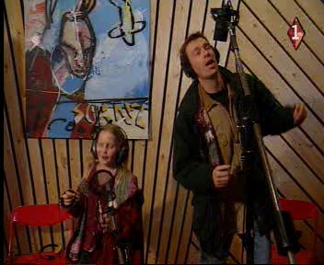
Use of Concept Relations
Hierarchical relations
Query: Buildings are shown
Building
THEN should be detected,
Office_Building is
wrongly detected
Office_Building
IF detected,
Sibling relations (Disjoint partition)
Query: Person appears with computers
→ INDOOR needs to be detected
LOCATION
Outer_Space
Underwater
Outdoor
INDOOR
Should not be detected
Notes:
Our shot filtering method uses these two functions. The first one is hierarchical relations among concepts. The motivation behind this is erroneous concept detection results. For example, Office_Building is wrongly detected for this shot. So it is retained for this query. To filter such irrelevant shots, we use the rule that if a concept is detected, its superconcept should be detected. In this example, if Office_Building is detected in a shot, its superconcept Building should be detected. Otherwirse, we regard that Office_Building is not detected in the shot.
The second function uses sibling relations among concepts. This is based on the fact that our video ontology is constructed based on the disjoint partition. It does not allow that a shot is an instance of more than one concepts at the same level of hierarchy. For example, if INDOOR is detected in a shot, these concepts should not be detected. Thus, we use the rule that a shot is filtered if a sibling concept for a selected concept is detected in the shot.
However, although these functions are theoretically effective, in an actual case, they does not work well due to erroneous concept detection results. In other words, we can filter many irrelevant shots. But, several relevant shots are wrongly filtered, because detected concepts do not necessarily satisfy these rules.

Slide 14
Overview of Our Approach
Query: Buildings are shown
Shot filtering
Concept vocabulary
Video ontology
Retained
Building
Building
Outdoor
Concept selection:
Buildings, Outdoor,
Tower, etc.
Outdoor
House
Window
Tower
Window
Filtered
Tower
House
Video ontology construction: Organize concepts into a meaningful structure
Concept selection: Select concepts related to a given query
Shot filtering:
Filter as many irrelevant shots as possible
Retain as many relevant shots as possible
Notes:
Thus, in addition to these functions, we devise a function for retaining as many relevant shots as possible.

Slide 15
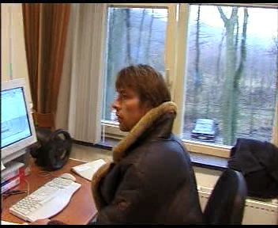
Uncertainty in Concept Detection
Ontologies present a priori knowledge which is taken as true by human.
→ Lack the support for uncertainty
Traditional ontology reasoning assumes … (Russell, 2003)
Locality: If A⇒B, then B is concluded by A without considering any other rules.
Detachment: Once B is proven, it is used regardless of how it was derived.
→ Do not consider the uncertainty of a hypothesis
Truth functionality: A complex rule can be examined from the truth of its components.
→ Does not consider the uncertainty of combining multiple hypotheses
Query: Person appears with computers → INDOOR needs to be detected
Indoor fails to be detected
How to manage erroneous concept detection results?
Notes:
Generally, ontologies present a priori knowledge. It is taken as true by human. So, ontologies lack the support for uncertainty. Specifically, traditional ontology reasoning assumes the following three issues. Informally, these two assumptions do not consider the uncertainty of a hypothesis. And, this assumption does not consider the uncertainty of combining multiple hypotheses. In other words, this requires all of composite hypotheses should be true. However, these assumptions cannot be applicable for uncertain or imprecise hypotheses, in our case, erroneous concept detection results. For example, although this shot is clearly relevant to the query, INDOOR fails to be detected in the shot, so this shot is wrongly filtered. Thus, we have to consider how to manage such erroneous concept detection results.

Slide 16
Dempster-Shafer Theory (1/2)
Demspter-Shafer Theory (DST):
Generalization of Bayesian theory where the probability of a hypothesis is
defined based on its degree of belief
Locality: If A⇒B, then B is concluded by A without considering any other rules.
Detachment: Once B is proven, it is used regardless of how it was derived.
→ Do not consider the uncertainty of a hypothesis
⇒ Represent the degree of belief of a hypothesis
Query: Person appears with computers → INDOOR needs to be detected
Degree of belief that a shot is certainly relevant
m({relevance}) = 0.2
Degree of belief that its relevance is uncertain
m({relevance, irrelevance}) = 0.6
Degree of belief that it is certainly irrelevant
m({irrelevance}) = 0.2
Notes:
To this end, we use Dempster-Shafer Theory (DST). It is a generalization of Bayesian theory. There, the probability of a hypothesis is defined based on its degree of belief. Thus, for the violation for these assumptions, DST represents the degree of belief of a hypothesis. Let us consider that although INDOOR fails to be detected in this shot, other related concepts such as Person and Computer are detected. In this case, DST provides 0.2 as the degree of belief that this shot is certainly relevant to this query. Similarly, DST provides 0.2 as the degree of belief that this shot is irrelevant. Furthermore, most importantly, DST provides 0.6 as the degree of belief that the relevance of this shot is unknown. It should be noted that we obtain these probabilities by referring to a manually-constructed lookup table. It is one of important future works to automatically extract a lookup table using annotated shots.

Slide 17
Dempster-Shafer Theory (2/2)
3. Truth functionality: A complex rule can be examined from the truth of its components.
→ Does not consider the uncertainty of combining multiple hypotheses
⇒ Combination rule for integrating uncertain hypotheses
Agreement
Conflict
Query: Persons appear with computers → INDOOR needs to be detected
Filtering by video ontology
m({relevance}) = 0.2
m({relevance, irrelevance}) = 0.6
m({irrelevance}) = 0.2
Filtering by visual –based approach
m({relevance}) = 0.7
m({relevance, irrelevance}) = 0.2
m({irrelevance}) = 0.1
jm({relevant}) = 0.71
Notes:
For the violation for this assumption, DST provides the combination rule for integrating uncertain multiple hypotheses. We need multiple shot filtering results to use this combination rule. In other words, we need multiple shot filtering results to disambiguate the uncertainty of deciding the relevance of a shot to the query. So, in addition to shot filtering using concepts selected by our video ontology, we conduct shot filtering using concepts selected by a visual-based approach. It selects concepts. They are detected in example shots with high detection scores. This equation is used to integrate these shot filtering results. Specifically, this part represents the agreement of two shot filtering results, while this part represents their conflict. Thus, when both of these shot filtering results indicate that the shot is relevant, the final probabilistic output jm becomes large. In this example, jm is computed as 0.71, so this shot is retained.

Slide 18
Experimental Setting
TRECVID 2009 video data
219 development videos (36,106 shots)
→ Manually select 10 example shots for each query
619 test videos (97,150 shots)
→ Retrieve shots matching the query
Target Queries
Query 1: A view of one or more tall buildings and the top story visible
Query 2: One or more people, each at a table or desk with a computer visible
Query 3: One or more people, each sitting in a char, talking
Evaluation measures
Precision: The fraction of retained shots that are relevant to a query.
Recall: The fraction of relevant shots that are successfully retained.
Filter recall: The fraction of irrelevant shots that are successfully filtered.
Retrieval performance: The number of relevant shots within 1,000 retrieved shots
Retrieval method: (Shirahama, 2011)
Notes:
We test our method using TRECVID 2009 video data. It consists of these development videos and these test videos. For each of these three queries, we select 10 example shots from development videos and examine whether each shot in test videos is relevant or irrelevant to the query. In order to evaluate shot filtering results, we use these four evaluation measures. Precision represents the fraction of retained shots that are relevant to a query, while Recall represents the fraction of relevant shots that are successfully retained. In addition, filter recall represents the fraction of irrelevant shots that are successfully filtered. Finally, in order to evaluate the effectiveness of shot filtering on video retrieval, we evaluate the retrieval performance as the number of relevant shots within 1,000 retrieved shots.

Slide 19
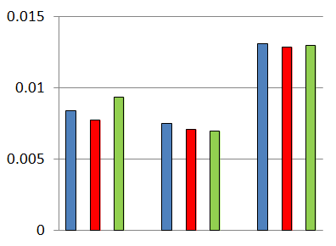
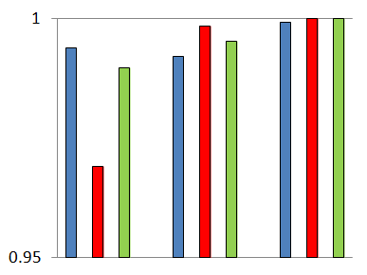
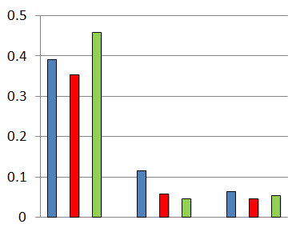
Importance of Concept Selection
Onto
WordNet
Visual
Filter shots if none of selected concepts are detected
(a) Precision
(b) Recall
(c) Filter recall
Query 1
Query 2
Query 3
Query 1
Query 2
Query 3
Query 1
Query 2
Query 3
Shot filtering does not heavily rely on concept selection methods.
(Selected concepts are similar to each other)
Examine the importance of using concept relations for shot filtering
Notes:
In this experiment, we examine the importance of concept selection for shot filtering. To this end, we compare shot filtering using concepts selected by our video ontology, to shot filtering using concepts selected by WordNet and visual-based approach. In WordNet, we manually associate WordNet synsets to LSCOM concepts. Based on this, we select concepts related to a query by expanding words in its text description based on WordNet hypernyms, hyponyms and meronyms. In visual-based approach, we select concepts. They are detected in example shots with high detection scores. In addition, in order to focus on concept selection process, all of these methods filter shots by the same rule that shots are filtered if none of selected concepts are detected. That is, no concept relations and Demspter-Shafer theory are used in this method.
These graphs show the performance comparison among these shot filtering methods. We can see that these methods are comparable. That is, shot filtering does not heavily rely on concept selection methods. This is because concepts selected by these methods are similar to each other. But, different from these methods, our video ontology defines concept relations. So, in the next experiment, using this shot filtering result as a baseline, we examine the importance of using concept relations.

Slide 20
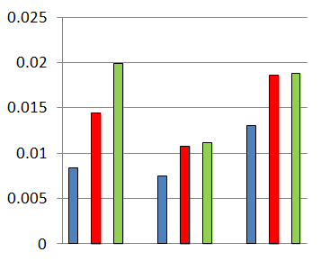
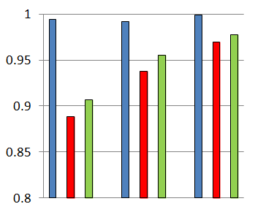
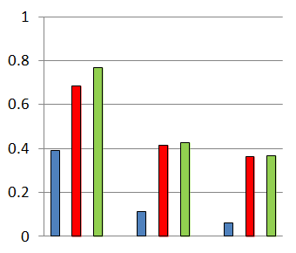
Effectiveness of Using Concept Relations and DST
Onto (base)
No-DST
DST
(a) Precision
(b) Recall
(c) Filter recall
Query 1
Query 2
Query 3
Query 1
Query 2
Query 3
Query 1
Query 2
Query 3
Onto: Many irrelevant shots are wrongly retained (Filter recall)
No-DST: Precision is significantly improved, but recall is degraded
DST: Recall is recovered while improving precision and filter recall
Best!
Concept relations and DST are useful to achieve shot filtering, which not
only filters many irrelevant shots, but also retains many relevant shots.
Notes:
Specifically, we aim to examine the effectiveness of using concept relations and demspter-shafer theory (DST). So, we compare this baseline shot filtering to shot filtering using concept relations and shot filtering using both concept relations and DST. These graphs show the performance comparison among these methods. As can be seen from the graph of filter recall, in the baseline, many irrelevant shots are wrongly retained. Compared to this, using concept relations and using both concept relations and DST significantly improve fitter recall. Corresponding to this, precision is significantly improved. But, as can be seen from this graph, only using concept relations wrongly filter several relevant shots. And, by adding DST to this method, recall is recovered. These graphs indicate the effectiveness of using concept relations and DST.

Slide 21
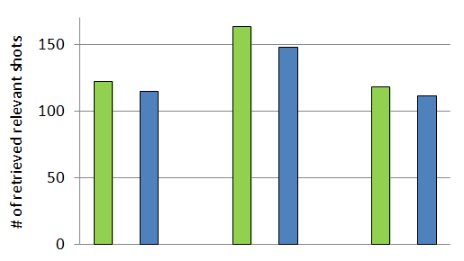
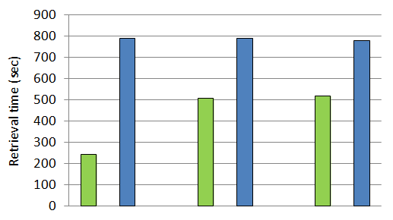
Retrieval Performance and Time
Using shot filtering
Without using shot filtering
(a) Retrieval performance
(b) Retrieval time
Query 1
Query 2
Query 3
Query 1
Query 2
Query 3
Shot filtering by our video ontology is effective for both
improving the retrieval performance and reducing the retrieval time!
Notes:
Finally, we examine the effect of shot filtering on video retrieval. In this graph, we compare the retrieval performance using shot filtering to the retrieval performance without using shot filtering. We can see that for all queries, shot filtering improves the retrieval performance. In addition, in this graph, we compare the retrieval time using shot filtering to the retrieval time without using shot filtering. This graph shows that for all queries, shot filtering significantly reduces retrieval times. This is because shot filtering reduces the number of shots. They are matched with example shots in terms of features. Therefore, shot filtering by our video ontology is effective for both improving the retrieval performance and reducing the retrieval time.

Slide 22
Conclusion and Future Works
Conclusion
Video ontology construction and utilization for fast and accurate QBE
Video ontology construction based on design patterns of general ontologies
Disjoint partition and visual co-occurrence
Concept selection by tracing the video ontology
Shot filtering
Improve precision → Concept relations
Improve recall → Dempster-Shafer theory (DST)
Future works
Compute detection scores for self-defined concepts
Estimate optimal parameter in Basic Belief Assignment (BBA) functions in DST
Reduce retrieval time by parallelizing the retrieval process
Notes:
Conclusion and future works are as follows. Thank you

Slide 23
Thank you!

