Slide 1
Contextual Augmentation of Ontology for Recognizing Sub-Events
Setareh Rafatirad and Ramesh Jain
srafatir@ics.uci.edu , jain@ics.uci.edu
ICSC2011, Sep 19-21, Palo Alto
Donald Bren School of Information and Computer Science
University of California Irvine

Slide 2
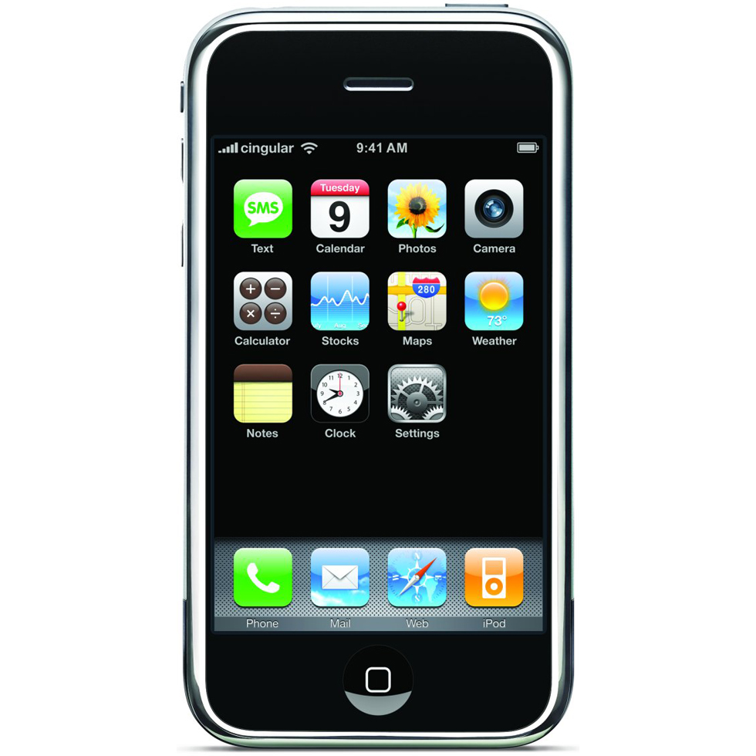
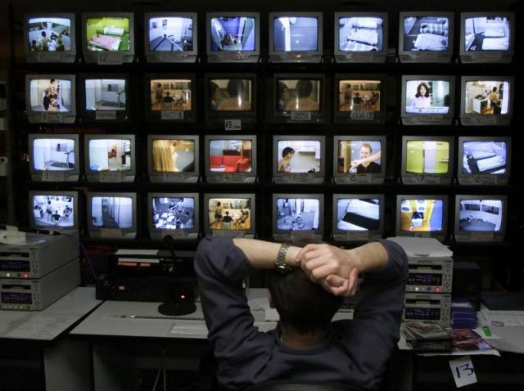
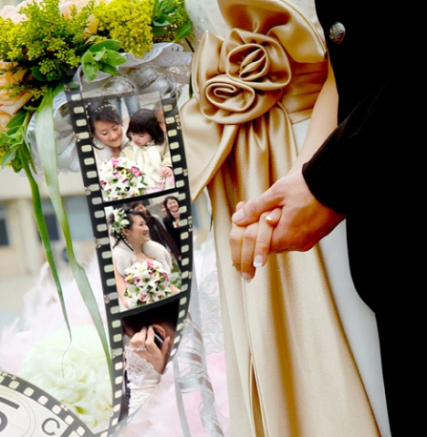
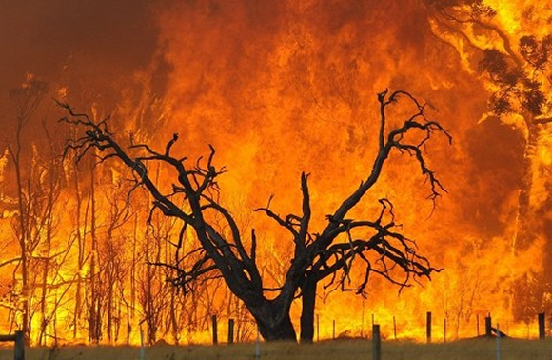
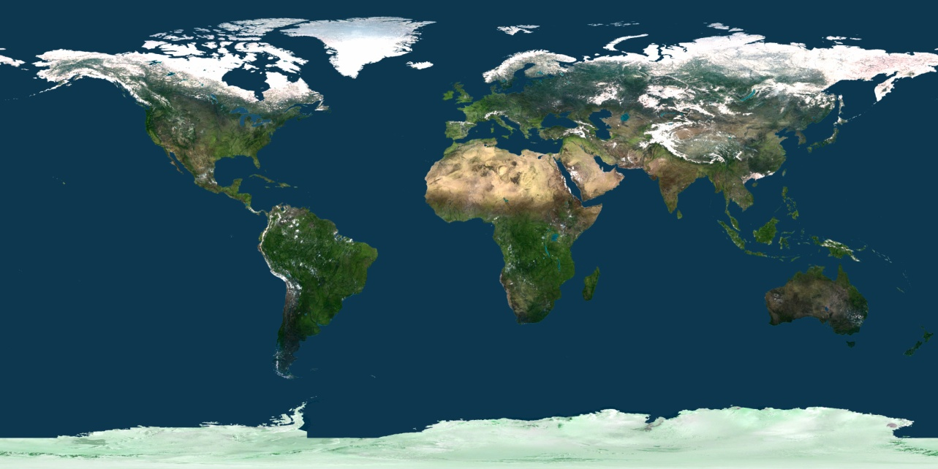
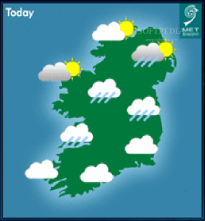
People query their personal photos very frequently.
University of California Irvine
Notes:
The availability of camera, GPS, and internet on Smart-phones has revolutionized the world we live in.
This has introduced new challenges resulted from explosion of user generated content.
One important group of user generated content are personal photos.
We need to query our personal photos very frequently:
60+M of uploaded photos per week.
3+B photos served to users per day.
2

Slide 3
User Queries are High-Level
Visual Data
Human Semantics
University of California Irvine
Notes:
Our queries include high-level semantics such as:
“show pictures of the places I visited and went for shopping”
These queries all include high-level semantics which leads to the semantic gap between .... And to query photos, the semantic gap between visual data and richness of human semantics needs to be bridged.
To bridge the gap, we need to focus on important recall queues in querying photos that are interesting to people and high level.
3

Slide 4
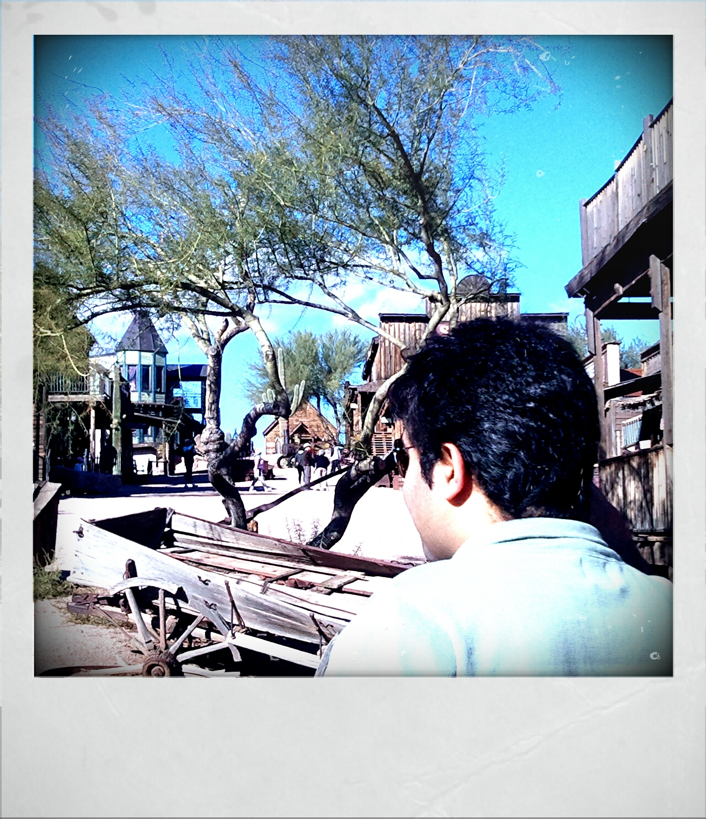
… add more “semantic” tags
People are interested in events and SubEvents!
Subevents as recall cues
Very important in retrieval
What is the current trend?
SubEvent: Visiting Ghost Town During Trip to Arizona
University of California Irvine
Notes:
We are interested in events …. So from here, we state the problem:
One group of these tags are events. State of art shows that events are important cues for recalling personal photographs. The reason is events carry human-understandable semantics and they facilitate faceted querying on time, space, structure, etc.

Slide 5
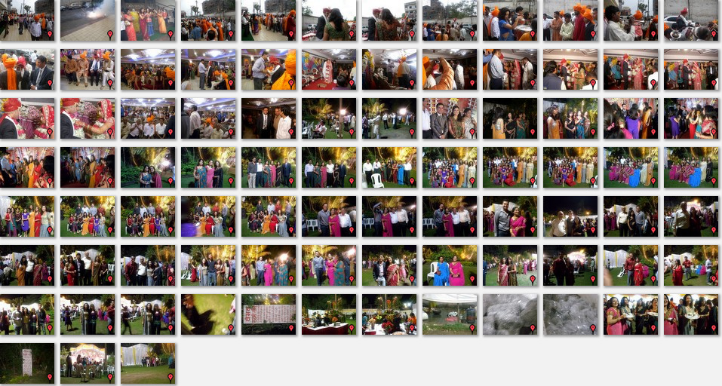
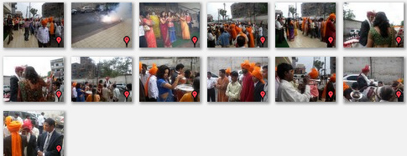
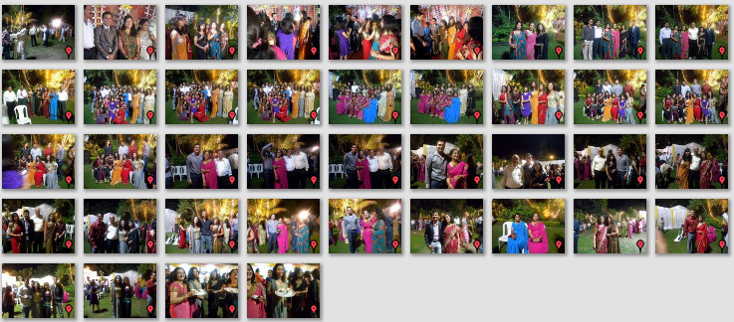
Problem
Given photos <p₁,…,p_{n}> with EXIF metadata for an event E, we partition them into its subevents <se₁,…,se_{n}>.
University of California Irvine
Notes:
Current applications do not annotate personal photos in terms of the subevents of an event a person participates.
We want to take this to the next level by stating the problem as follows:

Slide 6
But photos contain limited data
Common meta-data include:
Time
Camera Params (exposure time, aperture, focal length, ISO..)
More recently, GPS Tags.
How to tackle this limitation?
External Data Sources
Sensory Data
Web 2.0
Ontologies
University of California Irvine
Notes:
Bridging this gap is not trivial because of the limitation in availability of data for photos. We need to identify external data sources.
For years people have been focused on capturing the data from sensory devices.
Unfortunately even though Information sources have become available extensively on web, but there is no significant utilization in photo organizing applications.
this is the opportunity to start using such data.
Ontologies are nothing but conceptual models that are important because they can describe high level semantics to present events and subevents.
Ontologies are independent of lower level data models.

Slide 7
Multi-modal
context
visual content features
only when required
high relevance to smart-phone applications.
Visual Data
Contextual
model
Human Semantics
University of California Irvine
Notes:
In fact we need ontology to create a contextual model to tackle this limitation.
Multi-modal context is fed into the ontology using web-based sources. 100% relevant: because lot more contextual information using web and sensors is available on smart phones.
7

Slide 8
Outline
Introduction
Related Work
Problem Formulation
System Overview
Experimental Results (the fun part ☺ )
Summary
University of California Irvine

Slide 9
From Conceptual Model to Contextual Model
Conceptual Model
Multi-layered abstract domain model
Flexibility for multiple Classifications
Avoid replication
Leads to complex processing
Mereological,Relative/Absolute temporal, spatial Relations
Contextual Model
Visual Semantics
Contextual Semantic
e.g. time and location of events
Hindu
Hindu
University of California Irvine
Notes:
To generate the contextual model we created a multi-layered domain ontology.
In face the multi-layered architecture facilitates different classifications of the same abstract domain for instance (give the wedding example… and other people can introduce their own wedding classification using this hierarchical architecture).
Then according to the classification, different external sources are used to create the contextual model.
The reason is that we want to avoid replication of common concepts and provide flexibility . Analogy: OOP
Then we build out contextual model that is a combination of visual and contextual semantics.
Actually events have visual and contextual semantics in this conceptual model.
Upper , domain ontology, and then the populated conceptual model. Upper : essential universal types and relationships.domain : domain related entities and some very abstract context.
Visual semantics: visual concepts.
Not all contextual data is hardcoded in domain models.
Contextual data are textual data that evaluate the non-visual properties of events such as absolute/relative time, location/place, participants, structure, etc.
Constant : non-changing textual properties that describe knowledge in a logically consistent and constant manner that remain the same through all instances of the same model.
Variable : dynamic textual data that vary through instantiation of the same model.
if Civ is given in the domain ontology, the model is not flexible enough to describe another instance of the same class.we need flexible models to carry CIv.

Slide 10
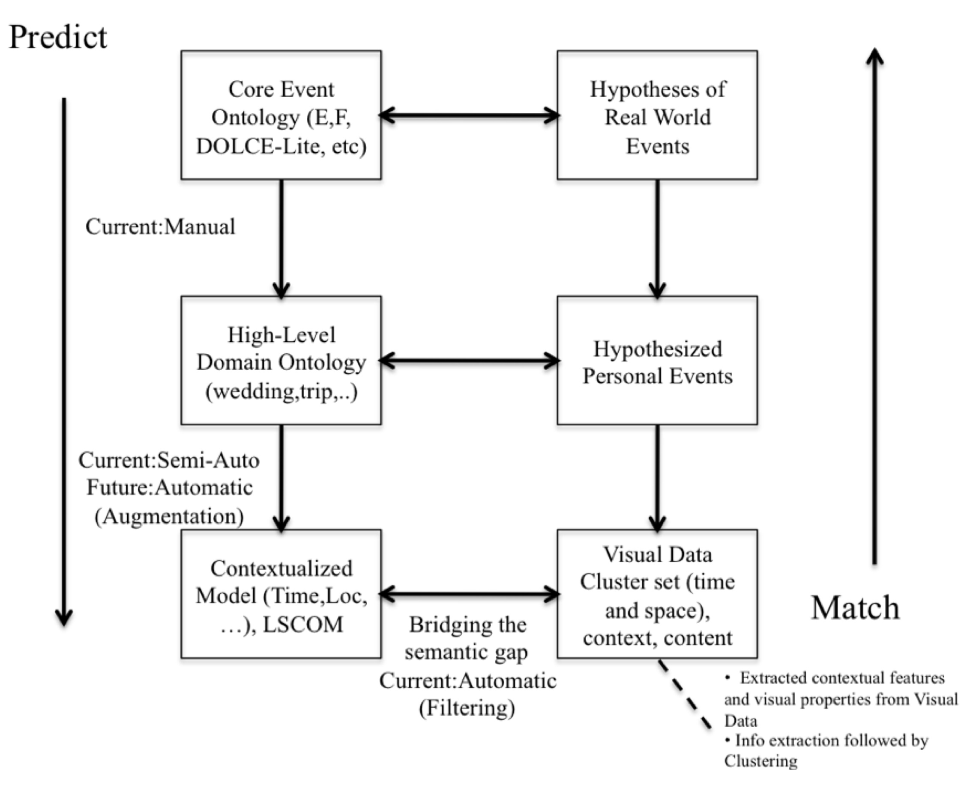
Inspired by Binford Hierarchical Object Model
University of California Irvine
Notes:
Binford hierarchical geometric model [14] is one of the early works in model-based image understanding that is used to create flexible models for object recognition at different feature levels (low-level). This motivates and elaborates the flow and components of our approach in Fig2 by replacing 3D Object Models with Core Ontology, 2D Projections of 3D Models with Domain Ontology, and the next two levels with available content models (e.g., LSCOM[21]) and context-aware recognition models to bridge the semantic gap.
Binford in Stanford.

Slide 11
R-Ontology
TRIP scenario
Individual: <domain#event_n>
Types:
<domain#Staying>
Facts:
<upper#SUPEREVENT> <domain#Trip-to-Beijing>,
<upper#P-POI-LOCATION> <domain#place_k>,
<upper#P-T-BEFORE> <domain#Checking-out_j>,
<upper#P-T-AFTER> <domain#Checking-in_j>
Individual: <domain#place_k>
Types:
<domain#POI>
Facts:
<upper#HAS-CATEGORY> “hotel”, {domain}
<upper#HAS-LATITUDE> 21.13, {R-Onto}
<upper#HAS-LONGITUDE> 79.06 {R-Onto}
<upper#HAS-BOUNDARY> <domain#bound-k>
Individual: <domain#bound-k>
Types:
<upper#Bounding-Box>
Facts:
<upper#S-CONTAINS> <domain#coor_k1>,
<upper#S-CONTAINS> <domain#coor_k2>
Individual: <domain#coor-k1>
Types:
<upper#Coordinates>
Facts:
<upper#HAS-LATITUDE> 39.908094,
<upper#HAS-LONGITUDE> 116.444083
University of California Irvine
Notes:
The OWL API is a Java API and reference implementation for creating, manipulating and serializing OWL Ontologies. The latest version of the API is focused towards OWL 2, The OWL API is open source
Domain models are created manually.

Slide 12
Related Work
Object-based systems
Describing geometric objects [Kokarand et.al.]
Pixel-based ontology
Description rather than Recognition!
COMM,ABC
Event-based systems
Only ontology creation e.g. F-Model,E-Model [Schertp et.al, Westerman et.al.]
Activity recognition
University of California Irvine
Notes:
In related work, we want to address the lack of actual usage of domain ontology in event-based multimedia systems especially for visual data.
1-tedious annotation
2- proposes pixel-based ontology for recognition of pixel-based objects (at pixel-level)
Ontologies have been for description rather than recognition in multimedia systems. COMM and ABC for describing information objects.
Activity recognition from surveillance video.
There has been no usage of ontology on subevent recognition.

Slide 13
Problem Formulation
Given photos P :< p₁,...,p_{n} > for an event E , we partition them into its subevents < se₁ , . . . , se_{m} >.
R-Ontology
How can O_{r} be employed for partitioning P?
I: set of instances of the classes in domain ontology
CI_{v}: context
R: set of relationships between the instances
University of California Irvine
Notes:
We will answer to the following questions in this work:
Given photos P :< p₁,...,p_{n} > with EXIF metadata for an event E , we partition them into its subevents < se₁ , . . . , se_{m} >. We use O_{d} corresponding to the type of the event, instantiate that using information available for the event (i.e. time, location, participating people), and augment O_{i} with all available information related to the context of the subevents i.e. CI_{v} using operator ×_{A}. Finally, O_{r} is used to partition P.
How does operator ×_{A} create O_{r}?
How can O_{r} be employed for partitioning P
To apply this model on a large photo collection, it is necessary to extract recognizable features from photos .
Ontology Definition:
E(x) : means x is extracted information.
Instances are members of the classes in the domain ontology for e.g. visiting-forbidden city is an instance of class visiting in trip ontology.
Ontology instance contains the instances with relationships between them. Relationships maybe subevent-of, after, before (mereological, relative-temporal,etc). These relationships are derived from the domain ontology.
We divide contextual information into two groups: constant and variable. Constant context -CIc- never changes in different instances of the same domain ontology (e.g. place category-staying happens in a hotel type place-) while variable context _CIv_ is very likely to change for different instances of the same domain model (e,g, the information about the landmarks of the trip destination). Therefore Civ can not be part of the domain ontology.

Slide 14
System Overview
Photos
Ontology
Augmentation
<place, locType, ambient condition, etc>
Feature Extraction
Input Context
Request
Particular
Context
P: <p1,…,pn>
Metadata Extractor
(time, coordinate, camera parameters)
Imaging Feature Extractor
WWW
Ontology Store(upper and domain)
Content Descriptor Extractor
Instantiation
Ontology instance Modifier
Media
Modification
Agglomerative SpatioTemporal Clustering
Filtering
(Content and context features)
R-Ontology (-ies)
.
.
.
.
.
.
.
.
.
.
.
.
University of California Irvine
Notes:
ontology store maintains the upper and domainontology(-ies).
Spend 3 minutes on this.
Filtering: Filtering has two components: a) A function that filters redundant clusters based on the absolute/relative spatiotemporal extent of an event in R-Ontology by pruning the branches of the cluster-tree that lead to irrelevant clusters by using the following conditional expression: InsideST (cluster, event) → P opulate(event, cluster); Many-to-many cardinality exists between events in R- Ontology and clusters in cluster tree, this is followed by b) A function that filters redundant images in each assigned cluster for an event based on the described quality of the event in R-Ontology using the image content and context features (see equation 5) e.g., for an outdoor event, imaging parameters taken from EXIF such as focal-length, aperture and time are employed to recognize whether the photos in the assigned cluster(s) represent indoor or outdoor scene.We used an existing API in our lab [12]. Such descriptions can play a crucial role once extensive types of visual content and context features are taken into account e.g., image histogram to find distance measure based on the tonal distribution. We will bring in such features extensively in our future work.
Our filtering approach eliminates the need for optimization. The filtering is deeply guided by R-Ontology (see Fig5). During this operation, mereological/subevent relations are used for navigating the R-Ontology. Filtering based on absolute properties is centralized around only one event in R-Ontology, whereas filtering based on relative properties is distributed over multiple events: we give higher priority to analyse the events with absolute spatiotemporal extent to compute the relative properties of other events (that have necessary dependence towards counterpart absolute properties); our algorithm relatively translates relative properties to absolute ones (see equation 3). In order to track distinctive characteristics of each event in R-Ontology, we implemented a graph navigator using OWL API [1]. R-Ontology is writtenin OWL.

Slide 15
My friend’s Indian Wedding,
[02-12-09 02-13-09], Nagpur-India
University of California Irvine

Slide 16
My friend’s Indian Wedding, [02-12-09 02-13-09], Nagpur-India
My friend’s marriage
Groom arrival
Indian Ceremony
Wedding party
Taking portrait
University of California Irvine

Slide 17
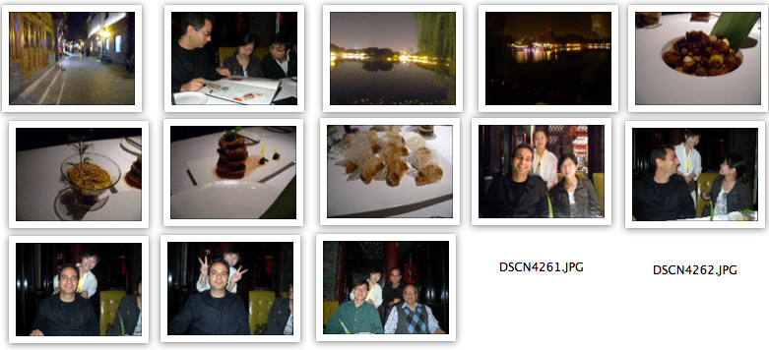
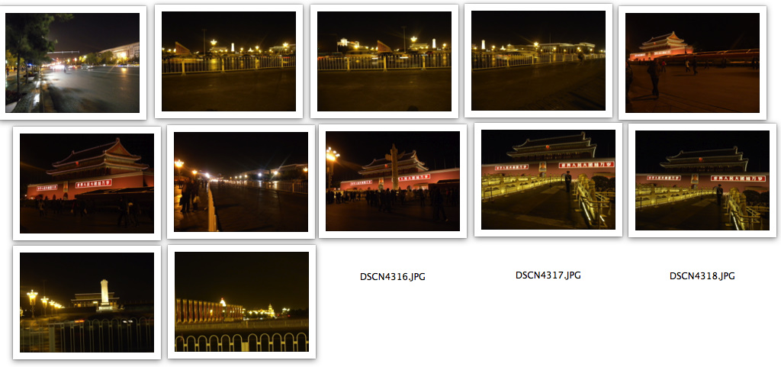
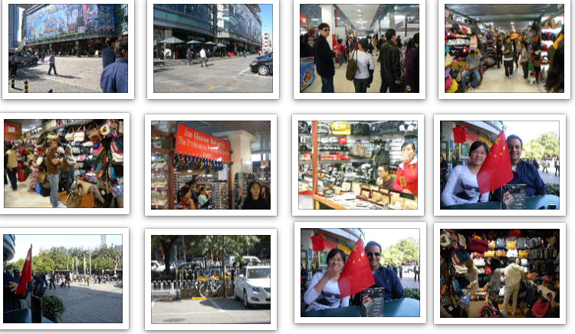
My Trip, [07-06-10 07-12-10], Beijing-China
Having Dinner
Ordering Dinner
Serving Dinner
Visiting forbidden city
Shopping at twins mall
University of California Irvine

Slide 18
Summary
Ontologies for Trip,Wedding
Sub-Events as important Tags
Future work
Extend the employment of context and content features of photos
Sensors on smart phones
University of California Irvine
Notes:
Upon the availability, we used righteous available sources of information that serve as contextual data during augmentation. Such sources are identified based on how well they describe the underlying situation. In this work we encountered some limitations according to the lack of discovering such sources, so some of contextual data had to be created manually, however this can be tackled in the future as more services and databases become publicly available. We also aim to extend on employing content and context features of visual data towards event recognition. This can happen with the presence of large number of personal sensors in smart-phones and can improve the evaluation of our framework on the correctness (COR) metric. We consider these extensions in our future work.

Slide 19
Q & A
And Thanks for listening.
Contact Information:
srafatir@ics.uci.edu
jain@ics.uci.edu
University of California Irvine

Slide 20
Back up Slides
University of California Irvine

Slide 21
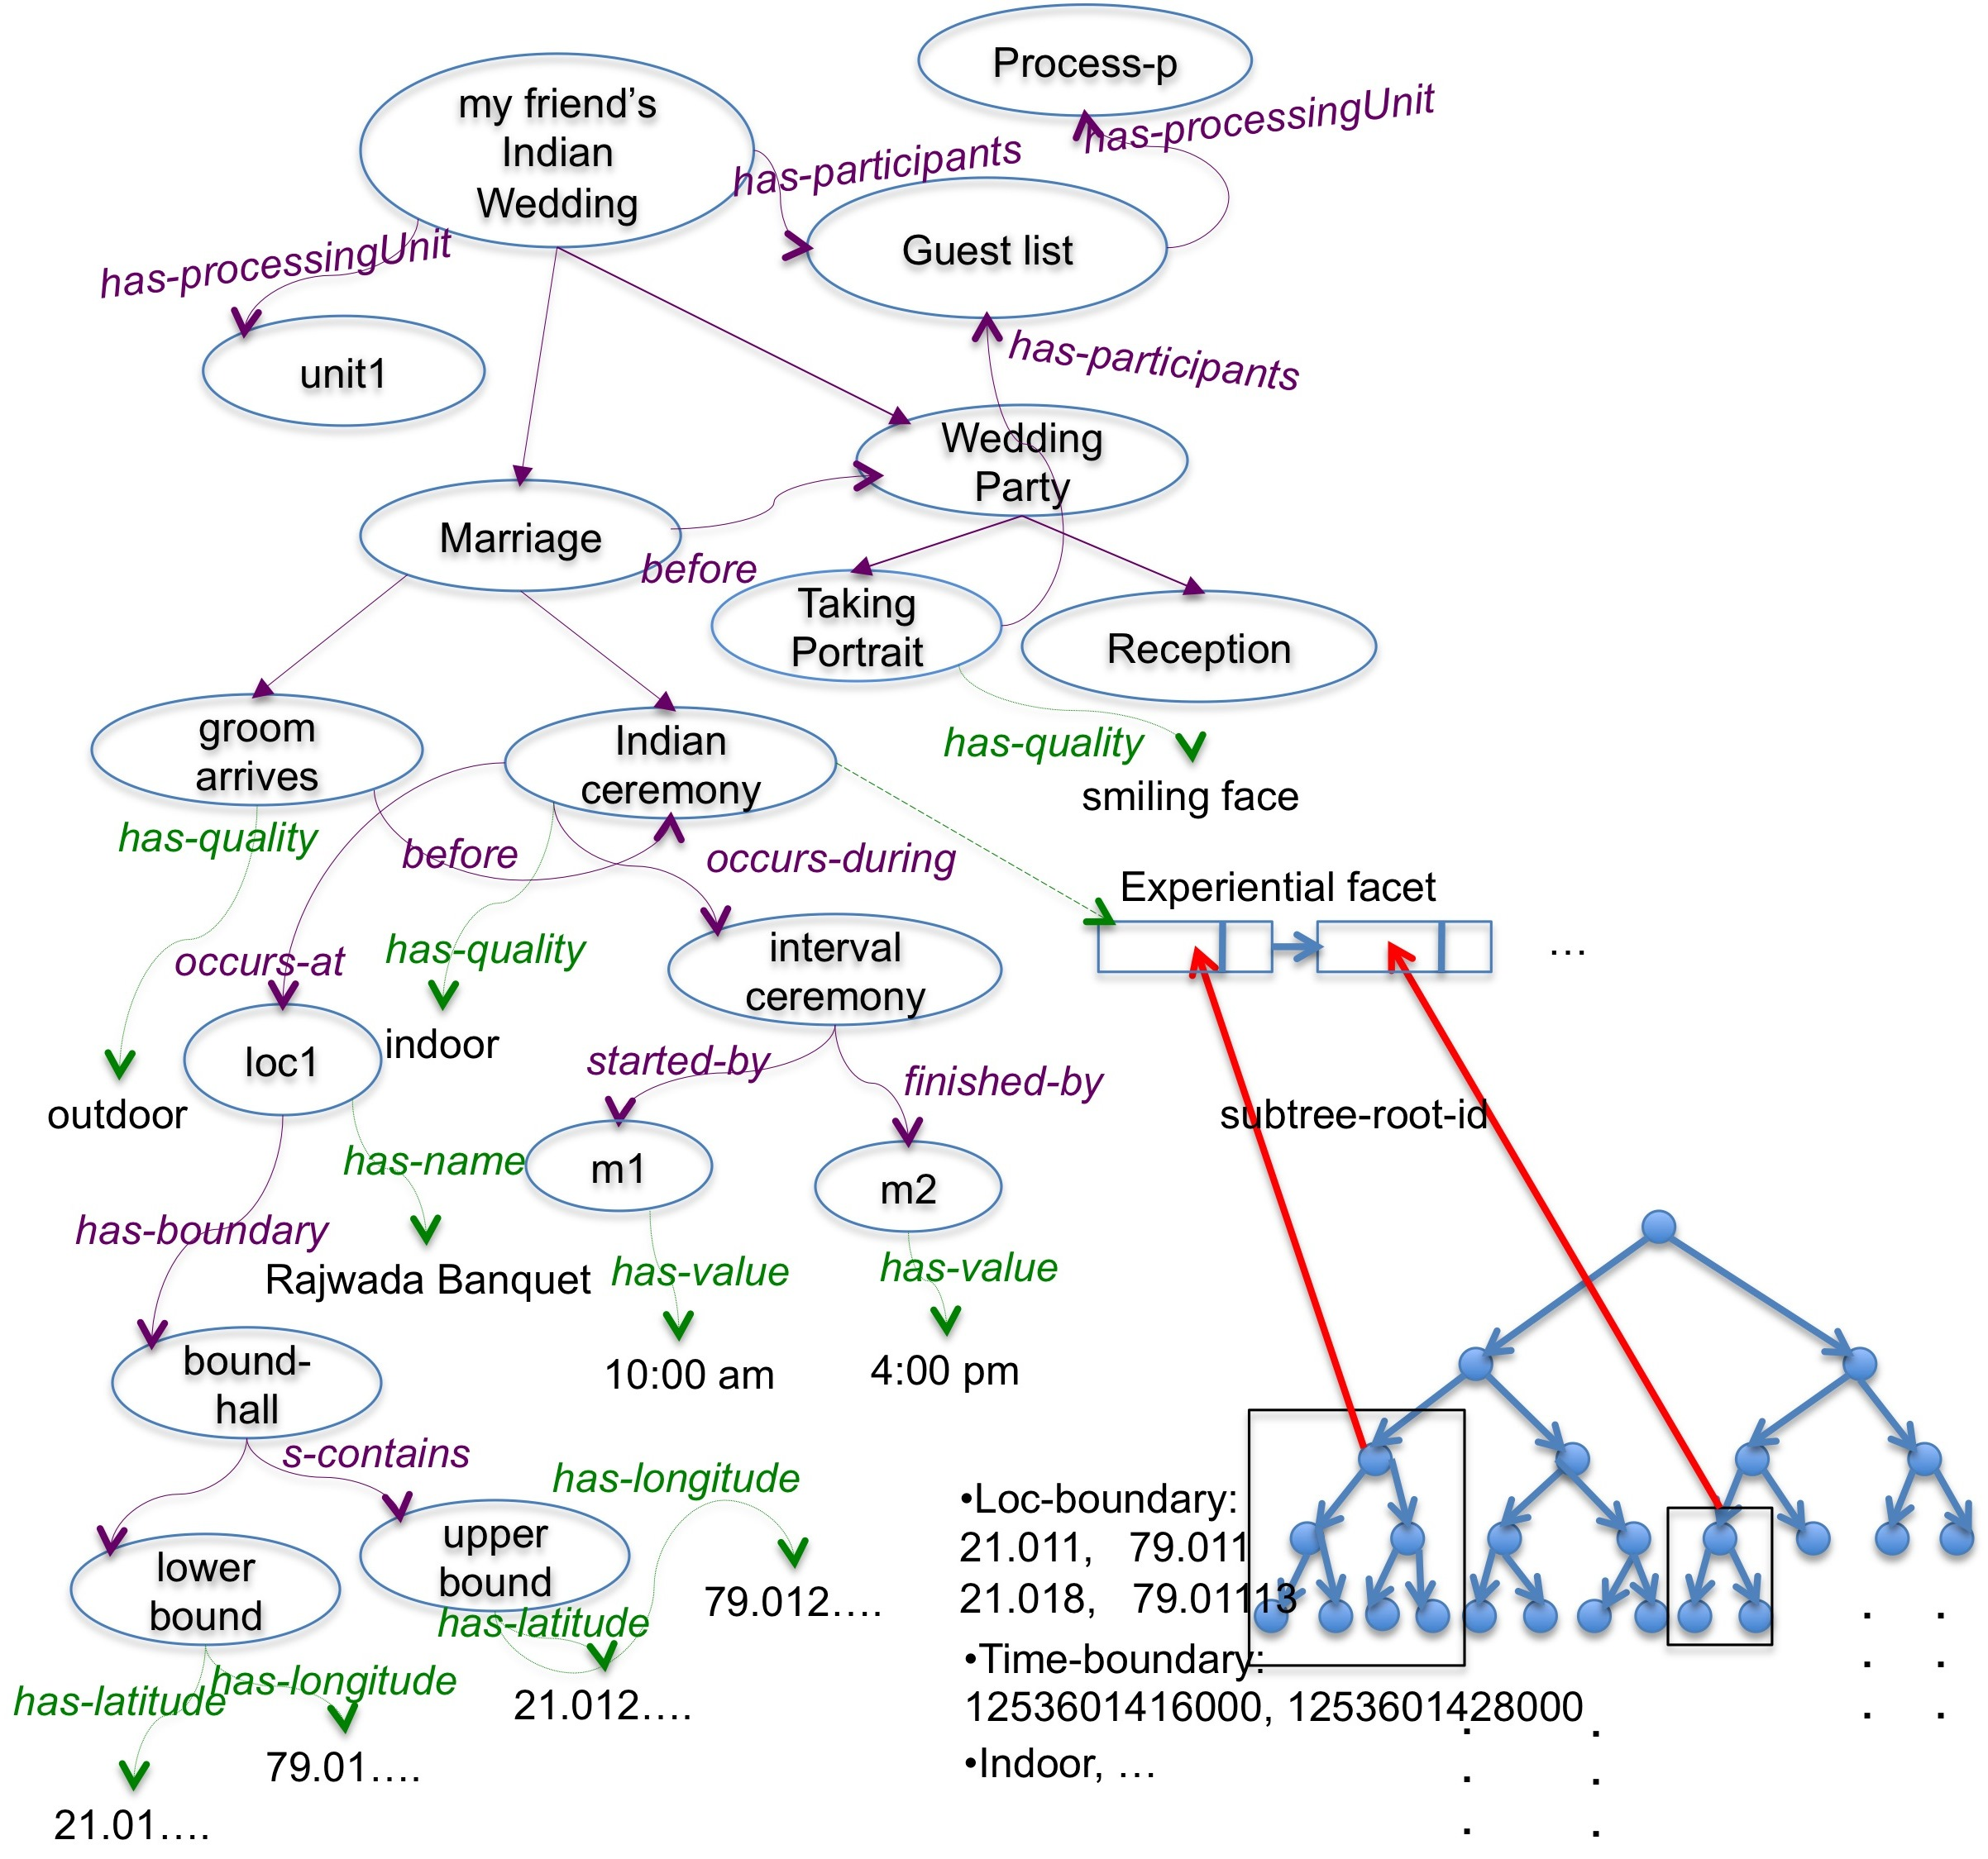
Hindu Wedding
Web and
other sources
Constant Context
Variable
Context
{srafatir,jain}@ics.uci.edu

Slide 22
Vacation-Trip
Trip to Beijing
has-subevent
Constant Context
has-subevent
has-subevent
Eating
Web and other sources
Visiting
Vacation Trip
has-subevent
has-subevent
has-processingUnit
Ordering food
has-subevent
has-subevent
Shopping
before
has-subevent
Serving food
Visiting
Variable Context
Process
Process-L
subClassOf
Eating
has-locationType
subClassOf
has-processingUnit
Professional Activity
Beijing restaurant
Shopping
restaurant ,cafe
Lunch
has-subevent
Mall,plaza,shopping center
has-subevent
subClassOf
has-boundary
Process-L
Ordering food
hotel,university
Dinner
occurs-at
subClassOf
occurs-during
bound-1
Process
ACM Confernce
Process-Schedule
has-locationType
subClassOf
Delta-dinner
s-contains
Professional Activity
before
has-processingUnit
has-value
upperbound
restaurant ,cafe
Lunch
has-subevent
lowerbound
Mall,plaza,shopping center
Keynote: 8-9 am
Speaker:…
…
finished-by
has-longitude
subClassOf
started-by
m2
has-latitude
Dinner
‘116.02..’
hotel,university
Serving food
m1
has-value
‘39.02..’
Conference
has-value
11:59 pm
has-longitude
Process-Schedule
has-latitude
has-processingUnit
3:00 pm
‘116.01..’
{srafatir,jain}@ics.uci.edu
‘39.01..’

Slide 23
Agglomerative Clustering
{srafatir,jain}@ics.uci.edu

Slide 24
Implementation and Results
TRIP scenario
Individual: <domain#event_n>
Types:
<domain#Staying>
Facts:
<upper#SUPEREVENT> <domain#Trip-to-Beijing>,
<upper#P-POI-LOCATION> <domain#place_k>,
<upper#P-T-BEFORE> <domain#Checking-out_j>,
<upper#P-T-AFTER> <domain#Checking-in_j>
Individual: <domain#place_k>
Types:
<domain#POI>
Facts:
<upper#HAS-CATEGORY> “hotel”, {domain}
<upper#HAS-LATITUDE> 21.13, {R-Onto}
<upper#HAS-LONGITUDE> 79.06 {R-Onto}
<upper#HAS-BOUNDARY> <domain#bound-k>
Individual: <domain#bound-k>
Types:
<upper#Bounding-Box>
Facts:
<upper#S-CONTAINS> <domain#coor_k1>,
<upper#S-CONTAINS> <domain#coor_k2>
Individual: <domain#coor-k1>
Types:
<upper#Coordinates>
Facts:
<upper#HAS-LATITUDE> 39.908094,
<upper#HAS-LONGITUDE> 116.444083
WEDDING scenario
Individual: <domain#event_m>
Types:
<domain#Groom-Arrival>
Facts:
<upper#SUPEREVENT> <domain#indianWeddingCeremony>,
<upper#P-POI-LOCATION> <domain#place_p>
<….
….>
<domain#HAS-LOC-QUALITY> “outdoor”,
…
Individual: <domain#event_s>
Types:
<domain#Taking-Portrait>
Facts:
<upper#SUPEREVENT> <domain#indianWeddingParty>,
<upper#P-POI-LOCATION> <domain#place_p>
<….
….>
<domain#HAS-OBJECT> <domain#face_h>,
<domain#HAS-Processing-Unit> “http://www.unitX.com”,
…
Individual: <domain#face_h>
Types:
<domain#Face>
Facts:
<domain#HAS-VIS-QUALITY> “smiling”
{srafatir,jain}@ics.uci.edu
Notes:
The OWL API is a Java API and reference implementation for creating, manipulating and serializing OWL Ontologies. The latest version of the API is focused towards OWL 2, The OWL API is open source
Domain models are created manually.

Slide 25
Upper/Domain Ontology
Basic Derivation of E* by A. Gupta, R. Jain.
Context of event classes in domain ontology
Temporal model (absolute and relative)
Spatial model
Coordinate(lat,lng), boundingbox(a pair of coordinates), place-name (e.g. Disney Land), locationType
(Perdurant occurs-at Place),(Place has-boundary BoundingBox), (BoundingBox s-contains Coordinates).
Structural model (subevent)
entailment rule
{srafatir,jain}@ics.uci.edu
Notes:
Also some of the concepts in E* are taken from DOLCE ontology that is a Descriptive Ontology for Linguistic and Cognitive Engineering and the first module of wonderweb ontology infrastructure for Semantic Web. upper ontology contains the fundamental relationships used to describe Perdurants/occurrnts as a happening during time T at place X (generic class for real world events).
In designing the Domain Ontology, each type of event classes described via CIc such that CIc is a subset of spatial,temporal, quality, structural (subevent), and conceptual(objects) information.
absolute interval is represented by standard attribute-pair start-time and end-time through occurs-during relationship, and the basic form of relative interval is expressed by standard temporal predicates after and before. Using the relative time and the reference interval, a new temporal entity is created and associated to one or more existing entities. Relative interval is associated with a reference time interval. In fact a relative interval is initially implicitly expressed until the referencing interval is evaluated e.g. if A and B are both Perdurants, and B is associated with a relative interval that references A.I (absolute interval for A), then the following describes the above inference rule:
Spatial model:
The following RDF N-triple describes the association of absolute locations to events using relationship occurs-at:(Perdurant occurs-at Place),(Place has-boundary BoundingBox), (BoundingBox s-contains Coordinates).

Slide 26
Implementation and Results
Vacation Trip | Indian Wedding
Organize my photos based on the subevents I participated during event-x | Organize my photos based on the subevents I participated during event-y
photos of my stay at “blah” hotel | photos of wedding party
photos of my visits to famous landmarks | photos of groom arriving
photos of shopping | photos of serving dinner
photos of having lunch/dinner/breakfast | photos of marriage ceremony
Sources from Web:
For Trip {Landmark finder, Trip itinerary,location database}
For Wedding {Electronic invitations,face-detector,location database}
OWL-API
EXIFTOOL
Lab tools
Personal Archives
{srafatir,jain}@ics.uci.edu
Notes:
For buying use the time of the credit card transaction to match it to the relevant photos.
Use the information in the trip itinerary to get the light connection information.
Journey is not a trip, it is a movement during a trip and happens in one day.
Groom /bride arriving in Indian wedding is based on the time slice in which they arrive, for instance the beginning of the ceremony. For instance in the context of Christian wedding, groom arrives before the ceremony, and the bride arrives in the beginning (just after) of the ceremony. In Indian wedding, groom arrives before the wedding (outdoor) again and bride arrives.
Throwing flower bouquet: it happens at the end of the ceremony with people in the photo. This happens after serving dinner.
Cutting cake is after 10p and before throwing flower bouquet. Throwing flower bouquet is relative to the end of the wedding, however, when throwing flower become temporally absolute, it is used to address the time of cutting cake.

Slide 27
Ontology Augmentation
{srafatir,jain}@ics.uci.edu

Slide 28
A Qualitative User Study
{srafatir,jain}@ics.uci.edu
Notes:
The test data consisted of two sets, one with 86 (for Trip) and the other with 87 (for Wedding) photos. We asked the owner of these photo collections to manually organize those photos in terms of our modeled sub-events since the person who took the photos, actually participated in the corresponding events, and that the way these photos are organized by him can serve as a ground truth for our results to some extent. We compared the results obtained from manual annotation with the outcome of our approach. TableI reflects the result of this evaluation. COV indicate the coverage of photos for each event, and COR indicates the correctness of the assigned photos for that event. These values show that for each event, the relevant visual data is covered, however due to the lack of features in the second step of filtering, COR does not look as good as COV. We are currently in the process of collecting more data to evaluate our work in a larger extent. We plan to use the ground truth and evaluation introduced by MediaEval8 that is a benchmark for multimedia evaluation.

Slide 29
Implementation and Results
Sources from Web:
For Trip {Landmark finder, Trip itinerary,location database}
For Wedding {Electronic invitations,face-detector,location database}
OWL-API
EXIFTOOL
Lab tools
Personal Archives
{srafatir,jain}@ics.uci.edu
Notes:
For buying use the time of the credit card transaction to match it to the relevant photos.
Use the information in the trip itinerary to get the light connection information.
Journey is not a trip, it is a movement during a trip and happens in one day.
Groom /bride arriving in Indian wedding is based on the time slice in which they arrive, for instance the beginning of the ceremony. For instance in the context of Christian wedding, groom arrives before the ceremony, and the bride arrives in the beginning (just after) of the ceremony. In Indian wedding, groom arrives before the wedding (outdoor) again and bride arrives.
Throwing flower bouquet: it happens at the end of the ceremony with people in the photo. This happens after serving dinner.
Cutting cake is after 10p and before throwing flower bouquet. Throwing flower bouquet is relative to the end of the wedding, however, when throwing flower become temporally absolute, it is used to address the time of cutting cake.

