Slide 1
Computable Semantics and Probabilistic Graphical Models
Where Probabilistic Systems and Semantics Rub Elbows
Peter Haug, MD
Homer Warner Center for Informatics Research
Intermountain Healthcare
Notes:
Tutorial and Workshop on Semantic Computing in Health Care (TWSCHC 2013)
The Medical domain has been at the forefront of the semantic technology with the development
and standardization of numerous ontologies and the development of tools to support the
authoring and integration of the semantic models. With the continued increase in health care
costs and the promise of personalized medicine, there is a strong incentive to understand,
leverage, and deploy tools for more effective processes and outcomes.
The Tutorial and Workshop on Semantic Computing in Health Care (TWSCHC 2013) consists of
a halfday
tutorial and a halfday
workshop to be held in conjunction with the 7th IEEE
International Conference on Semantic Computing (ICSC2013) on September 19, 2013. The
tutorial will provide an overview of the problems and challenges faced by the health care industry
in adopting and effectively leveraging the promise of semantic technology. The workshop will
consist of presentations of invited papers and peerreviewed
papers.
Tutorial Speakers
Peter Haug, Intermountain Healthcare
Joanne S. Luciano, Tetherless World Constellation, RPI

Slide 2
First of all: Thanks
This work has many contributers:
Dominik Aronsky, MD, PhD
Jeffrey Ferraro, PhD
Stan Huff, MD
Scott Evans, PhD
Robert Hausam, MD
Lee Pierce
Xinzu Wu, PhD
Matthew Ebert
Kumar Mynam
And many more!

Slide 3

Please ask questions …

Slide 4
Agenda
Why Decision Support?
Introduction: Bayesian Diagnostic Networks
  Bayesian Systems
    A Framework for Computable Models
  A Few Bayesian Tools
  Diagnostic Systems
Representing the Semantics of Diagnosis
  Diagnostic Modeling with Ontologies
  Ontologies -> Bayesian Network
Clinical Data
  A Brief Look at Medical Data Forms
Notes:
Use the word “CONCEPTS”
Numbers say Probability, Best ‘Story”, Information, Collapsed Utilities

Slide 5
Computerized Decision Support:
Core Assumptions
‘... man is not perfectible. There are limits to man’s capabilities as an information processor that assure the occurrence of random errors in his activities.’
~ Clement J. McDonald, MD (1976)
‘The complexity of modern medicine exceeds the inherent limitations of the unaided human mind.’
~ David M. Eddy, MD, Ph.D. (1990)
Notes:
David M. Eddy, MD, Ph.D.
Clinical Decision Making
JAMA 263:1265-75, 1990
Clem McDonald
New England Journal of Medicine
1976

Slide 6
Patient

Slide 7
Underlying principle:
We are designing the system so that the computer is an active part of patient care, not just a way of getting data to people to read.

Slide 8
Agenda
Why Decision Support?
Introduction: Bayesian Diagnostic Networks
  Bayesian Systems
    A Framework for Computable Models
  A Few Bayesian Tools
  Diagnostic Systems
Representing the Semantics of Diagnosis
  Diagnostic Modeling with Ontologies
  Ontologies -> Bayesian Network
Clinical Data
  A Brief Look at Medical Data Forms
Notes:
Use the word “CONCEPTS”
Numbers say Probability, Best ‘Story”, Information, Collapsed Utilities

Slide 9
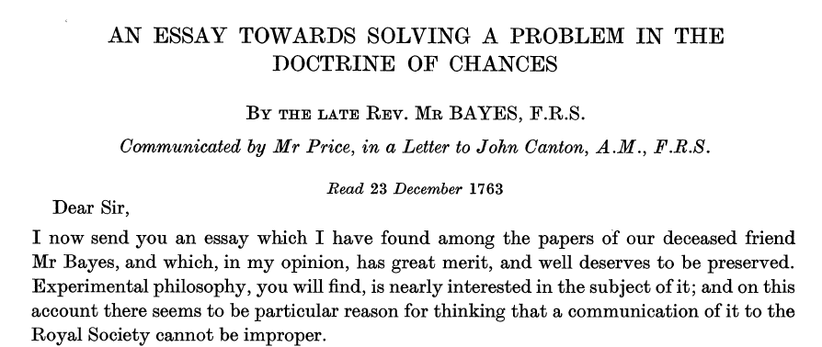

The Reverend Thomas Bayes
1702 to 1761
Bayes set out his theory of probability in 1764. At that time, Richard Price, a friend of Bayes, discovered two unpublished essays among Bayes's papers which he forwarded to the Royal Society.
Notes:
His conclusions were accepted by Laplace in 1781, rediscovered by Condorcet, and remained unchallenged until Boole questioned them. Since then Bayes' techniques have been subject to controversy.

Slide 10
A Way to Think about Probabilistic Systems
(and an introduction to some terminology)
Learning from Data
  The data comes from Health Care Encounters
  It is captured in Electronic Health Records (EHRs)
  It is aggregated and organized in Enterprise Data Warehouses (EDW)
  It includes the diagnoses and the data that support them
Bayesian Networks
  Model the joint probability distribution of the data and diagnoses
  Use directed graphs to structure these models

Slide 11
Re-Using Healthcare Data
Episodes of Care
Medical Information System
Enterprise Data Warehouse
Quality Improvement
Measures of Care
Clinical Research
Medical Decision Support

Slide 12
Example: Patients with Symptoms of Heart Disease
Patient Population
Data Collected in a
Care Setting

Slide 13
Original Data

Slide 14
Summarizing the Data: The Numbers
A Condensed Look at 1000 Cases

Slide 15
Summarizing the Data: The Numbers
A Condensed Look at 1000 Cases
And the “Marginal Probabilities
Another Summary: The Joint Probability Distribution

Slide 16
Another View of the 2x2 Table
Dividing by the Column Marginals
Sensitivity: P(F|D)
False Positive Rate: P(F|no D)
False Negative Rate: P(no F| D)
Specificity: P(no F|no D)

Slide 17
Bayes Equation
Inferring the probability of a Disease (D) from a Finding (F)
Prior Disease
Probability
Sensitivity
Posterior Disease
Probability
Probability of
Finding

Slide 18
Probability Updating
The Disease is Myocardial Infarction
The Finding is Chest Pain
P(MI) = 2.0% (0.02)
P(Chest Pain|MI) = 75% (0.75)
P(Chest Pain) = ?

Slide 19
The Question of P(F)
Simple Bayes
  Patient has One and Only One Disease
Multi-Membership Bayes
  Patient has Any Group of Disease
  Each Disease is Evaluated Independently
Bayesian Networks
  Patient has Any Group of Disease
  Diseases are Evaluated According to Their Collective (Joint) Behavior
Add All of the Probabilities
Of Having Both the
Finding and Disease

Slide 20
The Question of P(F)
Simple Bayes
  Patient has One and Only One Disease
Multi-Membership Bayes
  Patient has Any Group of Disease
  Each Disease is Evaluated Independently
Bayesian Networks
  Patient has Any Group of Disease
  Diseases are Evaluated According to Their Collective (Joint) Behavior
Two States Apply for Each Disease:
With and Without the Disease

Slide 21
The Question of P(F)
Simple Bayes
  Patient has One and Only One Disease
Multi-Membership Bayes
  Patient has Any Group of Disease
  Each Disease is Evaluated Independently
Bayesian Networks
  Patient has Any Group of Disease
  Diseases are Evaluated According to Their Collective (Joint) Behavior
Disease
Intermediate
Concept
Finding 3
Finding 4
Finding 1
Finding 2
P(F) is Determined from
the Joint Effect of Child Nodes
on Their Parents

Slide 22
Probability Updating
The Disease is Myocardial Infarction
The Finding is Chest Pain
P(MI) = 2.0% (0.02)
P(Chest Pain|MI) = 75% (0.75)
P(Chest Pain) = ?
Multi-Membership Bayes

Slide 23
Probability Updating
Using the Multi-Membership Model
The Disease is Myocardial Infarction
The Finding is Chest Pain
P(MI) = 2.0% (0.02)
P(Chest Pain|MI) = 75% (0.75)
P(Chest Pain) = 0.02 x 0.75 + 0.98 x 0.08

Slide 24
Probability Updating
Using the Multi-Membership Model
The Disease is Myocardial Infarction
The Finding is Chest Pain
P(MI) = 2.0% (0.02)
P(Chest Pain|MI) = 75% (0.75)
P(Chest Pain) = 0.02 x 0.75 + 0.98 x 0.08

Slide 25
Diagnostic Bayesian Networks
(Demonstrating Different Characteristics)
Simple Bayes
  Patient has one Disease
  All findings are Conditionally Independent
Multi-Membership Bayes
  Patient can have multiple Diseases
  All Diseases are evaluated independently
Bayesian Networks
  Any relationship among diseases and findings
  Can represent any of the other models
  Multilayered models
  Graphical/probabilistic representation of knowledge

Slide 26
Using a Bayesian Network
Examples of Bayesian Diagnostics
In Netica (www.Norsys.com)

Slide 27
More Diagnostic Examples
(Myocardial Infarction)
Using Pulmonary Diseases
  Pneumonia
  Asthma
  COPD
  Pulmonary Embolism
With Increasingly Complex Models
  Simple Bayes
  Multi-Membership Bayes
  Complex Relationships
Notes:
Go to

Slide 28
Bayesian Diagnostic Models
(Naïve Bayes)

Slide 29
Bayesian Diagnostic Models
(Multi-Membership Bayes)

Slide 30
Bayesian Diagnostic Models
(Bayesian Network: Two-Layer)

Slide 31
Bayesian Diagnostic Models
(Multi-Layer Bayesian Network)

Slide 32
Bayesian Diagnostic Models
(Multi-Layer with Continuous Variables)

Slide 33
Bayesian Diagnostic Models
(Multi-Layer with Added Associations)

Slide 34
Using Bayesian Diagnostic Systems in Care
Example: Diagnosing Pneumonia?

Slide 35
Protocols: Computers Intervene in the Workflow
(an example from the ED)
Goal:
  Rapidly Screen for Pneumonia Patients in the ED
  Assess Risk of Death
  Apply a Pneumonia Care Protocol
Approach:
  Use Probabilistic System to Identify Patients
    Diagnostic Bayesian Networks
    Supported with Natural Language Processing*
  Suggest Enrollment in Pneumonia Protocol
  Provide Therapeutic Suggestions
*Extracts Data from the X-ray Report

Slide 36
Advanced CDS
(Diagnositic Models)
Example: Community-Acquired Pneumonia
Does the patient have pneumonia?
Should we used the protocol?
Apply Pneumonia Care Protocol.

Slide 37
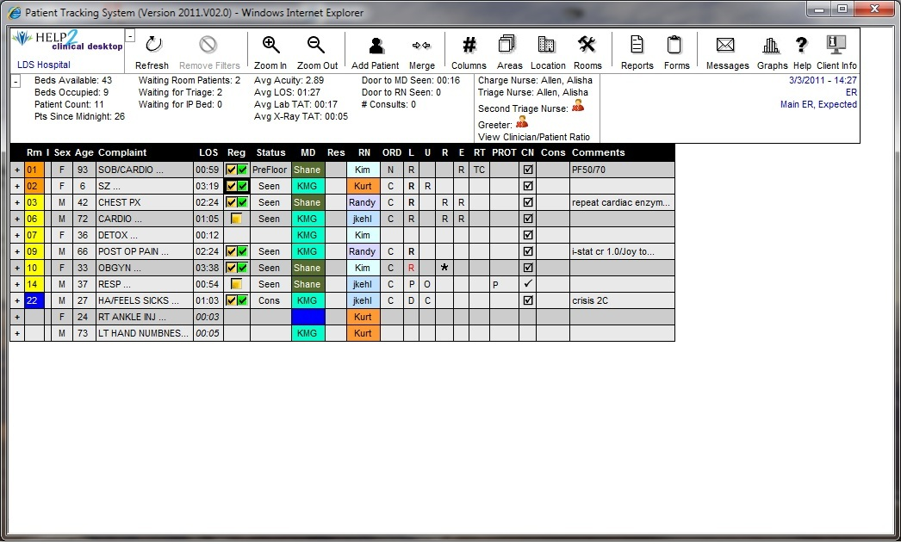
Alerting for Pneumonia in the Patient Tracking System
  The Emergency Department Workflow
  Imbed logic, orders into process of care
  Imbed logic, orders into process of care
System Watches the Data Flow in the ED
Identifies Possible Pneumonia Patients

Slide 38
  Imbed logic, orders into process of care
  Imbed logic, orders into process of care
  Imbed logic, orders into process of care

Slide 39
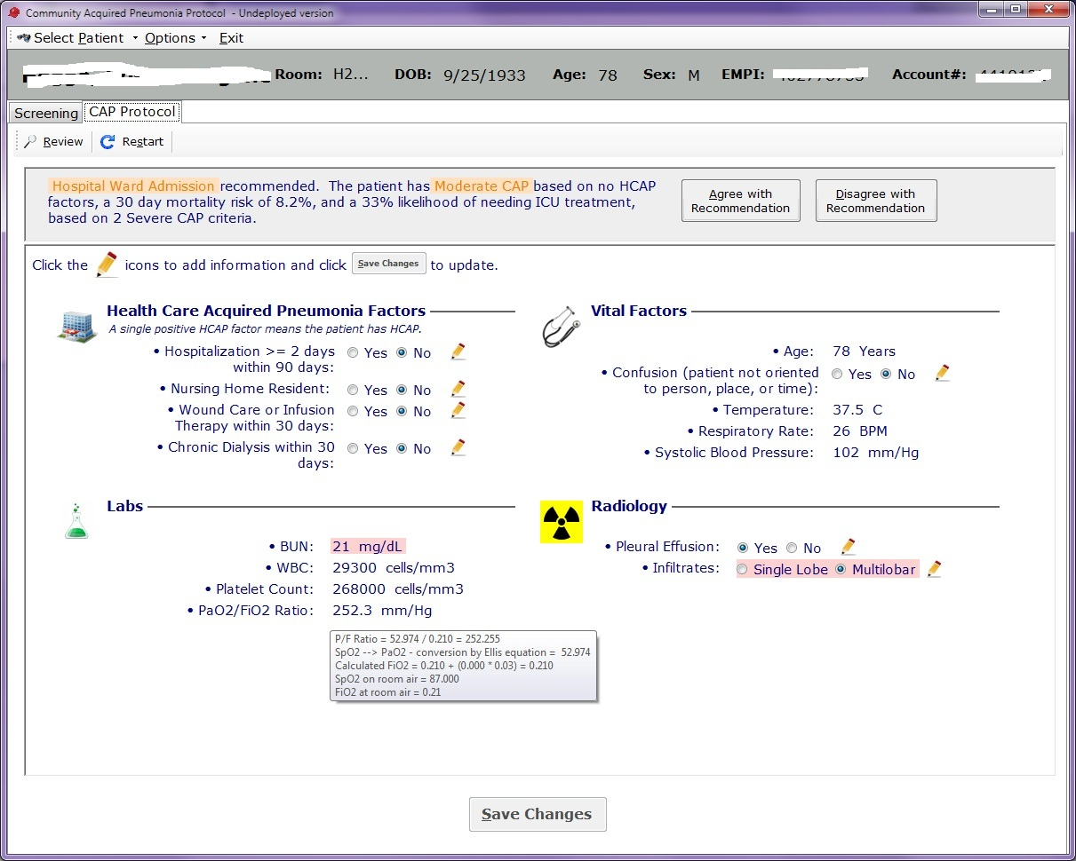
Treatment Protocol
Uses Data from the EHR Combined with Manually Input Data

Slide 41
Implemented Using:
Diagnostic System
  Bayesian Network
  Model Trained Using EDW Data
NLP System
  Random Forests-Based Concept Identification
  Trained with Documents in the EDW

Slide 42
Agenda
Why?
Introduction: Bayesian Diagnostic Networks
  Bayesian Systems
    A Framework for Computable Models
  A Few Bayesian Tools
  Diagnostic Systems
Representing the Semantics of Diagnosis
  Diagnostic Modeling with Ontologies
  Ontologies -> Bayesian Network
Clinical Data
  A Brief Look at Medical Data Forms
Notes:
Use the word “CONCEPTS”
Numbers say Probability, Best ‘Story”, Information, Collapsed Utilities

Slide 43
The Process of Data-Based Research
(finding the right data)
Identify Research Problem
Clinical Researcher
Clinical Researcher
+ Data Analyst
+ Terminologist
Query Database
Determine Subject Availability
Clinical Researcher
+ Data Analyst
+ Terminologist
Query Database
Determine Data Availability
Query Database
Clinical Researcher
+ Data Analyst
+ Terminologist
+ Statistician
Collect/Analyze Data
Data Review/
Analysis
Review Results
Clinical Researcher
Data discovery and extraction takes 80-90% of the time.

Slide 44
Building a System to Automate Predictive Modeling
Build a System That Can:
  Identify the Target Patients
  Identify Relevant Data Elements
  Extract Patients and Data from the EDW/AHR
  Provide Initial Analyses
  Support Refinement
The Key is Teaching the System a Certain Amount of Medical Knowledge
  Ontologies: Tools For Capturing Complex
  Medical Knowledge

Slide 45
Ontology-Driven Model Discovery
Can we use knowledge embedded in ontologies to drive research?
The Ontology would:
  Help select research patients
  Identify and extract relevant data
  Provide preliminary analysis of the data
  Allow visualization of this data
  Return Data and results to the user for further study
A tool to support Medical Data Mining

Slide 46
Ontologies Describe How Diseases Are Related
(according to ICD9)

Slide 47
Ontologies Describe How Clinical Data are Related to Diseases

Slide 48
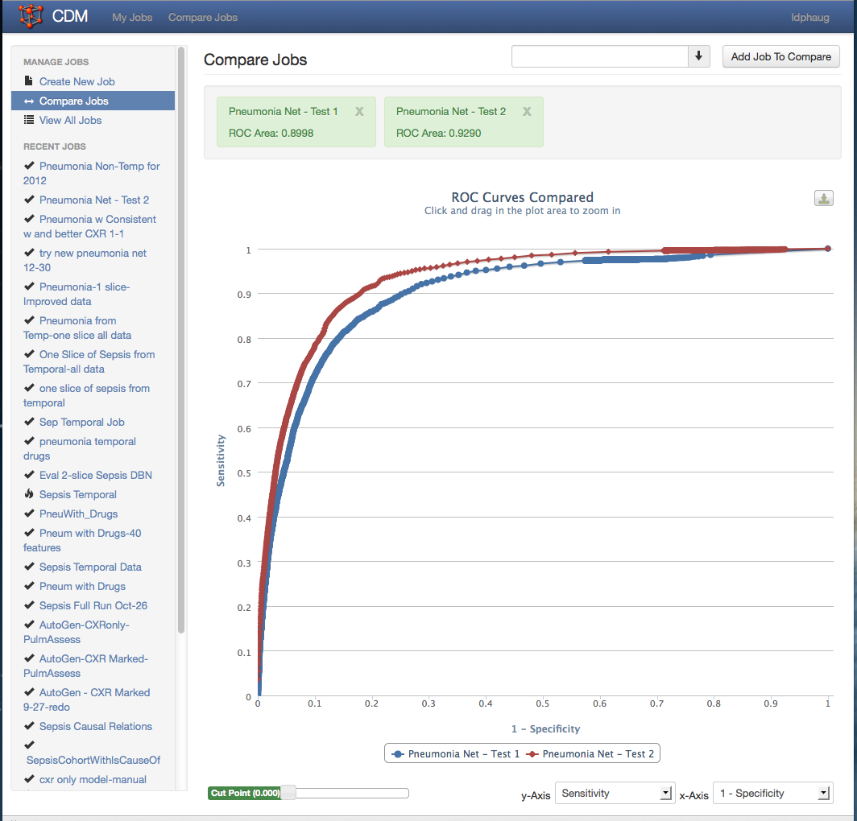
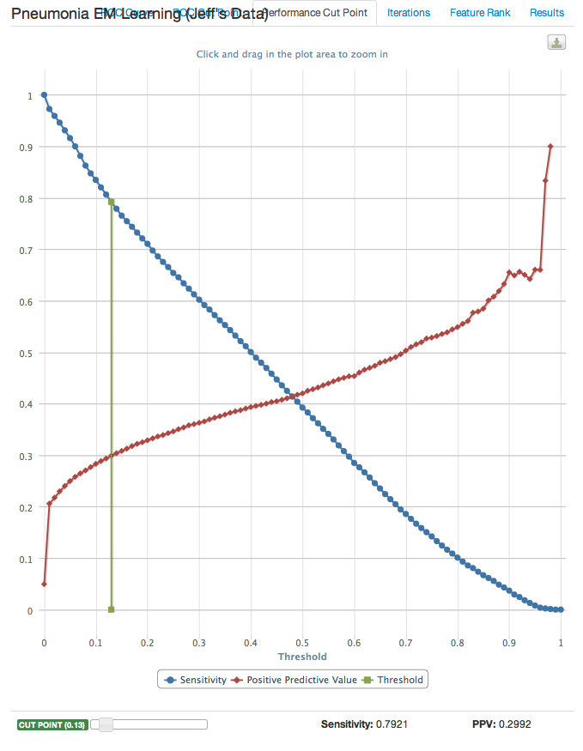
Visualizing the Results
Comparing Two Models Using the ROC Curves
Inspecting the Tradeoffs in Accuracy

Slide 49
Extensions of Diagnostic Modeling
Large Models
  Redundant Data
  Equations and Logic
Temporal Models
  Following Disease Over Time
  Summarized Data as Features
Simple Temporal Model
Time Slice 1
Time Slice 2
Time Slice 3

Slide 50
Agenda
Why Decision Support?
Introduction: Bayesian Diagnostic Networks
  Bayesian Systems
    A Framework for Computable Models
  A Few Bayesian Tools
  Diagnostic Systems
Representing the Semantics of Diagnosis
  Diagnostic Modeling with Ontologies
  Ontologies -> Bayesian Network
Clinical Data
  A Brief Look at Medical Data Forms
Notes:
Use the word “CONCEPTS”
Numbers say Probability, Best ‘Story”, Information, Collapsed Utilities

Slide 51
A diagram of a simple clinical model
(A Data Object)
Clinical Element Model for White Blood Count
WBCLabObs
White Blood Count
data
9.6 x 10³
Units
Cells per CC
quals
SpecimenType
Specimen Type
data
Whole Blood
Commment
Comment
data
Specimen Hemolyzed

Slide 52
What Does a Medical Concept Look Like
(in probability space)
Concepts vary based on source, goals, and usage.
Cough
Present
Absent
Unknown
Pneumonia
Present
Absent
Simple Concept
Human Reported Concept
Pulmonary Infiltrate (Chest X-ray Report)
Present
Possible
Absent
Unknown
White Blood Count
Specimen Type
Units
Value
Numeric Object
Human Reported Concept
(extended value set)

Slide 53
What Does a Concept Look Like
Some concepts have subconcepts.
Pulmonary Infiltrate (Chest X-ray Report)
Present
Possible
Absent
Unknown
Concept values
Specimen Type
Blood
Pleural Fluid
Ascitic Fluid
…
Categorical Concept
Units
Mg per Deciliter
Grams
Cells per CC
…
White Blood Count
Specimen Type
Units
Value
Numeric Concept
Value
Real Number
Subconcepts

Slide 54
What Does a Concept Look Like
Concepts can Modeled Probabilistically
Simple Concept
Human Reported Concept
Numeric Concept
Human Reported Concept
(extended value set)

Slide 55
What Does a Concept Look Like
Concepts are (in part) defined by their relationships.
Pulmonary Infiltrate (Chest X-ray Report)
Present
Possible
Absent
Unknown
Pneumonia
Present
Absent
Causes
Pulmonary Infiltrate
Present
Absent
Reported As
White Blood Count
Specimen Type
Units
Value
Specimen: Blood
Units: Cells/CC
White Blood Count
Elevated
Normal
Reduced
Unavailable
Value Thesholds:
High-9,000
Low-2,000

Slide 56
What Does a Concept Look Like
And there are a number of ways to compute Concepts.
Causes
Reported As
Value Thesholds:
High-9,000
Low-2,000
Specimen: Blood
Units: Cells/CC

Slide 57
Conclusion
Graphical Probabilistic Models can capture the Semantics of Medical Diagnosis.
These models can be manufactured using data collected during the course of care.
Probabilistic models can participate in clinical care.
Medical terminologies, embedded in Ontologies can help to develop these models.

Slide 58
Comments and Questions
Questions???

Slide 59
Probability and Semantics
One way to think of semantics: a set of relationships between concepts
Disease
Finding
Pneumonia
Cough
Concept
Word
Mammal
Mouse
Whole
Part
Hand
Thumb
The arrows provide link across which we can reason
P(A)
P(B|A)

Slide 60
A diagram of a simple clinical model
Clinical Element Model for Systolic Blood Pressure
SystolicBPObs
SystolicBP
data
138 mmHg
quals
BodyLocation
BodyLocation
data
Right Arm
PatientPosition
PatientPosition
data
Sitting

Slide 61
What if there is no model?
Site #1
Dry Weight:
70
kg
Site #2
Weight:
70
kg
Dry
Wet
Ideal

Slide 62
Too many ways to say the same thing
A single name/code and value
  Dry Weight is 70 kg
Combination of two names/codes and values
  Weight is 70 kg
    Weight type is dry

Slide 63
Care Delivery Framework

Slide 64
Terminology
Probability
  P(D) – Probability of Disease
  Implies a Ratio or Rate
  Names: Prevalence, Prior Probability
Location Specific
Population from a
Specific Setting

Slide 65
More Terminology
Conditional Probability
  Probability of a Finding in a patient with a Disease
  Probability of a Disease in a Patient with a Finding
  Probability of Disease in a patient with Finding 1, Finding 2, neg Finding 3, Finding 4, no Finding 5, etc.
Number With Disease and Finding
Number with Disease
Number With Disease and Finding
Number with Finding
Number With Disease and a Group of Findings
Number with the Group of Findings

Slide 66
Names for the Numbers
Prevalence
P(D)
Prior Probability

Slide 67
Yet Another View
Dividing by the Row Marginals
Positive Predictive Value: P(D|F)
Negative Predictive Value:
P(no D|no F)

Slide 68
From Data to Probabilities
Data
Data
Bayesian
Calculation
DIAGNOSIS | PROB
Pneumonia | 92%
Asthma | 14%
Chronic Bronchitis | 12%
Acute Bronchitis | 8%

Slide 69
Bayes Equation
Probability of Both
The Disease and Finding
Probability of Disease
When the Finding is Present
Probability of
Finding

Slide 70
Bayes Equation
From probability theory:
P (F and D) = P (D) * P (F|D)

Slide 71
Bayes Equation
Prior Disease
Probability
Sensitivity
Posterior Disease
Probability
Probability of
Finding

Slide 72
Probability Updating
The Disease is Myocardial Infarction
The Finding is Chest Pain

Slide 73
Probability Updating
The Disease is Myocardial Infarction
The Finding is Chest Pain
P(MI) = 2.0% (0.02)
P(Chest Pain|MI) = 75% (0.75)
P(Chest Pain) = ?

Slide 74
Probability Updating
The Disease is Myocardial Infarction
The Finding is Chest Pain
P(MI) = 2.0% (0.02)
P(Chest Pain|MI) = 75% (0.75)
P(Chest Pain) = ?

Slide 75
The Question of P(F)
Simple Bayes
  Patient has One and Only One Disease
Multi-Membership Bayes
  Patient has Any Group of Disease
  Each Disease is Evaluated Independently
Bayesian Networks
  Patient has Any Group of Disease
  Diseases are Evaluated According to Their Collective (Joint) Behavior
Add All of the Probabilities
Of Having Both the
Finding and Disease

Slide 76
The Question of P(F)
Simple Bayes
  Patient has One and Only One Disease
Multi-Membership Bayes
  Patient has Any Group of Disease
  Each Disease is Evaluated Independently
Bayesian Networks
  Patient has Any Group of Disease
  Diseases are Evaluated According to Their Collective (Joint) Behavior
Two States Apply for Each Disease:
With and Without the Disease

Slide 77
The Question of P(F)
Simple Bayes
  Patient has One and Only One Disease
Multi-Membership Bayes
  Patient has Any Group of Disease
  Each Disease is Evaluated Independently
Bayesian Networks
  Patient has Any Group of Disease
  Diseases are Evaluated According to Their Collective (Joint) Behavior
Disease
Intermediate
Concept
Finding 3
Finding 4
Finding 1
Finding 2
P(F) is Determined from
the Joint Effect of Child Nodes
on Their Parents

Slide 78
Probability Updating
Using the Multi-Membership Model
The Disease is Myocardial Infarction
The Finding is Chest Pain
P(MI) = 2.0% (0.02)
P(Chest Pain|MI) = 75% (0.75)
P(Chest Pain) = 0.02 x 0.75 + 0.98 x 0.08

Slide 79
What about more findings?
The joy of recursion!
F₁= Chest Pain
F₂= ST Elevation
F₃= CK Increased
….
etc.

Slide 80
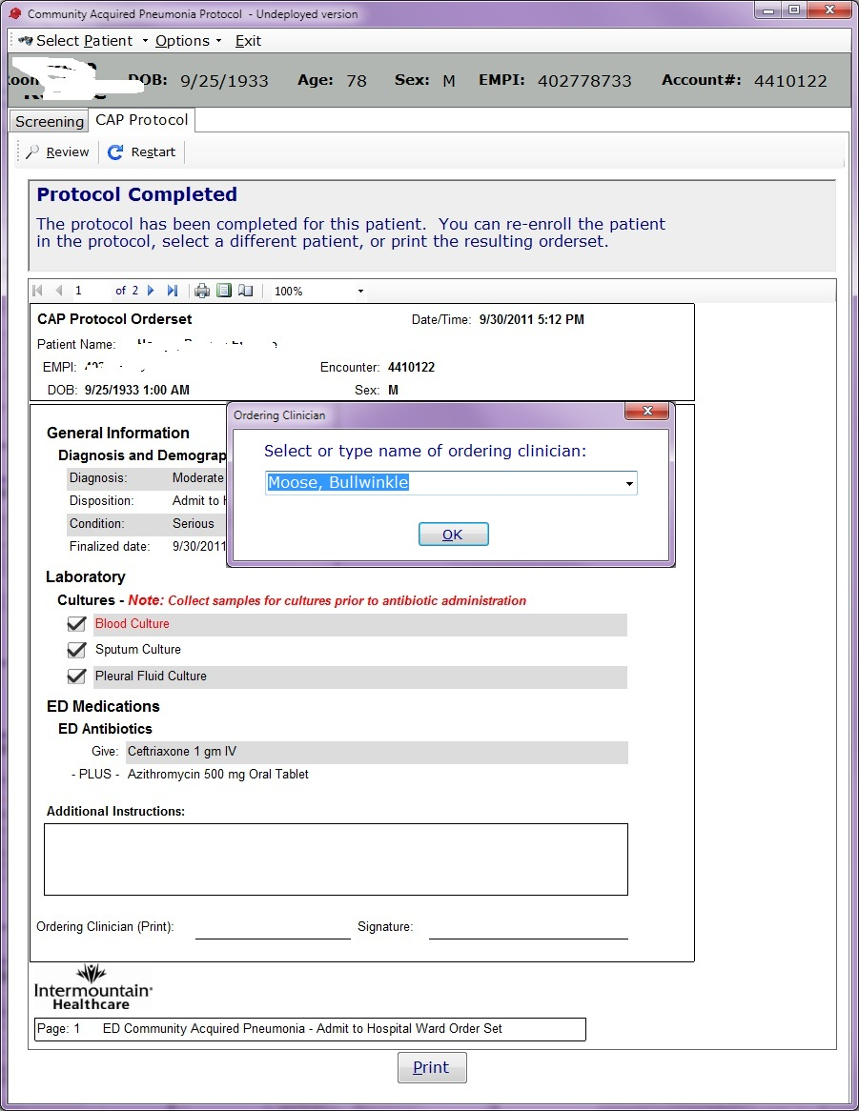
Supports Accurate and Complete
Ordering Process
Notes:
The intrusive nature of electronic processes can be an advantage. Clinicians don’t need to remember rules or where the forms are.

Slide 82
Modeling Medical Phenomena
Examples of Some of the Things that can be Modeled

Slide 83
Noise
The Effect of Noise on the Diagnosis of Pneumonia
  Noisy Lab (continuous) Data
  Noisy Physical Exam (categorical) Data
Types of Noise
  Bias
  Imprecision
Normal and LogNormal Distributions
Noise/Bias modeled with Simple Discrete Distributions
Different Types of Normal Noise/Bias

Slide 84
Boolean Logic
Four Variables
Probabilistic Logic
  If A and B then C
    P(C) = P(A and B) = P(A) * P(B|A)
  If A or B then C
    P(C) = P(A or B) = P(A) + P(B) – P(A and B)
  In a Bayesian Network, the resolution of Linked Rules Occurs Automatically
Five Interconnected Rules

Slide 85
Temporal Phenomena
Several Approaches to Temporal Modeling have been Proposed
Markov and Hidden Markov Models are Most Common
  Called Dynamic or Temporal Bayesian Networks
  Can Model Complex Disease Behavior
  Trained from Data Organized in “Time Slices”
  Can be Extended to Include Decisions and Utilities
    (become “Partially Observable Markov Decision Processes”)

Slide 86
The Dynamic Bayesian Network
First Time Slice
Second Time Slice
Can Model Changing Medical Phenomena
  Changes in the State or Status of a Disease
  Findings Caused by the Disease in it’s Various States
  Can be Used for Diagnosis, Prediction and Explanation

Slide 87
Pancreatitis Over Time
First Time Slice
Second Time Slice

Slide 88
Bayesian Networks and Diagnosis
Re-Purposing Clinical Data

Slide 89
Strategic Goals
Minimum goal: Be able to share applications, reports, alerts, protocols, and decision support with ALL customers of our same vendor
Maximum goal: Be able to share applications, reports, alerts, protocols, and decision support with anyone in the WORLD

Slide 90
Why do we need detailed clinical models?

Slide 91
Model fragment in XML
Pre-coordinated representation
<observation>
<cd>Dry weight (LOINC 8340-2) </cd>
<value>70 kg</value>
</observation>
Post-coordinated (compositional) representation
<observation>
<cd>Weight (LOINC 3141-9) </cd>
<qualifier>
<cd> Weight type (LOINC 8337-8) </cd>
<value> Dry (SNOMED CT 13880007) </value>
<qualifier>
<value>70 kg</value>
</observation>

Slide 92
More complicated items:
Signs, symptoms
Diagnoses
Problem list
Family History
Use of negation – “No Family Hx of Cancer”
Description of a heart murmur
Description of breath sounds
  “Rales in right and left upper lobes”
  “Rales, rhonchi, and egophony in right lower lobe”

Slide 93
What do we model?
All data in the patient’s EMR, including:
  Allergies
  Problem lists
  Laboratory results
  Medication and diagnostic orders
  Medication administration
  Physical exam and clinical measurements
  Signs, symptoms, diagnoses
  Clinical documents
  Procedures
  Family history, medical history and review of symptoms

Slide 94
Clinical System Approach
Intermountain can only provide the highest quality, lowest cost health care with the use of advanced clinical decision support systems integrated into frontline workflow

Slide 95
Decision Support Modules
Antibiotic Assistant
Ventilator weaning
ARDS protocols
Nosocomial infection monitoring
MRSA monitoring and control
Prevention of Deep Venous Thrombosis
Infectious disease reporting to public health
Diabetic care
Pre-op antibiotics
ICU glucose protocols
Ventilator disconnect
Infusion pump errors
Lab alerts
Blood ordering
Order sets
Patient worksheets
Post MI discharge meds

Slide 96
How are the models used in an EMR?
Data entry screens, flow sheets, reports, ad hoc queries
  Basis for application access to clinical data
Computer-to-Computer Interfaces
  Creation of maps from departmental/external system models to the standard database model
Core data storage services
  Validation of data as it is stored in the database
Decision logic
  Basis for referencing data in decision support logic
Does NOT dictate physical storage strategy

Slide 97
Need for a standard model
A stack of coded items is ambiguous (SNOMED CT)
  Numbness of right arm and left leg
    Numbness (44077006)
    Right (24028007)
    Arm (40983000)
    Left (7771000)
    Leg (30021000)
  Numbness of left arm and right leg
    Numbness (44077006)
    Left (7771000)
    Arm (40983000)
    Right (24028007)
    Leg (30021000)

Slide 98
Core Assumptions
‘The complexity of modern medicine exceeds the inherent limitations of the unaided human mind.’
~ David M. Eddy, MD, Ph.D.
‘... man is not perfectible. There are limits to man’s capabilities as an information processor that assure the occurrence of random errors in his activities.’
~ Clement J. McDonald, MD

Slide 99
Ontologies, Concepts, and Probabilities
The way from medical concepts to diagnostic models

Slide 100
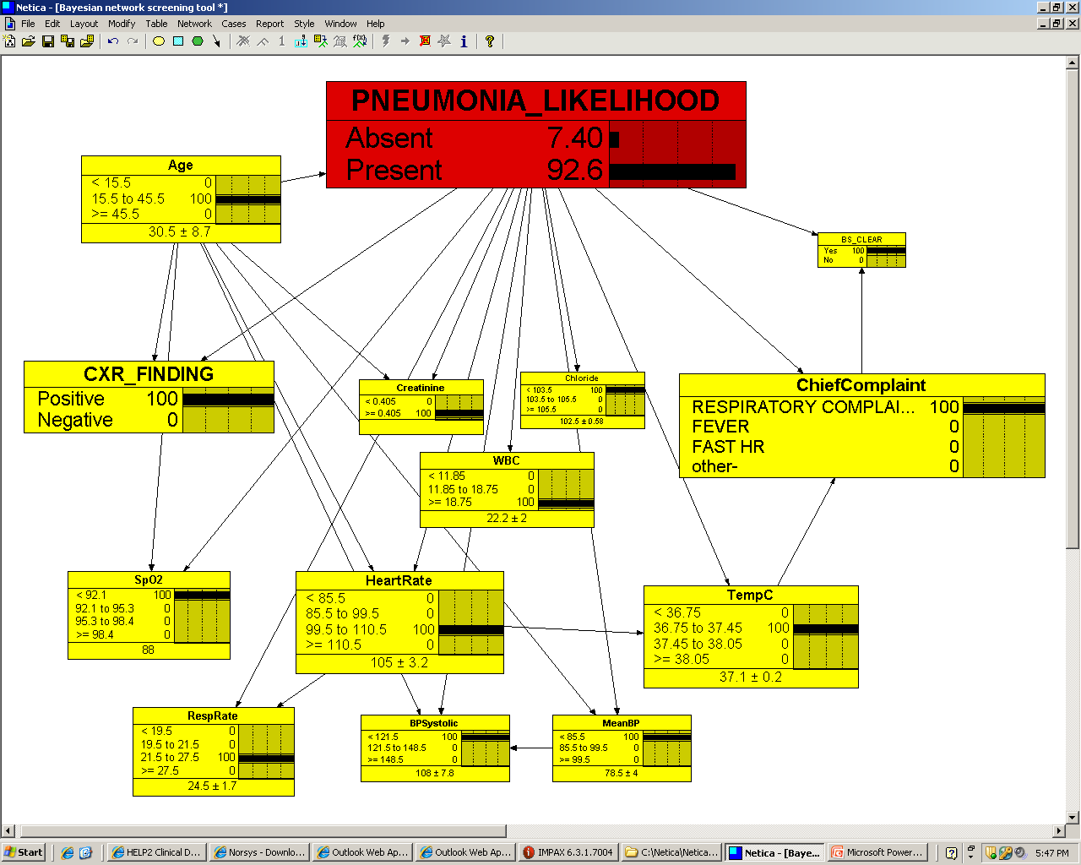
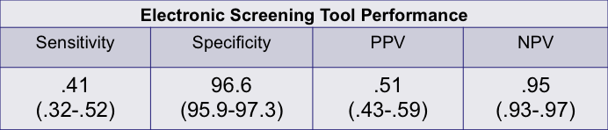
Example: Pneumonia Alerting
Goal: Detect Pneumonia in ED Patients
Provide Reminder for Computerized Care Protocol
A Probabilistic Model was Derived from EDW Data
A Natural Language Processing System Provided X-ray Data
The System is in Regular Use
Notes:
Our outcome data demonstrate reduced mortality between the 2010 baseline and the 2012 study period among UCR pneumonia patients, while urban north and south showed no change. The absolute mortality reduction was 1.5 % (relative 25%), severity-adjusted inpatient mortality Odds Ratio was 0.55, p=.02. This translates to about 20 lives saved last year in Salt Lake County. We hypothesize that this mortality reduction underestimates the potential effect had tool utilization been greater.

Slide 101
Relational database implications
Patient Identifier
Date and Time
Observation Type
Observation Value
Units
123456789
7/4/2005
Dry Weight
70
kg
123456789
7/19/2005
Current Weight
73
kg
Patient Identifier
Date and Time
Observation Type
Weight type
Observation Value
Units
123456789
7/4/2005
Weight
Dry
70
kg
123456789
7/19/2005
Weight
Current
73
kg
How would you calculate the desired weight loss during the hospital stay?

